Slide 1

Unit 3
The Restoration:
Liberalism and Nationalism

Slide 2






Restoration of the Ancien Régime
THE RESTORATION: return to the political system of the Ancien Régime after Napoleon’s defeat in 1815 imposed by the winning European powers
Congress of Vienna
(1814-1815)
Reinstated absolute monarchy
The Holy Alliance
New European borders
Mutual monarch support
The Quadruple Alliance

Slide 3
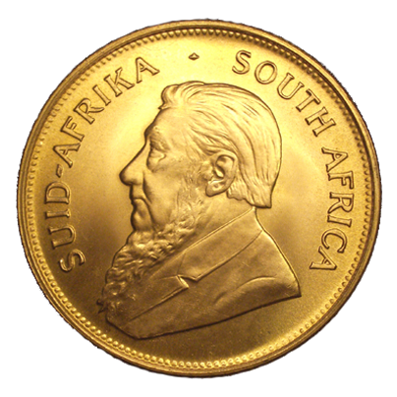

Ideologies of the Restoration
LIBERALISM: advocating individual liberties (e.g. the rights to life, private property, voted political representatives, and the freedom of expression and religion)
Key principles of Liberalism
Moderate liberals
Radical liberals
Wealthy bourgeoise
Constitutions & constitutional monarchy
Separation of powers
Popular sovereignty through limited male suffrage
Individual liberties
Very limited male suffrage
Sovereignty belongs to king & parliament
Freedom of speech with censorship
More open male suffrage
Sovereignty belongs to the people
Unrestricted freedom of speech

Slide 4
Ideologies of the Restoration
DEMOCRACY: advocating ordinary people’s right to participate in politics
to end social and economic inequalities
Key principles of Liberalism
Key principles of Democracy
Wealthy bourgeoise
Petite bourgeoise & peasants
Constitutions & constitutional monarchy
Separation of powers
Popular sovereignty through limited male suffrage
Individual liberties
Republic government
(no monarchy)
Popular sovereignty through universal manhood suffrage

Slide 5


Ideologies of the Restoration
NATIONALISM: advocating the right of people who define themselves
as a nation to form independent states
Key principles of Nationalism
Unification
Separatist
Nation/state is based on population with common links (e.g. culture, history, language)
Popular sovereignty
Nation chooses its own form
of government
Uniting states with common links
Gaining independence

Slide 6
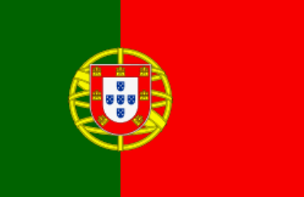





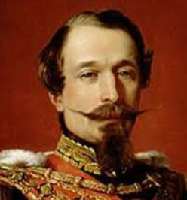

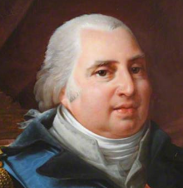
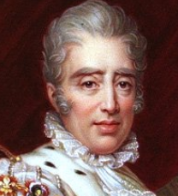
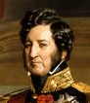
Political Revolutions of the 19th Century
1820s
1830s
1848
Napoleon III
(The Second Republic)
Louis XVIII
Charles X
Louis Philippe

Slide 7
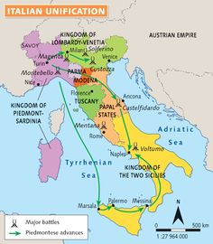
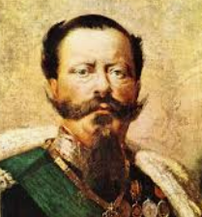
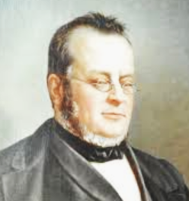
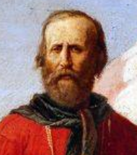
Italian Unification (1859-1870)
Victor Emmanuel II
Cavour
Parliamentary monarchy in 1870
Garibaldi

Slide 8
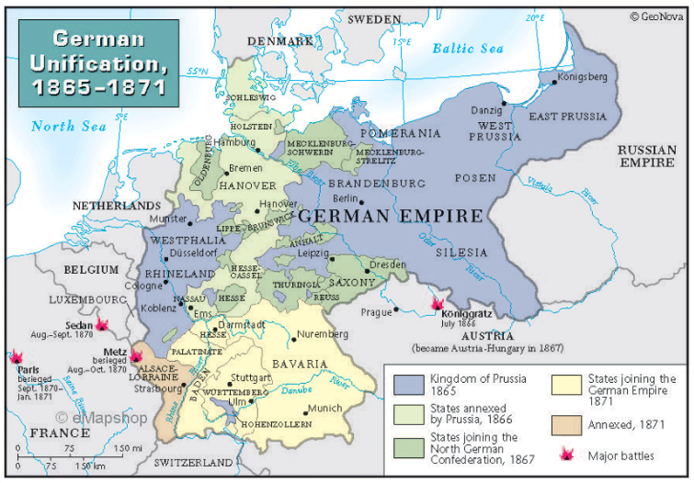
German Unification (1866-1871)
1815: 39 states
1834: Zollverein
1848: Revolution
1862: Otto von Bismarck
1866: North unification
1871: Second Reich

Slide 9
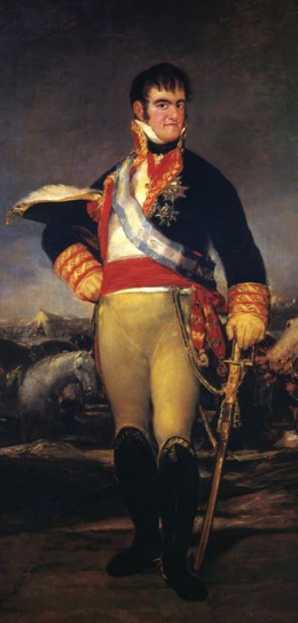
Reign of Fernando VII (1814-1833)
Absolutist Phase
1814 - 1820
Fernando VII regains the throne
Cortes are dismissed
Absolute monarchy
Liberal Phase
1820 - 1823
Military coups
Reinstated Constitution of 1812
Ominous Decade
1823 - 1833
Holy Alliance assistance
Liberals defeated & prosecuted
Absolute monarchy
Pragmatic Sanction
Queens can now rule

Slide 10
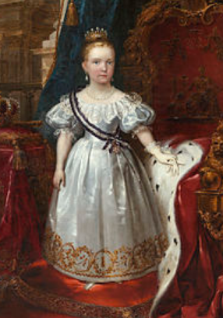
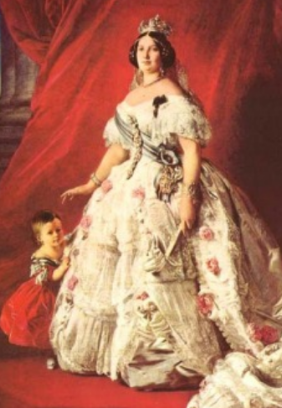
Reign of Isabel II (1833-1868)
Liberal Constitutional Monarchy
Shared sovereignty w/ the Cortes
Moderates & Progressives
Military participation
The Regency
1833 - 1843
Maria Cristina Bourbon (mother)
General Espartero (Progressive)
1st Carlist War (1833-1839)
The Majority
1843 - 1868
2nd Carlist War (1846-1849)
Social instability
Expropriations
The End of
the Reign
Manipulation of election results
Economic crisis

Slide 11
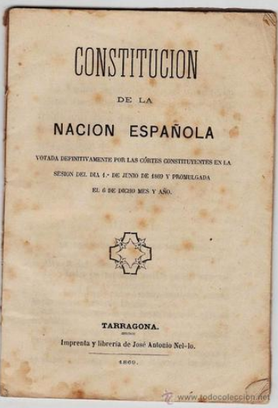
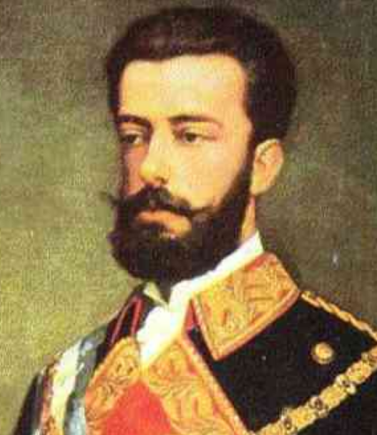
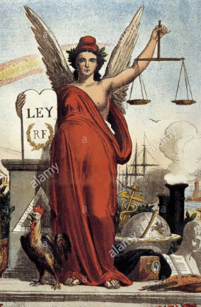
Democratic Sexennium (1868-1874)
Glorious Revolution
1868
Military revolt against Isabel II
Isabel II is forced into exile
Provisional Government
1868 - 1870
Looking for a non-Bourbon king
Constitution of 1869
Constitutional Monarchy
1871 - 1873
Amadeo of Savoy (son of King Victor Emmanuel II)
3rd Carlist War (1872-1876)
First Republic
(1873 – 1874)
First time without a monarch
Political divide & tensions
Federal vs. centralized republic
Dissolved in 1874

Slide 12
Latin American Independence
Causes
Sequence
Consequences
Enlightenment ideas
Other revolutions
GB support
Interests of Creole bourgeoisie
Desire for unrestricted trade
1808: Spanish War of Independence
1810: Councils (juntas) declare autonomy
  Hidalgo in New Spain (Mexico)
  Simon Bolivar in New Granada (Santa Fe de Bogota)
  Jose de San Martin in Rio de la Plata (Buenos Aires)
1840s: All colonies (except for Cuba and PR) gain independence
For Spain:
Lost control in LATAM
Lost international power
Lost trade monopoly in LATAM
Loss of taxes & LATAM imports
For LATAM countries:
Creole bourgeoisie with political & economic power
New republics
Influence of GB and US
Limitations of free trade

Slide 13
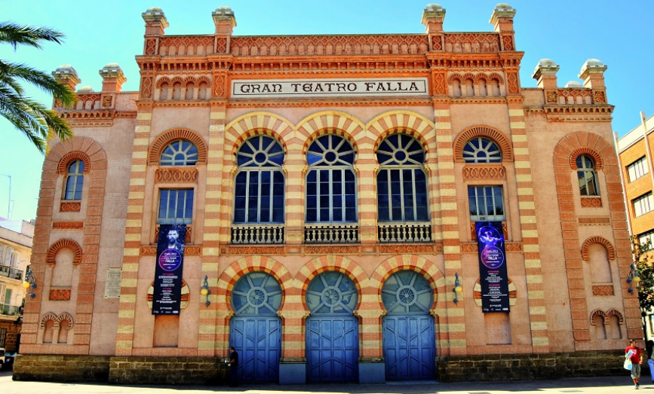
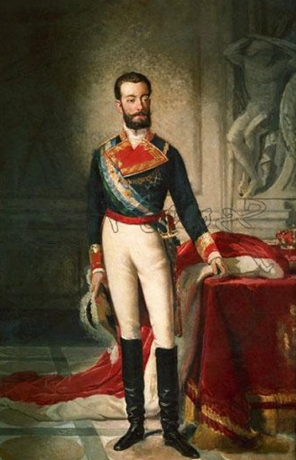
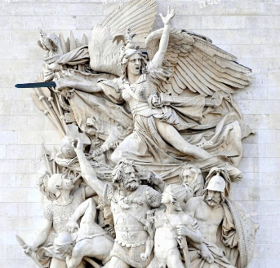
Romanticism
ROMANTICISM: cultural and artistic movement developed in Europe in the first half of the 19th century (music, literature, painting, sculpture, architecture)
Key characteristics:
Creative freedom
Respect for the individual
Expression of feelings
Glorified national history

