Slide 1
FOOD-RELATED ILLNESSES

Slide 2
Malnutrition
Occurs when someone does not get enough to eat
A lack of foods that contain energy and proteins
The majority of cases are in developing countries and affects children the most
Many types: ex) marasmus: complete lack of food
Kwashiorkor: considerable lack of protien in someone’s diet

Slide 3
Inadequate Diets
NOT a lack of food, rather a lack of the correct nutrients that our body needs to function! Examples of nutrients are vitamins, amino acids, or minerals that are essential
Illness examples – scurvy, beriberi, and pellagra

Slide 4
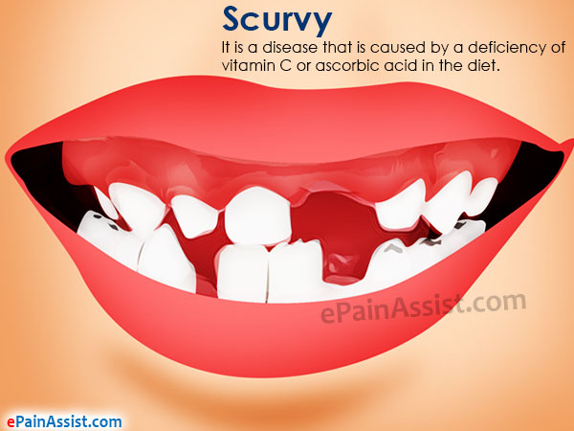
Scurvy
Caused by a lack of vitamin c in the diet
IT can lead to anemia, debility, exhaustion, spontaneous bleeding, pain in the limbs and swelling in parts of the body and ulceration in the gums/loss of teeth

Slide 5
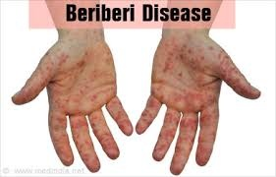
BeriBeri
Disease caused by a vitamin B-1 deficiency (or thiamine deficiency)
Symptoms include, shortness of breath, rapid heart rate, swollen legs/extremeties

Slide 6
A “beriberi” good story
For many years a trading company known as the Dutch East India Company had been sending settlers from Holland to China, Java, and the beautiful islands of the Pacific. Then a terrible disease struck the settlers. The victims grew listless. They couldn’t eat; their muscles failed; their hearts weakened; paralysis set in. Finally death overcame them.
The disease was known as beriberi, which means "I cannot." For some reason the malady struck the European settlers especially hard. Very few of the local people came down with the disease.
By 1880 the Dutch East India Company decided something had to be done. They selected a medical team to study the disease. One of the members was Christiaan Eijkman, a young doctor from Amsterdam.

Slide 7
At that time scientists were excited about Louis Pasteur's dramatic proof that bacteria could cause diseases. Pasteur's germ theory of disease led to triumph after triumph. Most scientists believed that all diseases were caused by one type of germ or another.
"All we have to do," Christiaan Eijkman said, "is find the germ that causes beriberi and destroy it.”
One day he noticed that the chickens at the institute looked sick. They showed symptoms like those of beriberi. The chickens' wings hung limp. They stumbled around the chicken yard.
Eijkman immediately examined the blood of the chickens. He reasoned that somewhere in the sample of blood had to be the bacteria that caused beriberi. But he found nothing suspicious in the blood.

Slide 8
Then, mysteriously, the chickens got well. A horrible thought came to Christiaan Eijkman. Suppose a germ did not cause beriberi at all! Christiaan Eijkman became a detective. He asked the cook, "What do you feed the chickens?"
"Brown rice," the cook explained. "Except last week I ran out of brown rice and used polished rice from the hospital storeroom. The hospital director made me stop. He says white rice is too expensive for chickens."
A simple experiment led Christiaan Eijkman to find the cause of beriberi. He separated the chickens into two groups. He fed brown rice to one group and polished rice to the other. The "good" white rice caused beriberi. The poor-quality brown rice cured it! This explained why the natives, who ate brown rice, were protected from the disease. Settlers, on the other hand, ate fluffy white rice without the brown bran–and got sick.

Slide 9
In the case of beriberi the missing substance is vitamin B1, also known as thiamin. Today rice is processed so that the vitamins in the husk are put into the white part of the rice. But white rice still does not include the fiber in the husk, which is also important for health.
Christiaan Eijkman's work initially went unnoticed, but in later years doctors tried his theory by feeding their patients brown rice and the disease was effectively wiped out within two years. Eijkman was awarded the highest honor in the scientific world–the Nobel Prize in medicine!

Slide 10
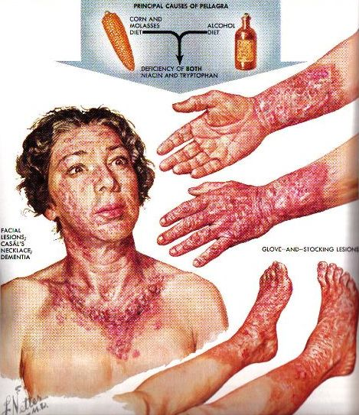
Pellagra
Caused by a lack of vitamin niacin (B3)
Symptoms include delusions or mental confusion, diarrhea, nausea, and scaly skin sores

Slide 11
Obesity
https://ed.ted.com/lessons/what-is-obesity-mia-nacamulli

Slide 12
Type 2 Diabetes
Inability to control the body’s blood sugar levels! Insulin is the hormone responsible for the release of glucose into the blood and its storage in the interior of cells
But an excessive consumption of sugar can cause cells to be immune to insulin resulting in high blood sugar level which is dangerous and causes disorders!

Slide 13
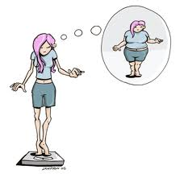
Eating Disorders

Slide 14
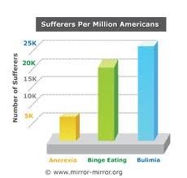
3 most common eating disorders
Anorexia nervosa
Bulimia nervosa
Binge eating

Slide 15
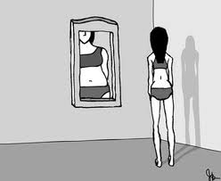
Anorexia nervosa
Emotional/psychological disorder characterized by an obsessive desire to lose weight.
A relentless pursuit of thinness

Slide 16
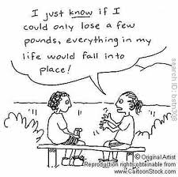
Causes of Anorexia
No definite cause- some possibilities are self-esteem issues, body image issues, social pressures & genetic factors.
Affects more females than males
Most common is white/middle-upper class/ adolescent females.
Affects about 1% of adolescent girls & 0.3% of males.

Slide 17

Symptoms of Anorexia
Restrictive eating
Excessive exercising
Over-use of diet pills, laxatives & enemas
Think they are overweight when really they are really thin
Obsessed about food
Vomit after eating
Denial

Slide 18
Complications of Anorexia
Malnutrition
Heart-rhythm disturbances
Digestive abnormalities
Bone density loss
Anemia
Hormonal & electrolyte imbalances
Kidney damage

Slide 19
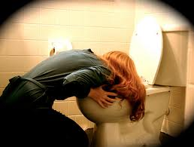
Bulimia nervosa
Characterized by recurrent & frequent episodes of eating unusually large amounts of food & feeling lack of control over eating.
This binge eating is followed by a behavior that compensates for the over eating.
Ex: purging/vomiting, excessive use of laxatives, fasting, excessive exercise.

Slide 20
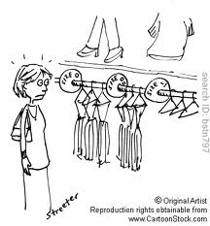
Causes of Bulimia
No definite cause
Social surroundings
Stressful situations
Cultural pressures
Low self-esteem
Depression
Abuse

Slide 21
Symptoms of Bulimia
Preoccupation with food
Binge eating (usually in secret)
Vomiting after eating
Abuse of laxatives
Compulsive exercise
Swollen salivary glands
Broken blood vessels in the eyes
Disappearance of food
Puffy cheeks

Slide 22
Complications of Bulimia
Electrolyte imbalances
Gastro intestinal problems
Oral & tooth problems
Swelling of the hands & feet
Weakness/dizziness
Acid reflux
Ulcers

Slide 23

Binge Eating
Also called compulsive eating.
Episodes of uncontrollable eating on a regular basis.

Slide 24
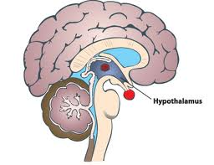
Causes of Binge Eating
Emotions (avoiding them)
Eating patterns (from childhood)
Biological (hypothalamus-fails to send message of fullness)
(serotonin-plays a role in some compulsion behaviors)

Slide 25
Symptoms of Binge Eating
Binge eating more than 2 times a week
Eating very quickly
Eating until uncomfortably full
Eating when not hungry
Eating alone (because of shame)
Feeling disgusted, guilty
Gain excessive weight

Slide 26
Complications of Binge Eating
Certain types of cancer
Diabetes
Gallbladder disease
High blood pressure
High cholesterol
Some psychiatric illnesses (anxiety, panic disorder, depression, alcoholism, drug abuse)

Slide 27
Allergies and Intolerances
The body rejects certain foods because they trigger adverse reactions after being eaten, usually genetic and the solution is to cut out these foods from the diet!

Slide 28
Two Types
Intolerances – Usually arise from people not being able to break down certain foods which then causes intestinal disorders of varying severity (ex) gluten/lactose intolerant
Food Allergies – provoke an allergic reaction that can sometimes cause anaphylactic shock (ex) Shellfish, peanuts, chocolate etc
Do you know people with allergies?

Slide 29
Ex) Gluten Intolerance
https://ed.ted.com/lessons/what-s-the-big-deal-with-gluten-william-d-chey

Slide 30
Food Poisoning
If food is not handled properly or is contaminated it can cause nausea, vomiting, cramps and fever!
It’s caused by a bacteria Salmonellosis and is usually associated with food containing raw eggs

