Slide 1
Will/Going to

Slide 2
How to use will/going to.
Both refer to the future, but there is a slight difference between the two.
In spoken english, the phrases can be interchangeable because they’re practically alike.
“Today we will go over the uses of will/going to.”

Slide 3
When to use Will.
Spontaneous decisions:
  I’m bored, I think I’ll (I will) go for a walk.
  Don’t worry, I’ll pay for this.
Promises:
  I promise I’ll do my homework so I can play fortnite. (Positive, Affirmative)
  I won’t (wil not) eat your sandwich.
Offers:
  I’ll give you my sneakers so you can play basketball.
Refusals:
  My students won’t listen to me.

Slide 4
Contractions for Will
I will
You will
We will
They will
He will
She will
It will
I’ll
You’ll
We’ll
They’ll
He’ll
She’ll
It’ll

Slide 5
When to use Going to. (Going to = gonna)
Plans/Something that is predetermined:
  I’m going to go skiing.
  I’m going to have the lobster.
Evidence/Signs
  It’s 3-0, Real Madrid is going to win.
  I think it’s going to rain, I felt a drop.
Intentions:
  I’m going to work hard next term.
  I’m going to join a gym next week.

Slide 6
When can they both be used?
Both will and going to can be used when predicting something.
  I think it will rain/I think it is going to rain.
  I think I’ll pass the exam/ I think I’m going to pass to the exam.

Slide 7
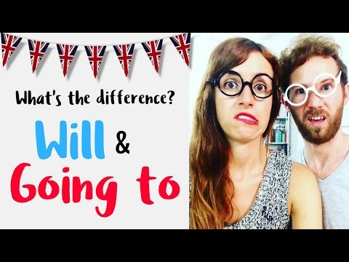

Slide 8
Exercises
Instructions: Put the verbs in the brackets into the gap. Use will-future or going to-future.
Example: For the main course I guess I _______ pasta. (to eat)
Answer: For the main course I guess I will eat pasta.

Slide 9
Jorge ______ 15 next wednesday. (to be)
They ______ a new computer. (to get)
I think my mother ______ this CD. (to like)
Paul’s sister ______ a baby/ (to have)
They ______ at about 4 in the afternoon. (to arrive)
Just a moment. I ______ you with the bags. (to help)
In 2020 people ______ more hybrid cars. (to buy)
Marvin ______ a party next week. (to throw)
We ______ to Venice in June. (to fly)
Look at the clouds! It ______ soon. (to rain)

