Slide 1
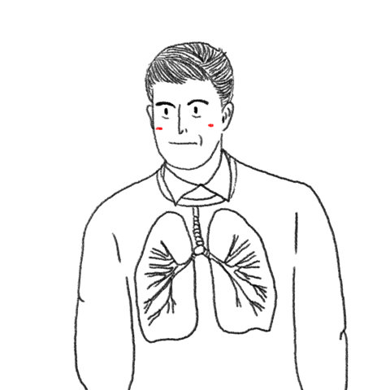
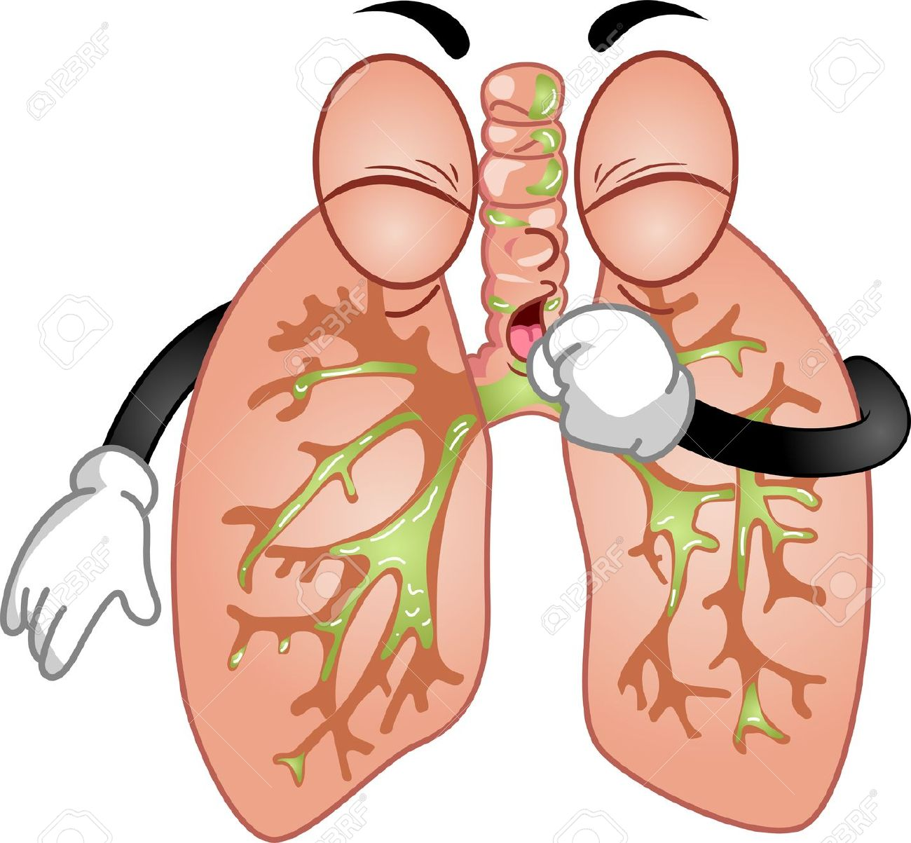
Illnesses of the Respiratory System

Slide 2


Two Types
All illnesses related to the respiratory sytem are caused by infections or an inflammation of the mucosa
Infectious Illnesses
Non-infectious Illnesses

Slide 3
Infectious Illnesses
Nasal Catarrh - Nose
Pharyngitis - Pharynx
Tonsillitis - Tonsils
Bronchitis – Bronchi, Bronchioles
Pneumonia – Lungs, very dangerous! Fill with mucus
All infections of a specific area usually accompanied by cough, fever, or localized pain

Slide 4




Infectious Illnesses
FLU
Widespread viral disease that causes a Winter Pandemic every 10-15 years
Can be fatal to elderly and those with pre-existing medical conditions

Slide 5
Flu Video
https://ed.ted.com/lessons/why-do-you-need-to-get-a-flu-shot-every-year-melvin-sanicas

Slide 6
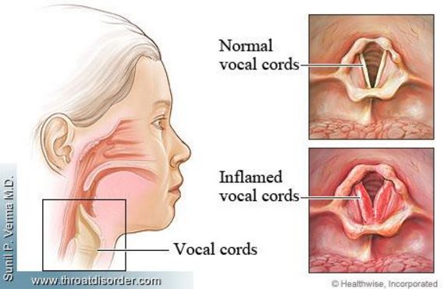
Non-Infectious Illnesses
Aphonia
Difficulty emitting sounds due to the inflammation of the vocal chords

Slide 7
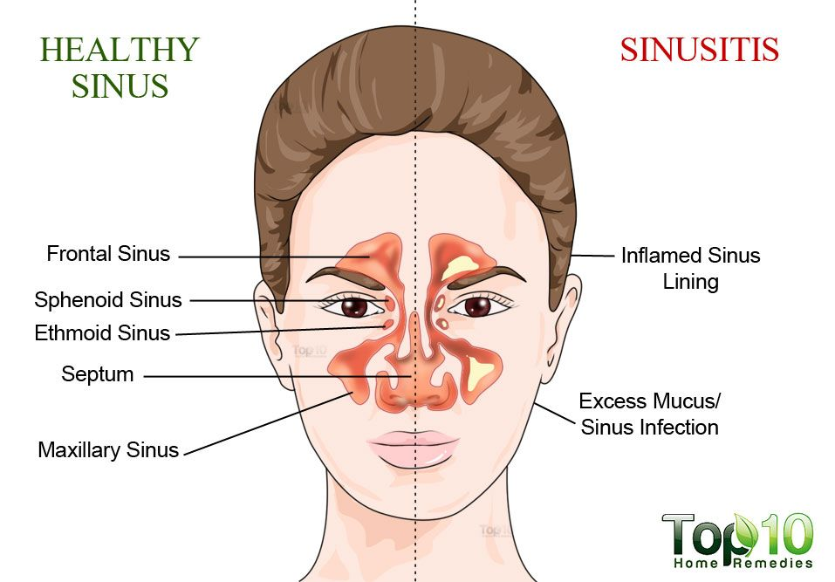
Non-Infectious Illnesses
Sinusitis
Inflammation of the sinus cavities of certain bones in the skull that are connected to the nostrils
Excess Mucus
Green/yellow

Slide 8

Non-Infectious Illnesses
Allergic Rinitis
Fancy name for allergies – certain things in the air can cause sneezing, itching, or runny noses
Allergens include: pollen, dust, fungi etc.

Slide 9
Non-Infectious Illnesses
Asthma
Characterized by contraction of the bronchi, complicating the passage of air and making it more difficult to breathe
Very common, do you know someone who has Asthma?

Slide 10
Asthma Video
https://www.youtube.com/watch?v=PzfLDi-sL3w

Slide 11
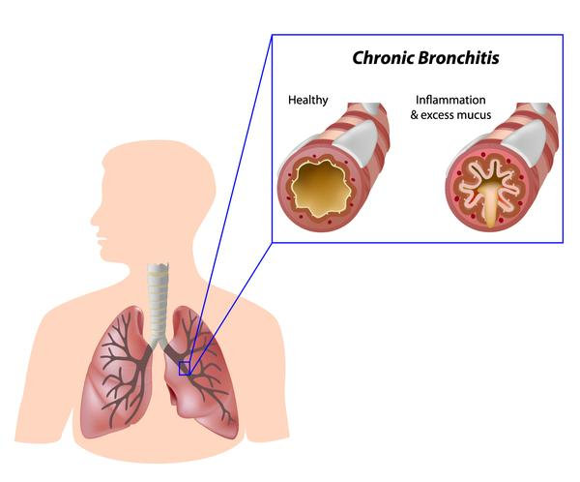
Non-Infectious Illnesses
Chronic Bronchitis
Irritation of the bronchial lining caused by smoke and air pollutants
Symptoms: frequent coughing, chest pain and asthma

Slide 12
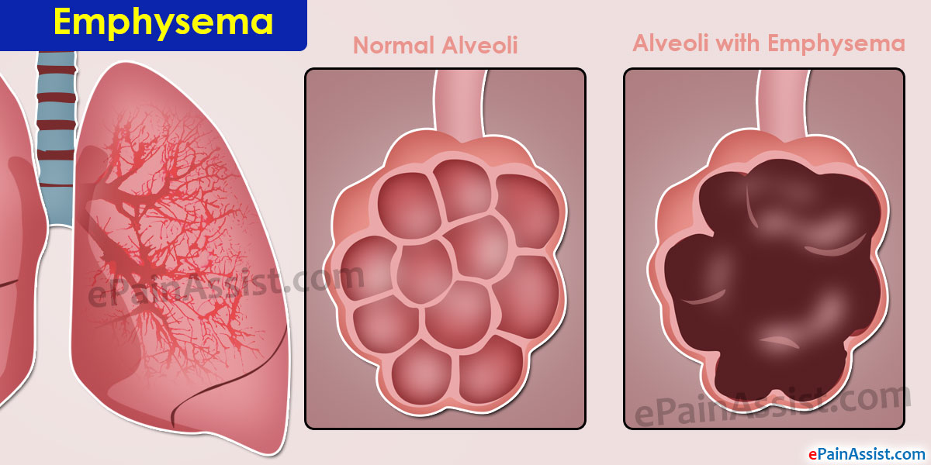
Non-Infectious Illnesses
Emphysema
Produces an enlargement of the pulmonary alveoli, causing them to break

Slide 13
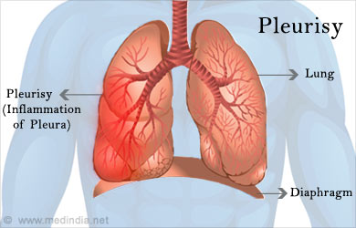
Non-Infectious Illnesses
Pleurisy
Inflammation of the pleura (lung cavities)
Causes severe pain (especially when coughing)
Fever and sometimes pleural fluid spills

Slide 14
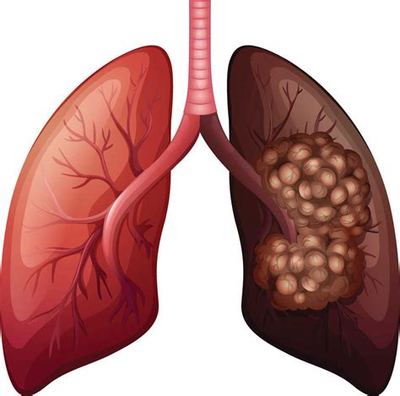
Non-Infectious Illnesses
Lung and Throat Cancer
Malignant tumors characterized by the uncontrolled growth of a mass that invades and destroys other tissues
Closely linked to smoking
https://www.youtube.com/watch?v=Y18Vz51Nkos

Slide 15
Non-Infectious Illnesses
Chronic obstructive pulmonary disease (COPD)
Inflammation of the bronchi and destruction of lung tissue
Inflammation blocks flow of air to the lungs
Symptoms:Coughing, shortness of breath, fatigue
Most common cause is smoking

Slide 16
#1
Charlie showed up at the Doctor’s Office complaining of Chest pain and uncontrollable coughing. He also has had a history of Asthma.
Chronic Bronchitis

Slide 17
#2 What Illness?
FLU

Slide 18
#3
Ada has had a cold now for about 3 weeks. At first she thought it was just a mere cold but after it didn’t go away she has decided to go into the doctor’s office. She reports common cold symptoms such as coughing, stuffy nose, but also compression headaches and green yellowy snot
Sinusitis

Slide 19
#4
Emphysema

Slide 20
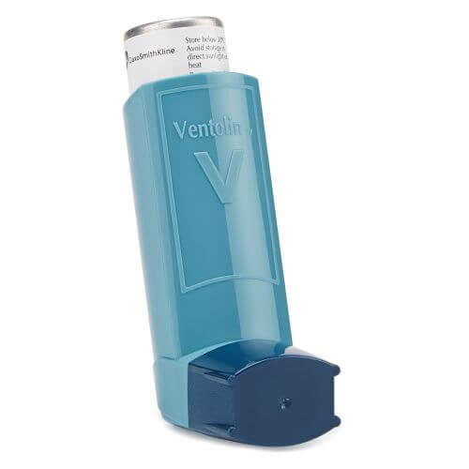
#5
Asthma

Slide 21
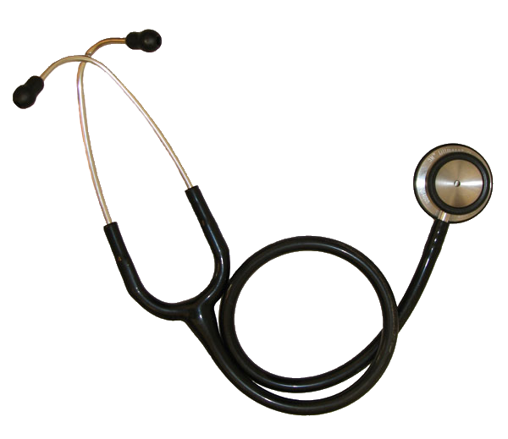
#6
Carly goes to the Doctor complaining of a really bad cough and fever. Because these symptoms are very common, the Doctor wasn’t sure what Illness Carly had until he took out his stethoscope which gave him a big clue.
Pneumonia

Slide 22
#7
Peter is complaining that it’s very painful to talk and sometimes he says he physically can’t speak because of the pain!
Aphonia

Slide 23

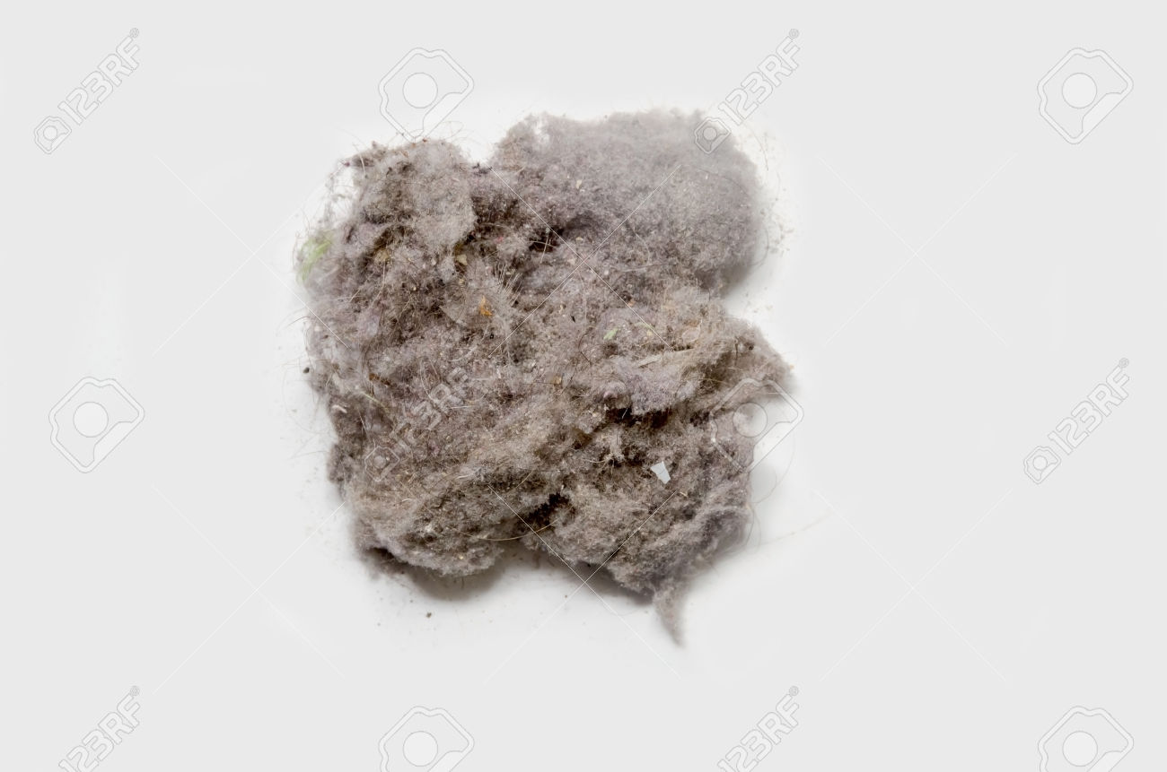
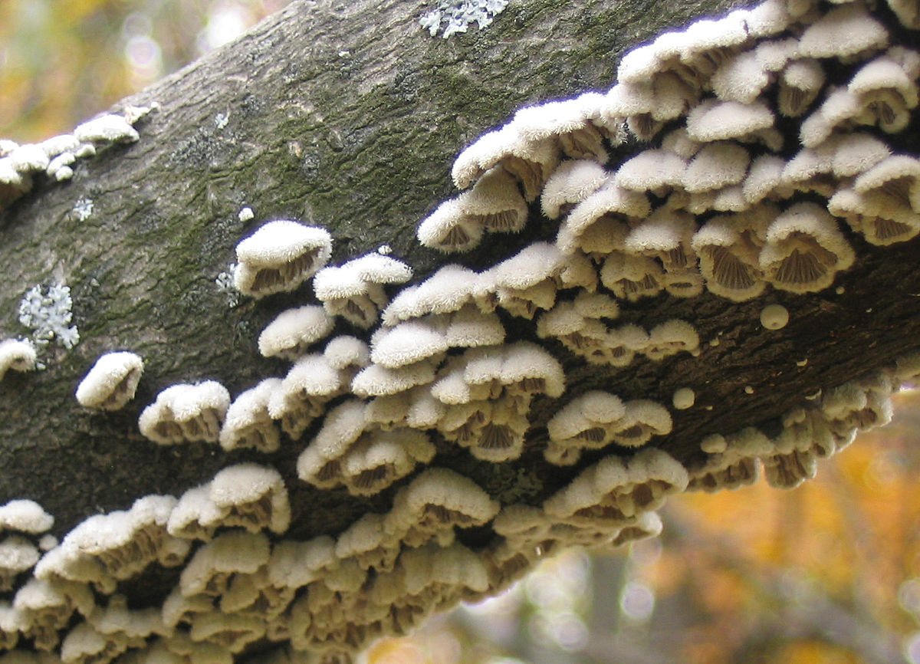
#8
Allergic rinitis

Slide 24
#9
Pam has been a heavy smoker for very many years now. She reports feeling a lot of fatigue and coughs a lot. A preliminary test shows that a lot of lung tissue is currently damaged.
COPD

Slide 25
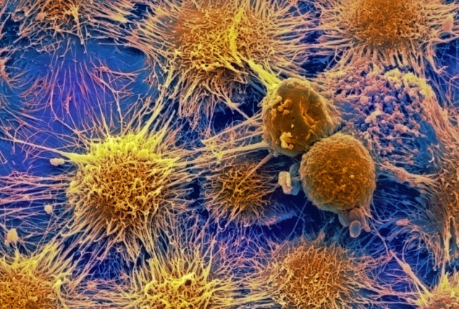
#10
Jerry had a lung cell biopsy performed and it revealed cells that looked like this:
Lung Cancer

Slide 26
#11
Ryan has a temperature of 38.3 degrees celsius when he goes into the doctor and reports extreme pain whenever he coughs.

