Slide 1
What Makes a Hero?
Heroes in Literature/Film

Slide 2
What is a hero?
Hero noun (1)
plural heroes
1a : a mythological or legendary figure often of divine descent endowed with great strength or ability
b : an illustrious warrior
c : a person admired for achievements and noble qualities
d : one who shows great courage
2a : the principal character in a literary or dramatic work —used specifically of a principal male character especially when contrasted with heroine

Slide 3
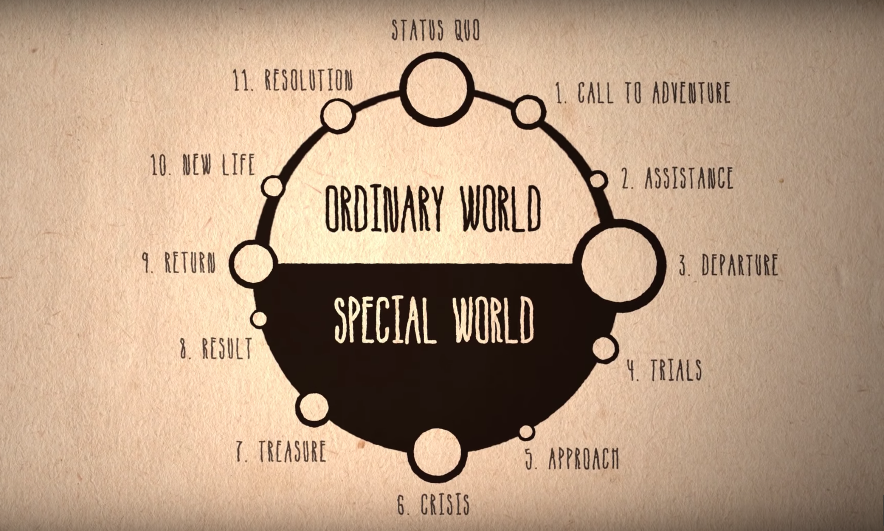
What Makes a Hero: Click Here

Slide 4
Wait…There are different types of heroes??
The Classical Hero
Classical heroes, sometimes known as romantic heroes, are everyday people that have a great talent! They often possess an attribute or quality that distinguishes them from ordinary people, making them a hero. It's important to remember that classical heroes are equal in their world, but possess a gift that others do not have.
Examples: Harry Potter, Hercules, or Victor Frankenstein.

Slide 5
Wait…There are different types of heroes?? (contd)
The Everyman Hero
In literature, the term everyman has come to mean an ordinary individual that the audience or reader easily identifies with. Also, the everyman hero has no outstanding abilities or attributes. An everyman hero is thrown into extraordinary circumstances where they must act with heroic qualities. Moreover, they have sound moral judgment and show selflessness in the face of adversity.
Many protagonists in realistic fiction are considered everyman heroes.
Examples: Han Solo, Bella (Twilight), Dorothy (The Wizard of Oz)

Slide 6
Wait…There are different types of heroes?? (contd)
The Superhero
Superheroes can start out as classical heroes or even everyman heroes and be given a power that makes them 'superhuman'. They can also be born with a ‘superhuman’ power.
Examples: Superman, Spiderman, Wolverine.

Slide 7
Wait…There are different types of heroes?? (contd)
The Tragic Hero
It was the great philosopher Aristotle who first defined the ill-fated protagonist as a tragic hero, or flawed hero. Aristotle suggested that a hero of a tragedy must evoke a sense of pity or fear from the audience. Also, the tragic hero has to be someone whose misfortune is brought about not by vice or depravity, but by some error or fate. To this day, literature is inundated with the use of this type of protagonist.
Shakespeare was famous for using this archetype in his plays
Examples: Romeo, Macbeth, and Darth Vader!

Slide 8
Wait…There are different types of heroes?? (contd)
The Epic Hero
As with the tragic hero, the Greeks were first to define the protagonist known as an epic hero. These are heroes of a tragedy who evoke in the audience a sense of heroism and legendary awe-inspiring lore. An epic hero is a man whose fortune is brought about by their admired characteristics. Many of the famous Greek Epics, such as The Odyssey and the Illiad, contain these larger than life heroes and deeds.
Examples: Odysseus, Lancelot, Beowulf.

Slide 9
Wait…There are different types of heroes?? (contd)
The Anti Hero
Anti Heroes begin with traits that are very uncommon or unbecoming of a hero. They display qualities that are more in-line with a villain's characteristics. With traits such as conceitedness, immorality, rebellion, and dishonesty, they are not viewed with admiration. Like many of the other heroes, anti heroes start out as average people who are controversially flawed and inherently good at the same time. An anti hero, by definition, is a central character who lacks conventional heroic attributes. These characters can range from a good person with an unattractive vice to a criminal mastermind who has a heart of gold.
Examples: Jay Gatsby, Severus Snape, Dexter, Deadpool.

