Slide 1

Unit 5
Second Industrial Revolution
& Imperialism

Slide 2

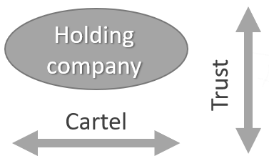



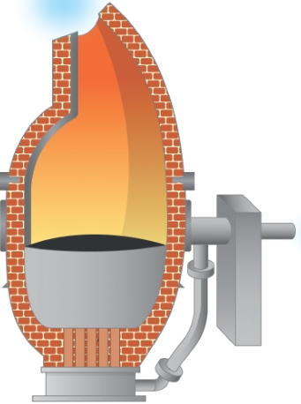
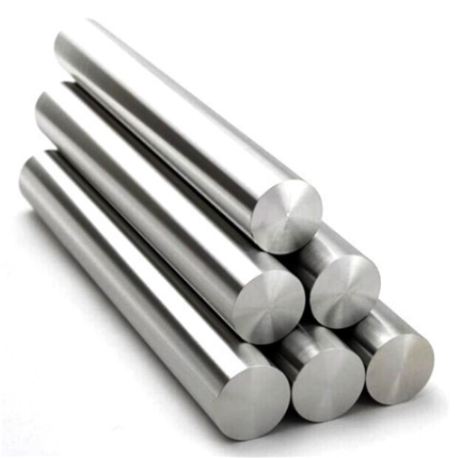
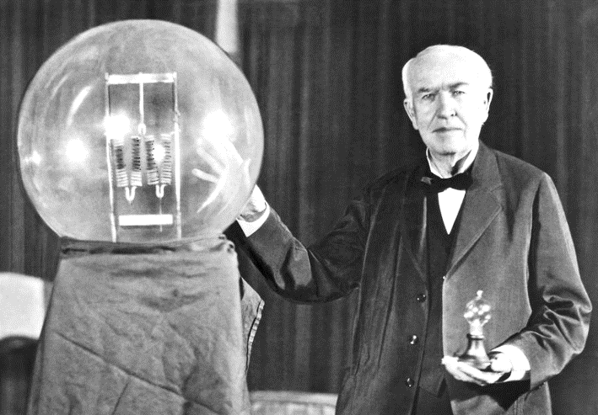
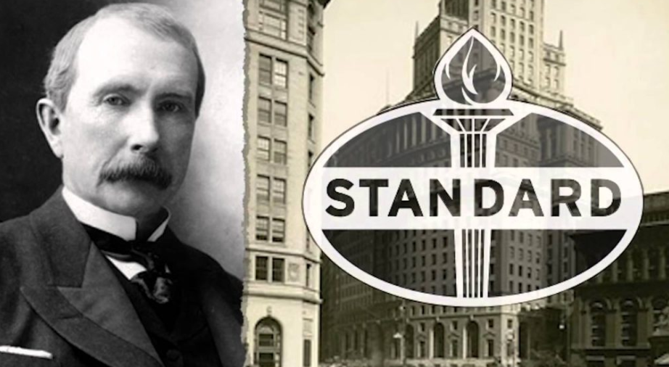


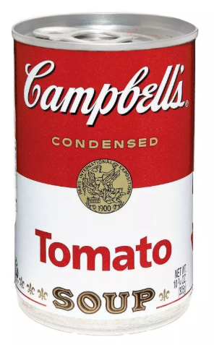
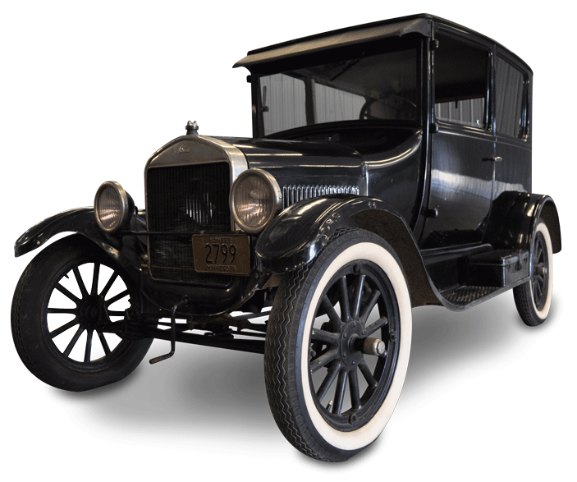
Second Industrial Revolution
2nd INDUSTRIAL REVOLUTION (aka Technological Revolution):
rapid industrialization and increase in production in 1870 – 1914 due to the
rise of the financial sector and finance capitalism in industry.
New finance sources
Business structures
New technology
Joint stock company
Banks
Stock exchange
New sources of energy
New industries

Slide 3
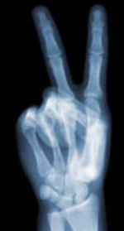

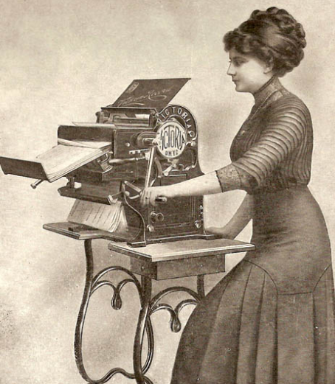




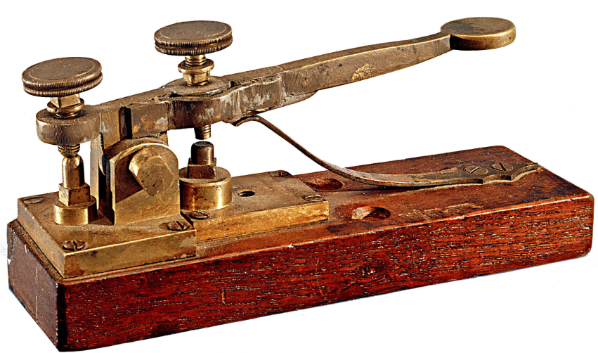




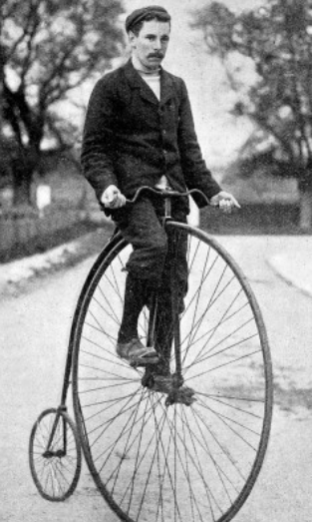
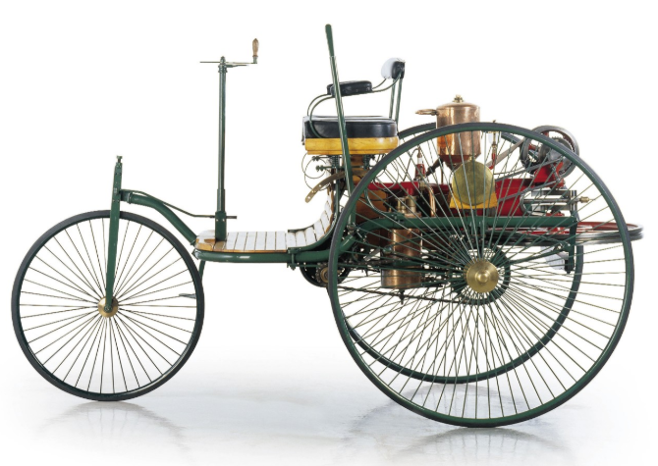
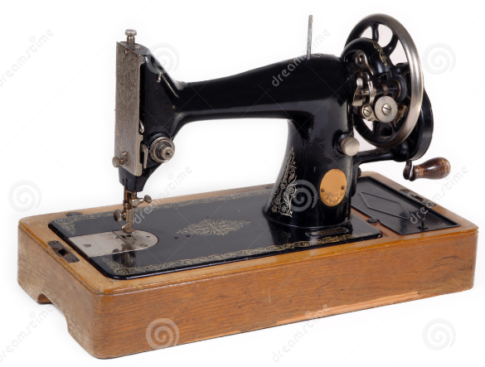
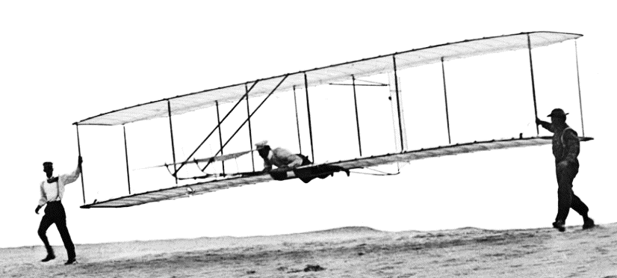
2nd Industrial Revolution Inventions
Medicine
Office / Communication
Leisure / Entertainment
Home
Transportation

Slide 4
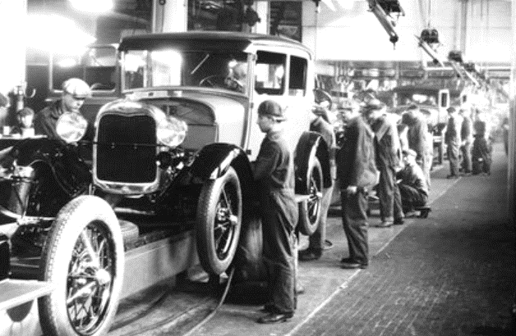
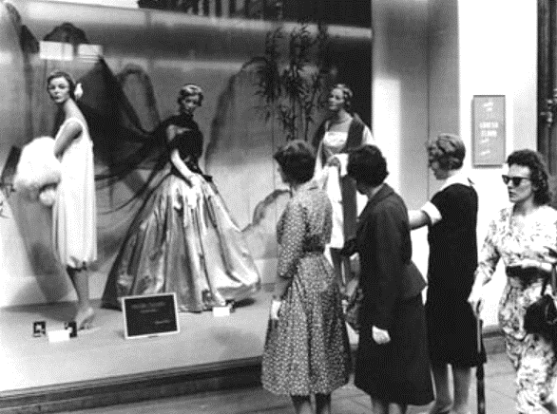

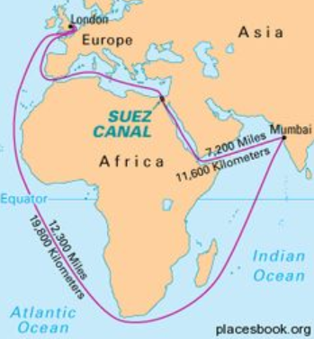
2nd Industrial Revolution Consequences
New organization of work
Consumer society
Assembly line
Henry Ford
Upper class
Lower class
Advertising
Design
Unstable economic cycle
Growth of international trade
Production growth
Improvements in transportation
Construction of tunnels & canals
Growth
Crisis
Recovery
Depression

Slide 5







Expansion of 2nd Industrial Revolution
Mass immigration; land & raw materials; trusts
Mechanization & industrialization
Chemical & electricity industries
Iron & steel
Chemical & electricity, and car industries
Strong financing systems & patent law
Outdated industries
Did not invest into new industries
Automobile & aeronautical industries
Slow, but steady industrialization
Industrialized later in 1890s
Sugar & wood
Textile in Cataluña
Iron & steel
State controlled industrialization

Slide 6
Imperialism (1870 – 1914)
IMPERIALISM: developed countries colonizing other lands to gain new
territories and increase their economic & political power.
Causes of imperialism
Colonization stages
Rise of finance capitalism
Search for new markets to invest and cheap energy & raw materials
International prestige
Strategic locations
Expeditions for scientific purposes
Belief in white supremacy
Occupation by conquest
Political & administrative control
Organization of the economy
Types of colonies
Exploitation: economic value
Settler: socio-economic value
Protectorate: strategic interest

Slide 7
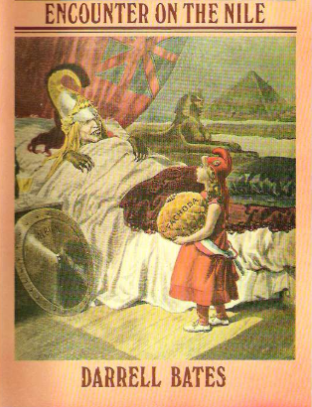
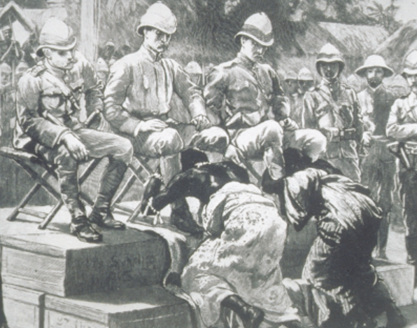
Consequences of Imperialism
Political
Economic
Removing indigenous tribes from their land leaving them w/o traditional resources
Single crop & extraction economy
Disappearing of indigenous crafts
New infrastructure & increased trade
Unequal economic organization of the world
International conflict & rivalry
Berlin Conference
Fashoda Incident
Boer War
Demographic
Social and Cultural
Improvements in health & hygiene
Rise of emigration
Rapidly increasing population
Scarce resources leading to poverty and starvation
Western culture
Social and racial segregation
Belief in colonists’ superiority over indigenous people

