Slide 1
Healthy Habits & Illnesses of the Digestive System

Slide 2
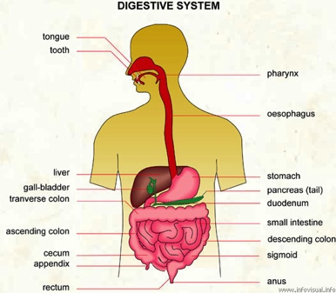
Digestive System: Health
We need to look after the organs that are part of the digestive system!

Slide 3
Some Tips for a healthy and happy digestive system ☺
Chew food slowly (helps digestive process)
Brush AND Floss your teeth
Reduce really hot and spicy foods (they irritate stomach/mouth mcuus)
Wash hands before preparing and eating food
Eat foods high in fibre (help intestinal movements)
Don’t consume alcohol (damage to liver and pancreas)

Slide 4
Why?
All of these tips help to ensure that you are looking after the organs of your digestive system and therefore yourself!

Slide 5
Illnesses
There are a range of conditions that your digestive system can suffer from
We will be looking at FOUR areas
  The mouth
  The stomach
  The liver
  The intestine

Slide 6
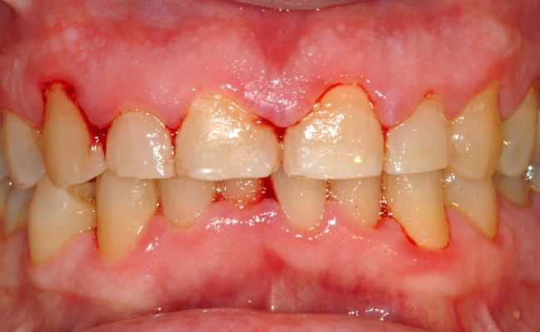
The Mouth
Cavities – destruction of tooth enamel caused by bacterial decomposition of food
Gingivitis – painful gum
inflammation, they
bleed and redden
Pyorrhoea – This is the inflammation and infection of the ligaments/bones that support the teeth

Slide 7
Cavities- video
https://www.youtube.com/watch?v=zGoBFU1q4g0

Slide 8
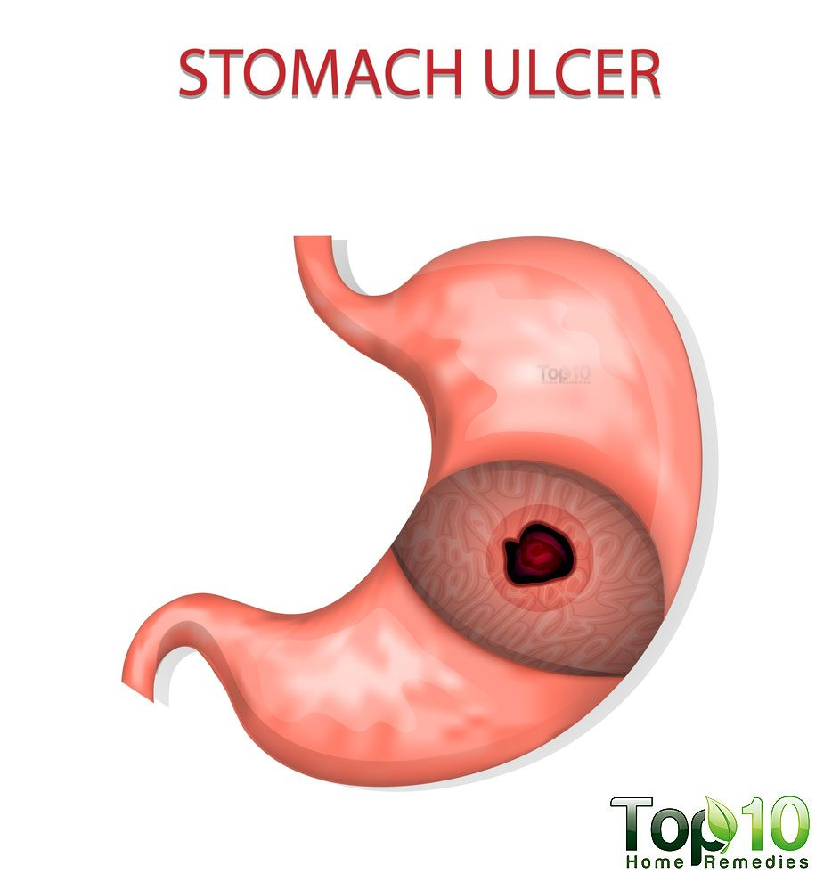
The Stomach
Gastritis – irritation of the gastric mucosa, causing it to become inflamed. It produces symptoms such as heartburn
Ulcers – wounds that are caused by the destruction of gastric mucosa (gastritis is a common precursor) found in stomach/intestine

Slide 9
Ulcers/Gastritis Video
https://www.youtube.com/watch?v=V_U6czbDHLE

Slide 10
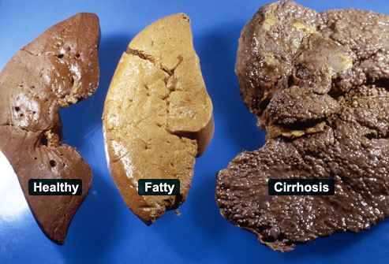
The liver
Hepatitis – liver inflammation caused by certain viruses, or abusive consumption of alcohol/medicines
Cirrhosis – very serious illness that destroys hepatic (liver) cells
Gallstones – solid particle build up of cholesterol or minerals found in bile

Slide 11
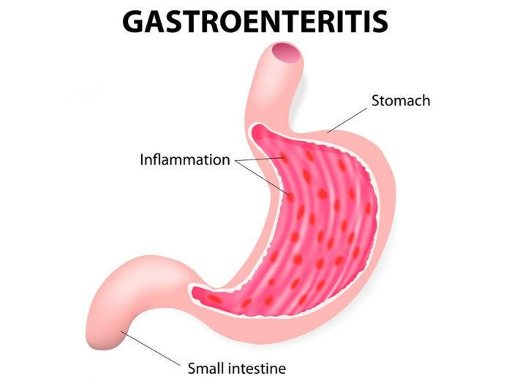
The Intestine pt. 1
Gastroenteritis –
intestinal infection caused by certain bacteria in water/food (ex cholera/typhoid – very serious!)
Appendicitis – appendix inflammation cause by bacterial infection, intense pain, vomiting, fever.
Constipation – difficulty passing stools due to low mobility of large intestine

Slide 12
Constipation - Video
https://www.youtube.com/watch?v=0IVO50DuMCs

Slide 13
The Intestine pt. 2
Diarrhea – food travels through the large intestine very fast, runny faeces because no water absorbed
Celiac Disease – autoimmune disease, chronic infection of jejunum. Body reacting badly to gluten
Colon Cancer – develops from polyps forming in mucosa of the colon, can invade other organs

Slide 14
Celiac Disease - Video
https://ed.ted.com/lessons/what-s-the-big-deal-with-gluten-william-d-chey

Slide 15
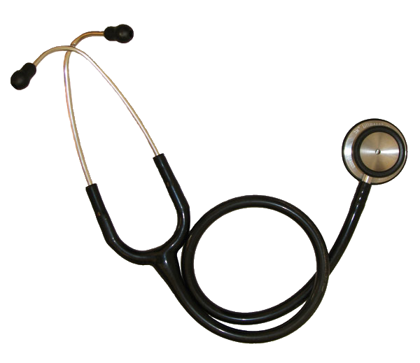
Let’s play Doctor!!!

Slide 16
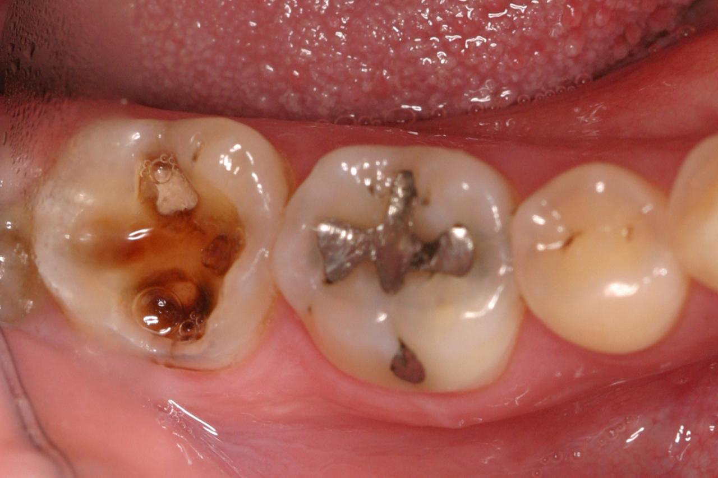
What do I have?

Slide 17
What do I have?
Lauren is a heavy alcohol drinker and has been for many years. Recently, she has been experiencing these symptoms: jaundice (yellow discoloration in the skin and eyes, fatigue, and abdominal pain.

Slide 18
What do I have?

Slide 19
What do I have?
Suzy was rushed to the hospital during the school dance complaining of pain in her lower right abdomen. Her friends had said that she looked like she was running a fever when they saw her.

Slide 20
What do I have?
Tommy’s mother is concerned because he tells her that he’s been sitting on the toilet for 5 hours and that nothing is happening.

Slide 21
What do I have?
Meanwhile, Peter is experiencing the opposite problem as Tommy. Everything is going straight through him.

Slide 22
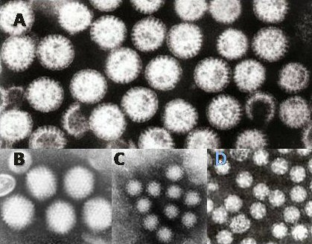
What do I have?
Sally’s symptoms include diarrhea, vomiting, and abdominal pain. Recently, a report from her hometown was released confirming contaminated water supplies infected with this bacteria

Slide 23
What do I have?
Michael has been experiencing irritability, fatigue, weight loss, and delayed growth. However the doctors notice that changing his diet significantly improved his symptoms.

Slide 24
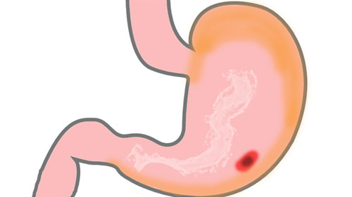
What do I have?
Brett has dull pain in his stomach, bloating, and heartburn
A picture of his stomach looks like this:

Slide 25
What do I have?

