Slide 1
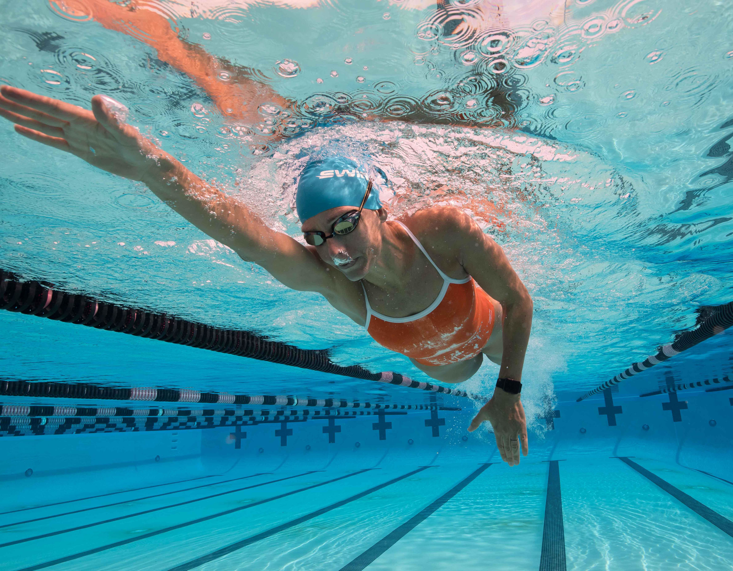
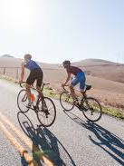
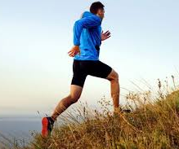

Specific Methods of Training
Continuous Training
  Steady pace
  Target zone is 60-80% of your MHR
  Improves aerobic fitness
What are examples of continuous training?
Endurance sports!!

Slide 2
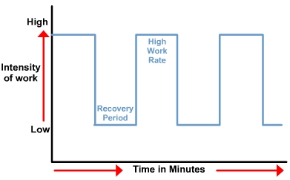
Specific Methods of Training
Fartlek Training
  Varying intensity of speed and terrain
  What type of fitness does it improve?
  What sports would benefit most from fartlek training?
This type of training improves both aerobic and anaerobic fitness.
Most team sports benefit from this type of training – examples include football, basketball, handball, volleyball, and many more!

Slide 3
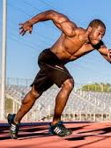
Interval Training
Alternating between intense exercise and rest
Improves speed and muscular endurance
Types of interval training
  Long Interval Training: 20 seconds – 3 minutes
  Short Interval Training: shorter than 20 seconds
How do lactic acid and oxygen debt fit into interval training?
What is the difference from fartlek training?
What types of athletes would use long vs. short interval training?
Long interval training – game sport athletes and middle distance runners
Short interval training – sprinters and racket sport players

Slide 4

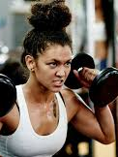
Weight Training
Weights, including body weight, provide resistance to muscles
Improves muscular strength and endurance…
  How could we adjust weight/reps to target strength vs. endurance?
Targeting strength? High weight and low reps
Targeting endurance? Low weight and high reps

Slide 5
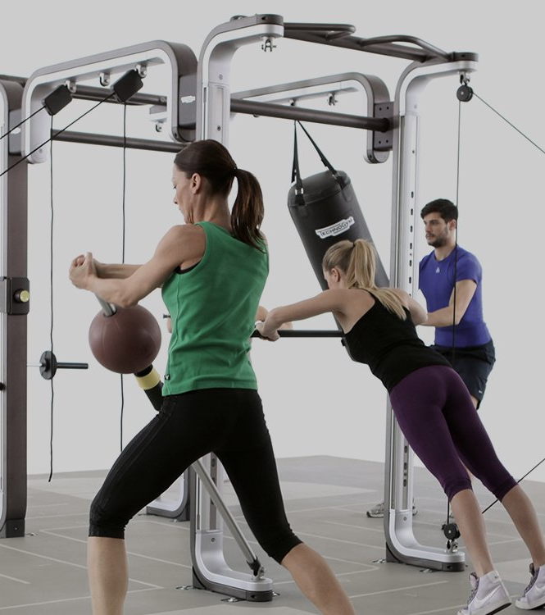
Circuit Training
A series of exercises completed in a special order
Good to develop general fitness
  Give an example of a simple circuit – what does it improve?
Can circuits be used for specific sports/skills?
Absolutely! You could use a circuit to practice free kicks, footwork, shooting, etc.

Slide 6
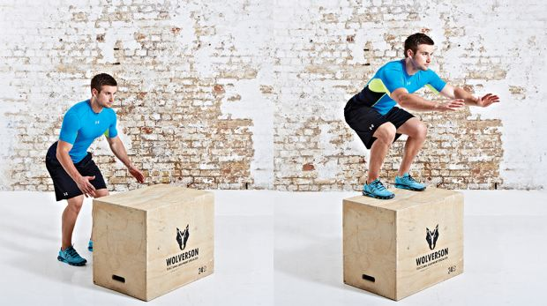
Plyometric Training
“Jump Training”
Maximum force is exerted for very short intervals
Improves muscular strength and power

Slide 7
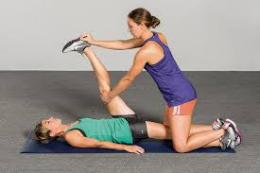
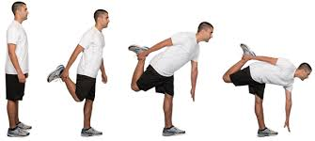
Stretching Training
Two types of stretching…what are they?
Static Stretching – holding a position to stretch the muscle
  Best for post-exercise stretching
Dynamic Stretching – ballistic exercises to stretch muscles and joints
  Best for warming up for exercise

Slide 8
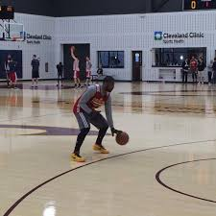
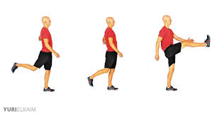
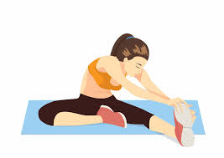
The Three Stages of a Training Session
Warm-Up
Whole body exercise
Raises HR
Stretching prepares soft-tissue
Practicing skills for that session
Main Activity
Fitness training
Skill development
Drills
Modified games
Cool-Down
Light exercise
Helps body to process CO2, LA, other waste
Gentle stretching prevents soreness and injury

Slide 9
Cool Videos
https://youtu.be/kLpJSCmxxpo - box jump, plyometric training
https://youtu.be/md7Qj-5QxTY?t=135 – world record lift, weight training
https://youtu.be/NilASeqRsjw?t=70 – Messi practicing some specific skills using circuit training

