Slide 1

Unit 1
The Ancien Régime
The Enlightenment

Slide 2




The Ancien Régime & The Enlightenment
Pre-History
Ancient History
Middle Ages
Early Modern Age
Modern Age
3000 BC
476 AD
1453 AD
1789 AD
The Ancien Regime
17-18th CENT
The Enlightenment
18th CENT
The Ancien Régime was a period of political, economic and social changes in Europe during the 17-18th century that brought the start of the Modern Age.
The Enlightenment was an intellectual movement in Europe during the 18th century, marking the end of the Ancien Régime and the transition from the Early Modern Age to the Modern Age.

Slide 3
Political Changes
The Ancien Régime
The Enlightenment
Absolute monarchy
Limited powers
Enlightened despotism

Slide 4
Political Changes
The Ancien Régime
The Enlightenment
Absolute monarchy
Limited powers
Enlightened despotism
France: Louise XIV (no Estates General)
England: Charles I → Oliver Cromwell → Charles II → James II → Glorious Revolution (1688) → William of Orange (Bill of Rights) → United Kingdom of Great Britain (1707) → Parliamentary Monarchy (House of Lords & House of Commons)
Spain: Less Hapsburgs (Felipe III, Felipe IV, Carlos II) → War of Spanish Succession (1701-1714) → Treaties of Utrecht and Rastatt (Family Compacts) → Bourbons (Felipe V, Fernando VI, Carlos III)

Slide 5
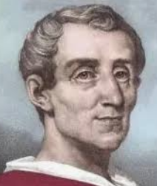
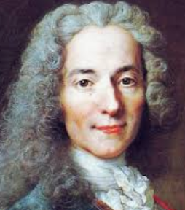
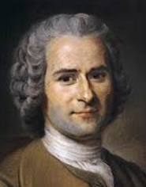
Political Changes
The Ancien Régime
The Enlightenment
Absolute monarchy
Limited powers
Enlightened despotism
Montesquieu argued for the separation of powers: the three branches of government (legislative, executive, judicial) should be separate.
Voltaire believed that the best form of government is a strong monarchy limited by the parliament.
Rousseau introduced popular sovereignty: the power resides with the people rather the crown, and the government is created by and for the will of its people.

Slide 6
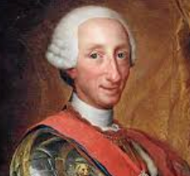
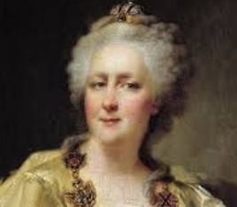
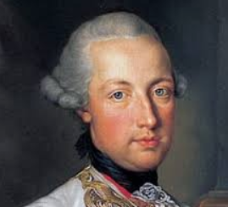
Political Changes
The Ancien Régime
The Enlightenment
Absolute monarchy
Limited powers
Enlightened despotism
Objective:
  Combine absolute monarchy (despotism) with enlightenment ideas to modernize the country and improve wellbeing
Features:
  Absolute power through centralized government & enlightenment thinkers appointed to high positions
  Peaceful changes through reforms & education
Examples: Carlos III (Spain), Catherine the Great (Russia), Joseph II (Austria), Frederick II (Prussia)

Slide 7
Economic Changes
The Ancien Régime
The Enlightenment
Feudal system
Estates of the realm
New reforms

Slide 8
Economic Changes
The Ancien Régime
The Enlightenment
Feudal system
Estates of the realm
New reforms
1. Clergy
3. Ordinary people
2. Nobles
Bourgeoisie: upper middle class (merchants)
Petite bourgeoisie: small merchants & craftsmen
Peasants & day laborers: paid taxes to 1st & 2nd estates

Slide 9
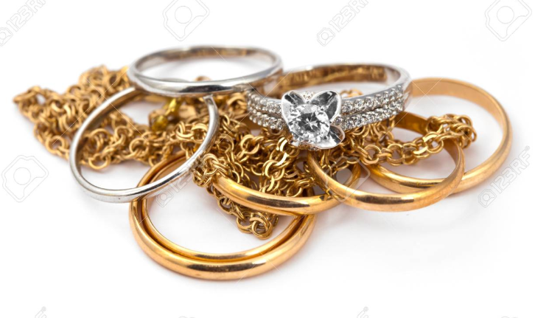


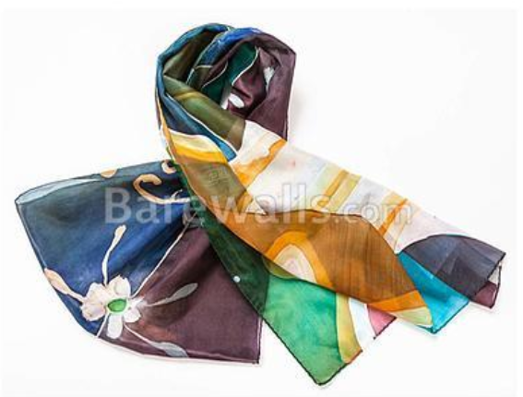
Economic Changes
The Ancien Régime
The Enlightenment
Feudal system
Estates of the realm
New reforms
Traditional agriculture
Physiocracy (agriculture)
New techniques
Low productivity
Economic liberalism
New crops
Mercantilism (gold)
Freedom of production
Higher productivity
Protectionist policies
Free trade & competition
Royal manufacturers

Slide 10
Scientific Progress
The Ancien Régime
The Enlightenment
Secret & Sacred Knowledge
Learning & Teaching
Irrational Beliefs & Dogma
Reason & Humanism
D'Alembert
Diderot
Rationalism
Empiricism
Encyclopedia
Scientific Method
Academies & Salons
Equality & Liberty
Nutrition & Hygiene

Slide 11
Scientific Progress
The Ancien Régime
The Enlightenment
Secret & Sacred Knowledge
Learning & Teaching
Irrational Beliefs & Dogma
Reason is Knowledge
17th century:
Galilei (Earth revolves around the sun)
Torricelli (barometer pressure)
Newton (gravity)
Leeuwenhoek (microscope)
Pascal (first calculator)
18th century:
Fahrenheit & Celsius
Benjamin Franklin (lightning rod)
Hutton (geology)
Hales (blood pressure)
Jenner (smallpox vaccine)

Slide 12
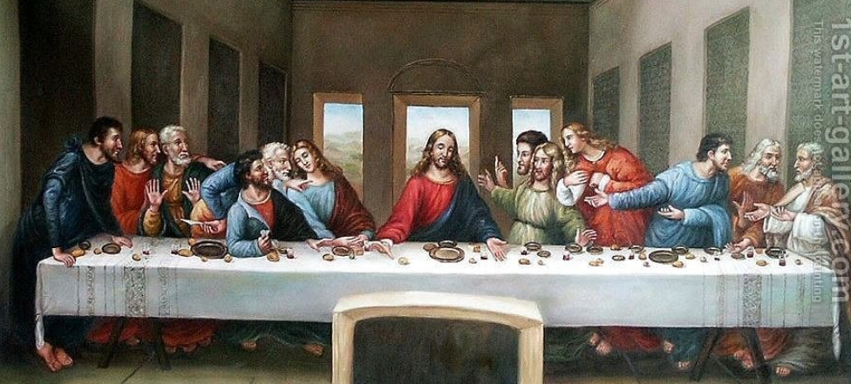
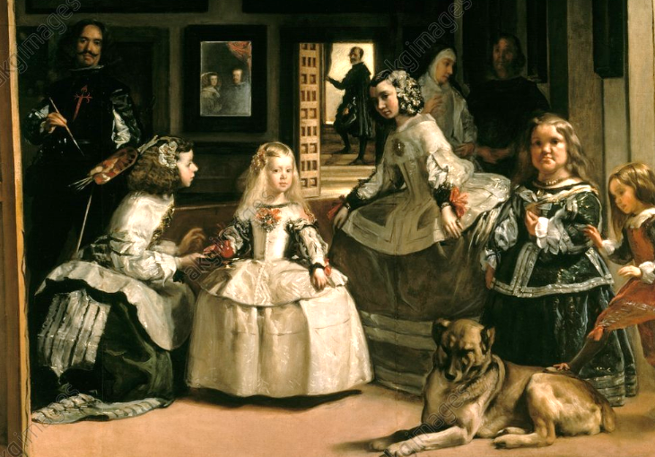
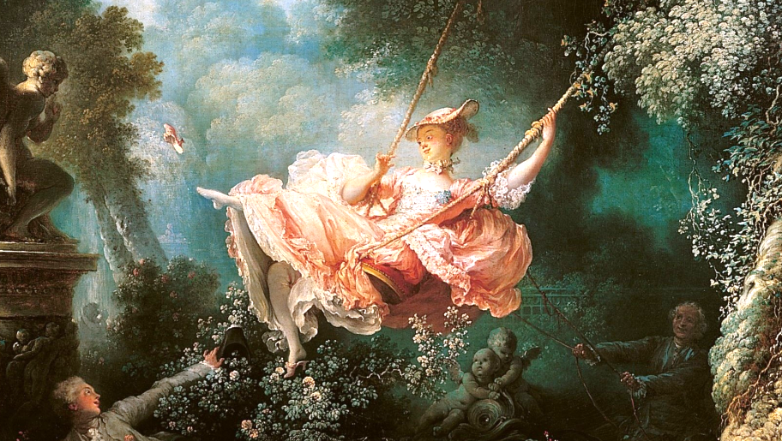
Evolution of Art
The Ancien Régime
The Enlightenment
16th century:
Religious art
Promoted exclusively by the Catholic Church
17th – early 18th:
Baroque art
Natural forms
Abundant decorative elements
18th century:
Rococo Art
Aristocratic style
Exuberant forms
Elaborate decoration
Curves, seashells, flowers

