Slide 1

Where does Halloween come from?
https://www.youtube.com/watch?v=R-VRAemIvbI
Key words:
To prank someone
Celtic people / Celts
Vandalism
Bribe
Extortion
Bonfire
video
Key words:
To prank someone = to trick = to play a joke on someone
Celtic people / Celts = descendants of Brittany and Ireland who speak Celtic
Vandalism = deliberate damage or destruction of public or private property
Bribe = dishonest payment to persuade someone in your favor
Extortion = obtaining something through violence or threats
Bonfire = large fire created by people in an open space

Slide 2
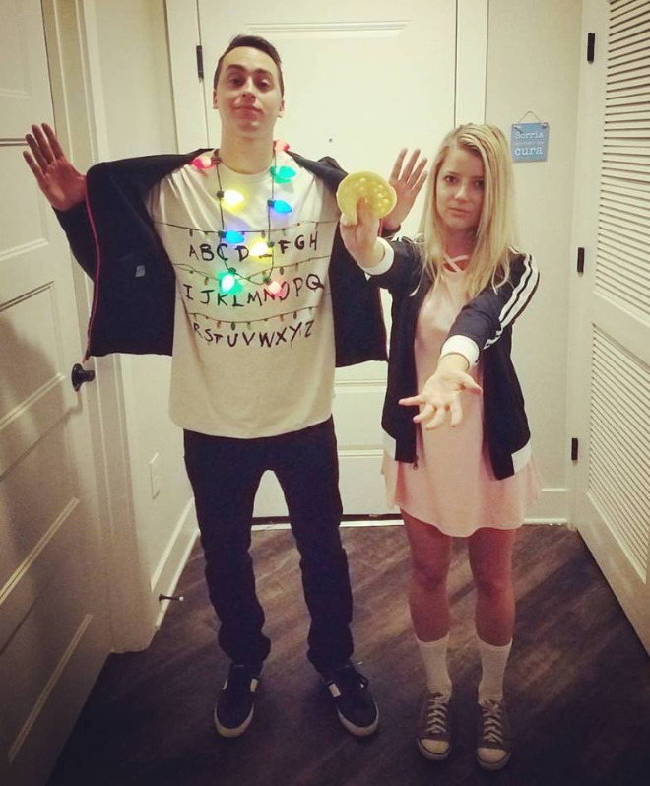
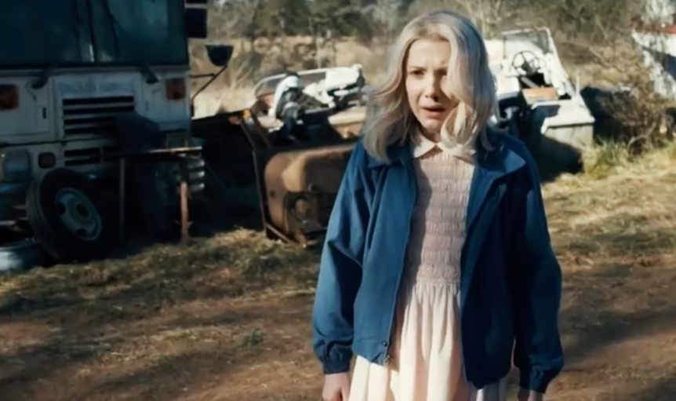
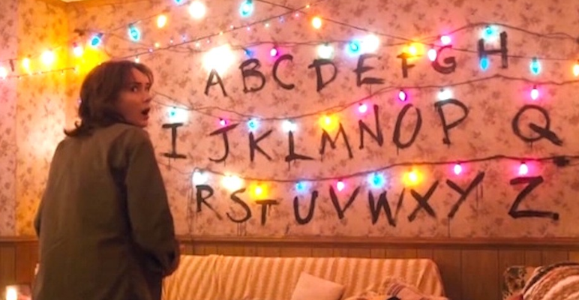
Halloween

Slide 3
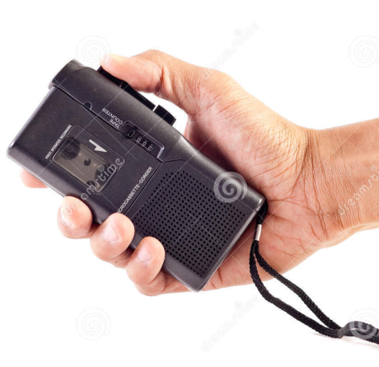
Murder Mysteries
https://www.youtube.com/watch?v=lCe-VW4E5yA
A man was found dead with a tape recorder in one hand and a gun in the other.
When the police came in, they pressed Play on the tape, and heard this:
“I have nothing else to live for. I can’t go on,” and then the sound of the gunshot.
The police immediately knew that this was a murder, and not a suicide.
How?

Slide 4
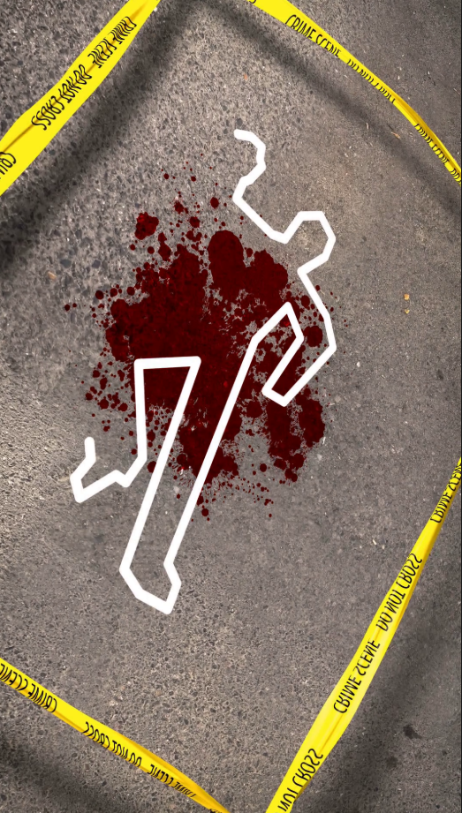
Murder Mysteries
A man is found murdered on a Sunday morning. His wife calls the police who question the wife and the staff, and they hear the following alibis:
The wife: “I was sleeping”
The butler: “I was cleaning the closet”
The gardener: “I was picking vegetables”
The maid: “I was getting the mail”
The cook: “I was making breakfast”
Who was the murderer?

Slide 5
Murder Mysteries
A Japanese ship was in the open sea. The captain went to take a shower and left his ring on the table. When he returned, the ring was missing. The captain called his crew members and asked each one what were they doing in the last 15 minutes.
The engineer said, “The engine had problems, so I was fixing it.”
The sailor said, “The flag was upside down, so I was on the deck correcting it.”
The radio officer said, “I was messaging the land about our arrival.”
The navigation officer said, “I was sleeping in my cabin.”
The cook said, “I was in the fridge room getting the meat for dinner.”
The captain immediately caught the thief and fired another crew member. Who and why?

Slide 6
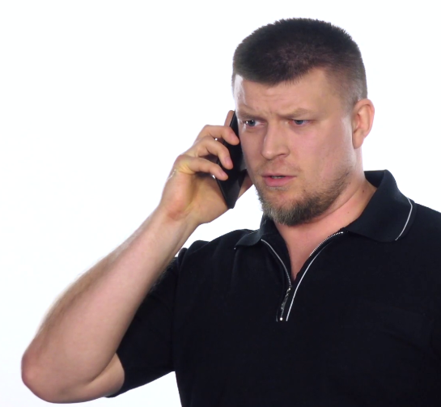
The Maid
There was once a very rich man who married a woman much younger than him. He always suspected that she was cheating on him, but he could never be sure. One day, when he was away on a business trip, he called the house to check on her. The phone was answered by a female voice that he didn’t recognize.
“Who are you?” asked the man.
“I’m the maid,” she replied.
“What? We don’t have a maid!” he said suspiciously.
“Oh… Um… The lady of the house just hired me this morning,” said the maid.
“Well, I’m the man of the house,” he said. “Can you put my wife on the phone?”

Slide 7

The Maid
“I don’t think I can,” the maid replied.
“Why? Where is she?” asked the man. He was getting quite angry now and growing more and more suspicious.
“She is upstairs in her bedroom with a man…” replied the maid reluctantly. “I thought he was her husband.”
As the man heard this, he became completely outraged.
“Listen, how would you like to make $10,000?” he asked the maid.
The maid thought for some time.
“That’s a lot of money,” she said. “What do you want me to do?

Slide 8

The Maid
“I want you to find the gun safe,” said the man. “Take one of my guns and load it up with bullets, they should be in a box next to the guns. Then go upstairs and shoot this no-good wife of mine and the bastard she is having an affair with!”
The maid remained silent for a long time. The man could tell she was hesitating.
“I will give you $50,000,” he said. “It will be quick and worth your while.”
After a long pause, the maid agreed. “Okay. I will do it,” she said.

Slide 9

The Maid
The man heard the sound of the maid placing the phone down on the table. Then he heard footsteps moving away from the phone. A few minutes later, he heard loud screams and two gunshots being fired. There was a long silence, then more footsteps, and finally the maid picked up the phone.
“I did it… They are dead,” she said nervously.
“What should I do with their bodies?
“Bring the bodies downstairs and throw them in the swimming pool in the garden,” said the man.

Slide 10

The Maid
“Swimming pool?” said the maid. “But you don’t have a swimming pool…”
There was a long silence on the other end of the phone.
Eventually, the man said, “I’m sorry, I think I dialed the wrong number…”

Slide 11
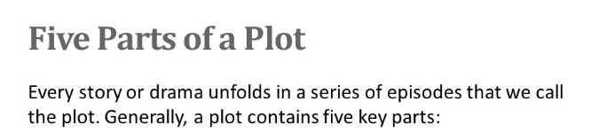
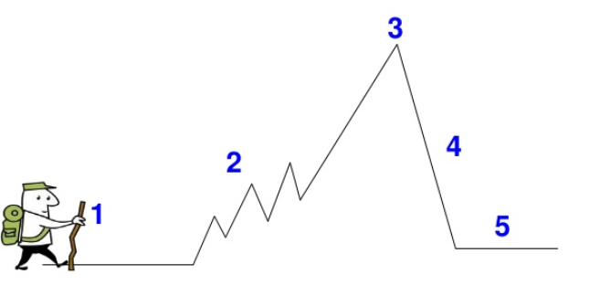
Story Plot
CULMINATION
RISING ACTION
FALLING ACTION
INTRODUCTION
RESOLUTION

Slide 12
Story Plot
The maid shoots and kills two people
The man marries a younger woman
The man calls to check on his wife
The man realizes it is not his house
The man is convincing the maid to kill
They decide what to do with the bodies
CULMINATION
RISING ACTION
FALLING ACTION
INTRODUCTION
RESOLUTION

Slide 13
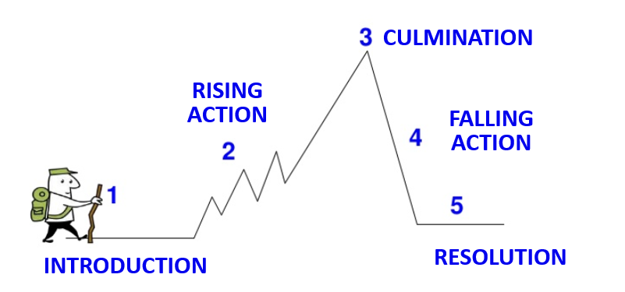
Your Story!
Main characters:
Setting (place & time):
Conflict (personal or with other characters?):
Resolution (happy ending or tragedy?):

