Slide 1

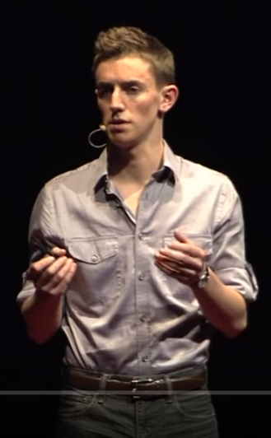
Thanksgiving
https://www.youtube.com/watch?v=QNfAnkojhoE
What do you think of Brian’s project?
Do you think 365 days of thanks is achievable? Could you do it?
Why do you think his dad was #170?

Slide 2
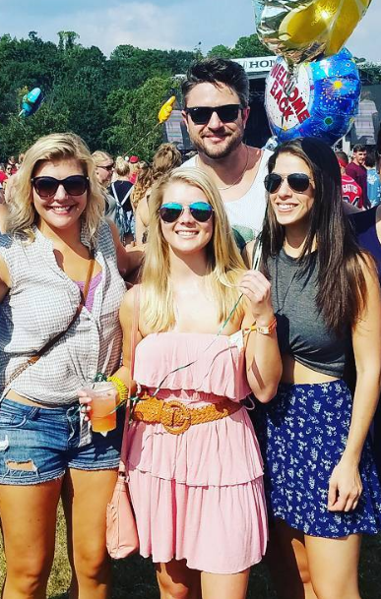
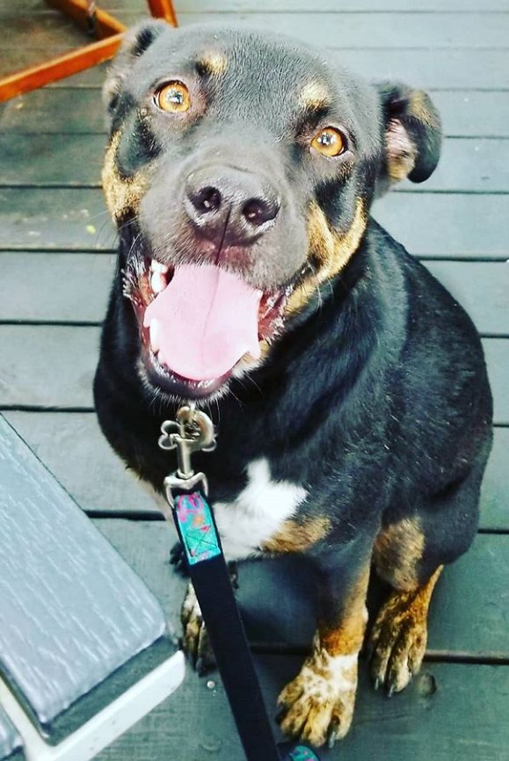
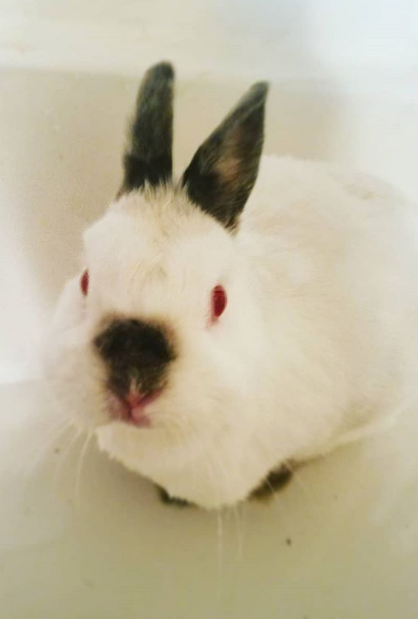
Thanksgiving
Who are your top 3 people to thank?
What is the #1 experience you are thankful for this year?

Slide 3
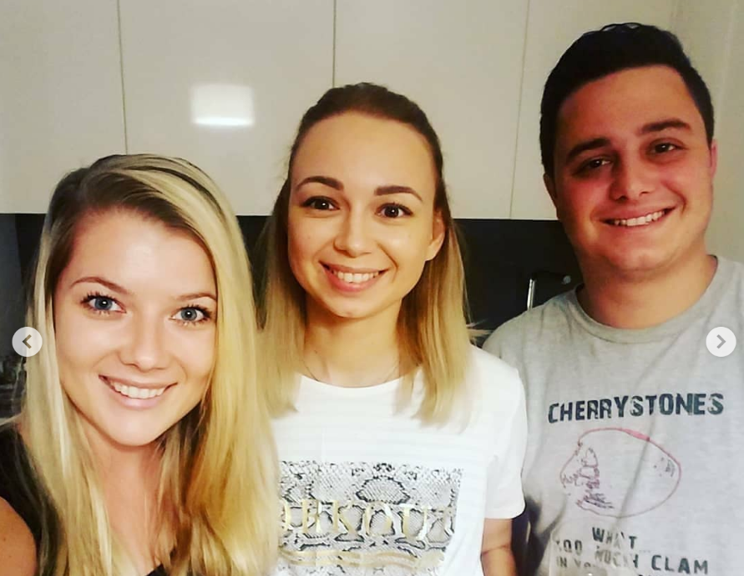
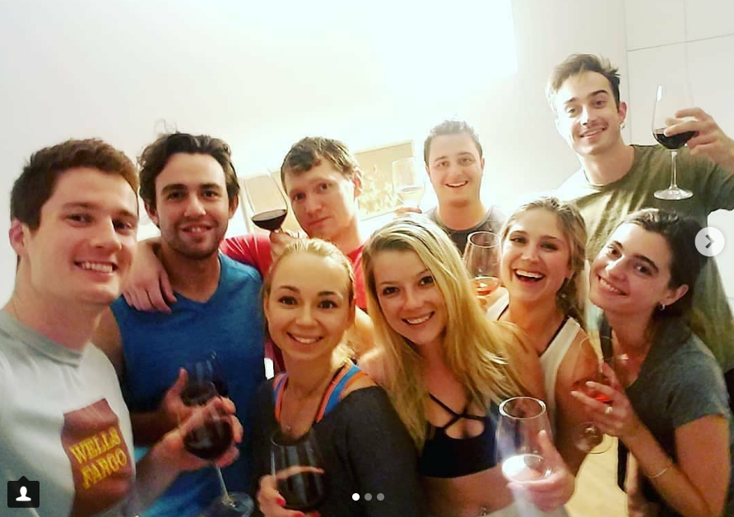
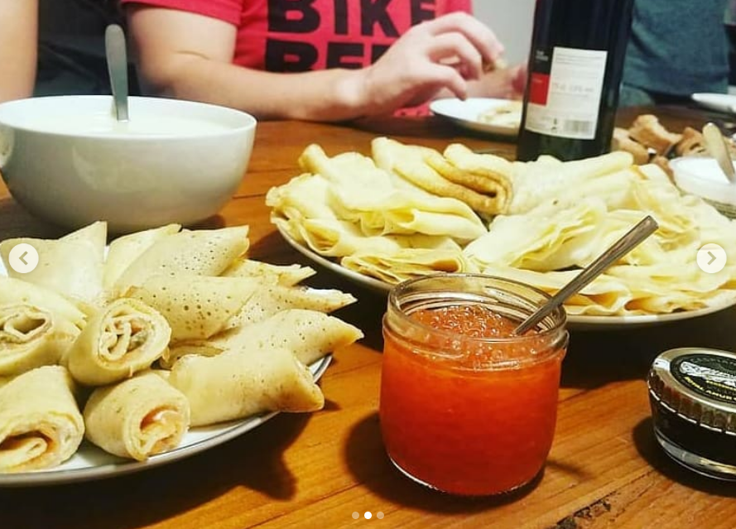
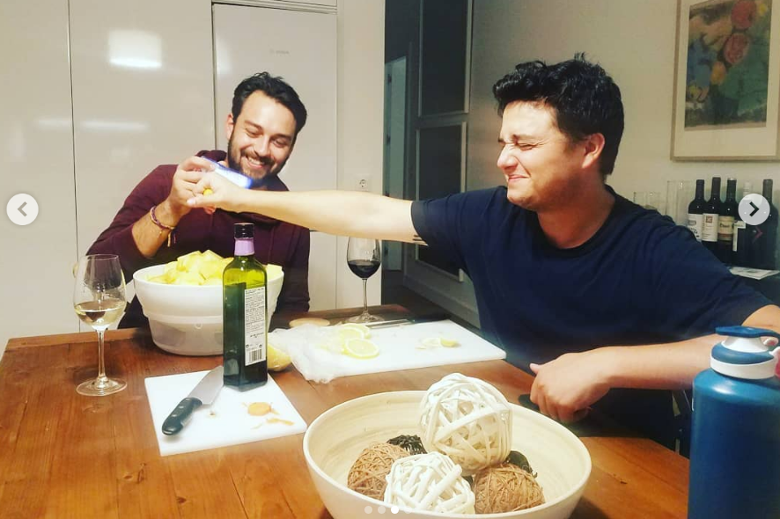
Thanksgiving

Slide 4
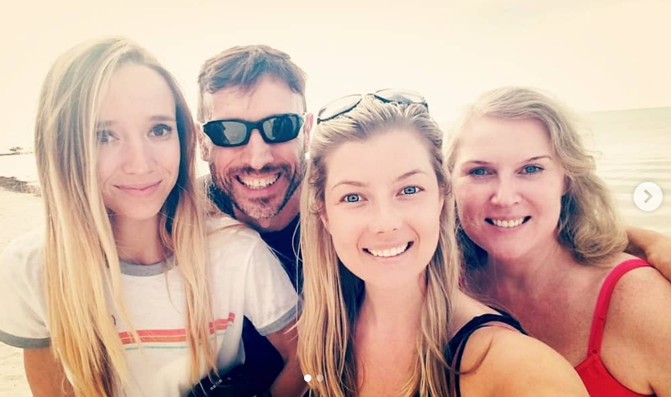
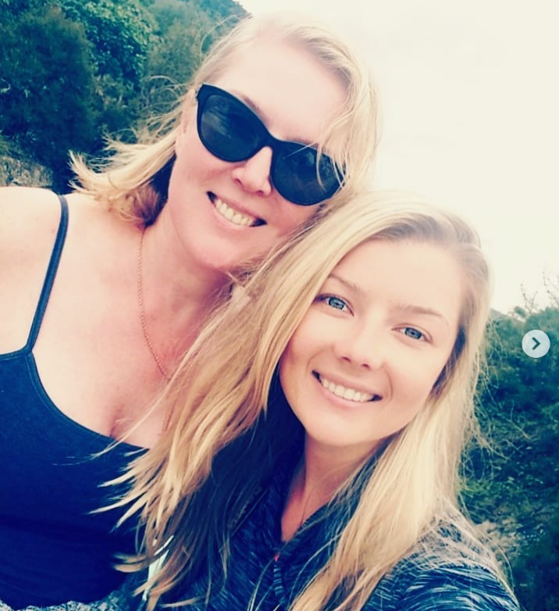
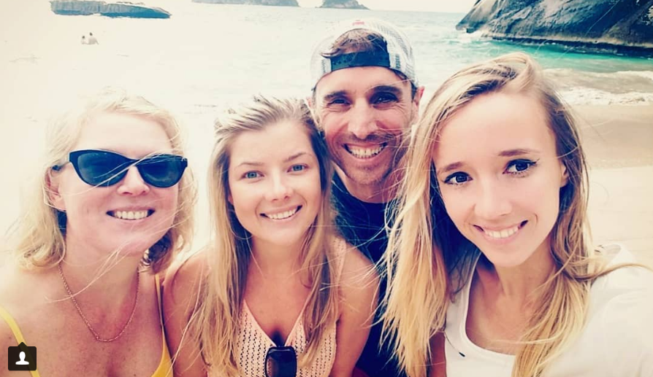
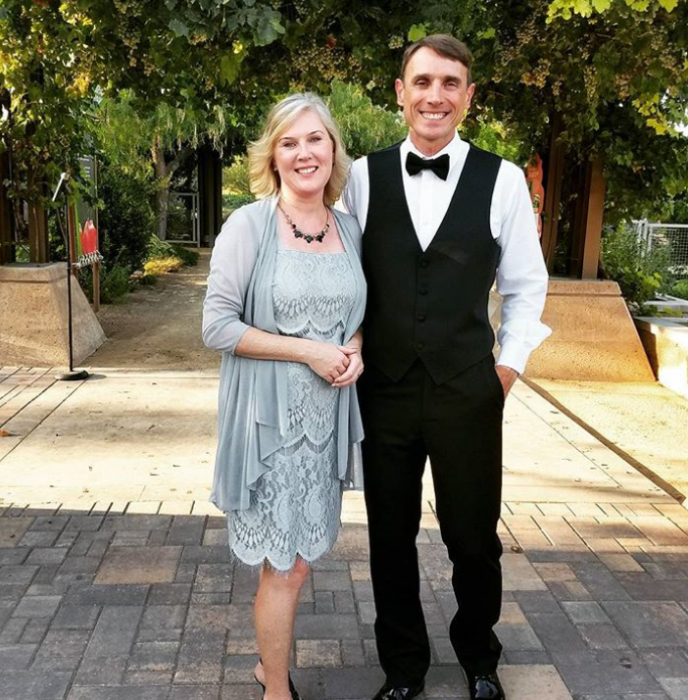
Thanksgiving

Slide 5
Thanksgiving
To B2CD,
I am thankful for all of you. I am happy to be an assistant at such a good school with students who are smart and cheerful. I am grateful that you stay engaged, participate in discussions, and show respect for me, Queta, and your classmates.
Every one of you is unique, and I love when you guys share your opinions and let your voice be heard. You are great, and I love coming to your class every week.
Thank you, guys, keep up the good work :)
Valeria

Slide 6
Thanksgiving
To S4CD,
I am thankful for all of you. I am grateful to be an assistant at such a good school with students who are smart and cheerful. I want you to know that you guys are very bright, and you make it easy for me to come to your class and have fun. I enjoy preparing lesson plans and presentations for you in History, and I appreciate that you stay engaged and participate in English. Thank you for staying on topic, following along, and showing respect to me and your classmates :)
Thanks guys!
Valeria

Slide 7
Thanksgiving
To B2BE,
I am thankful for you all. I am grateful to be an assistant at such a good school with students who are smart and cheerful. I really enjoy our conversations, and I appreciate that you share your opinions and participate in the discussion. Even when we go completely off topic, I love how engaged you are, that you follow along, and show respect to me and your classmates :)
Thanks guys!
Valeria

Slide 8
Thanksgiving
To S4A,
I am thankful for all of you. I am grateful to be an assistant at such a good school with students who are smart and cheerful. I really enjoy preparing lesson plans and presentations for you in History, and I appreciate that you stay engaged and participate in English.
I want you to know that your language skills are fantastic, and you make it very easy for me. Even when we read boring stories like Walter Mitty, I am thankful that you stay on topic, follow along, and show respect to me and your classmates :)
Thanks guys!
Valeria

Slide 9
Thanksgiving
To B2AF,
I am thankful for all of you. I am happy to be an assistant at such a good school with students who are smart and cheerful. I really enjoy our conversations, and love when you share your opinions and participate in the discussion. Even though it is our LAST class on Fridays and we all want to go home for the weekend, I really appreciate that you stay engaged, follow along, and show respect to me and your classmates ;)
Thanks guys!
Valeria

Slide 10
Thanksgiving
To S4EF,
I am very thankful for all of you. I am grateful to be an assistant at such a good school with students who are smart and cheerful. I really enjoy preparing material for you in History, and I appreciate that you stay engaged and participate in English. Even when we read boring stories like Walter Mitty, I am thankful that you stay on topic, show respect to me and your classmates, and follow along ;)
Thanks guys!
Valeria

Slide 11
Thanksgiving
To B1CD,
I am thankful for all of you. I am happy to be an assistant at such a good school with students who are smart and cheerful. I am grateful that you stay engaged, participate in discussions, and show respect for me and your classmates. I love when you guys share your opinions and let your voice be heard. You are amazing, and each one of you has a great story to tell. The day when we all shared funny stories about traveling and other experiences was one of my favorite days at the school.
Thank you, guys, keep up the good work :)
Valeria

Slide 12
Thanksgiving
To S4B,
I am very thankful for all of you. I am grateful to be an assistant at such a good school with students who are smart and cheerful. You guys make me laugh, and I love coming to your class. I really enjoy preparing unit reviews for you in History, and I appreciate that you stay engaged and participate in English. Even when we read boring stories like Walter Mitty, I am thankful that you stay on topic, show respect to me and your classmates, and follow along ;)
Thanks guys!
Valeria

Slide 13
Thanksgiving
To B1AF,
I am thankful for you. I am grateful to be an assistant at such a good school with students who are smart and cheerful. My only issue with your class is that you are ALWAYS talking, but I am grateful that this is the only problem we face. I know that students in other areas of Madrid have much bigger problems, like hunger at home, not enough resources for school, not warm enough clothes. So if talking is our only challenge, I am grateful for it. But with that, I am even extra thankful when you stay with me on topic in class, pay attention, and participate ;)
Thanks guys!
Valeria

Slide 14
Thanksgiving
WRITE DOWN a thank you letter to someone important to you. Give/send them this letter this week. (5 minutes)
Next week: SHARE their reaction!

Slide 15
Thanksgiving
Overview: https://www.youtube.com/watch?v=-BQSOkkoDjc
Real story: https://www.youtube.com/watch?v=ociHVDWxDaY
Friends: https://www.youtube.com/watch?v=FaLaPEnjeqY
Becoming a national tradition: https://www.youtube.com/watch?v=N1m5gUSRyTc

