Slide 1
Feudal Europe
Review Session

Slide 2
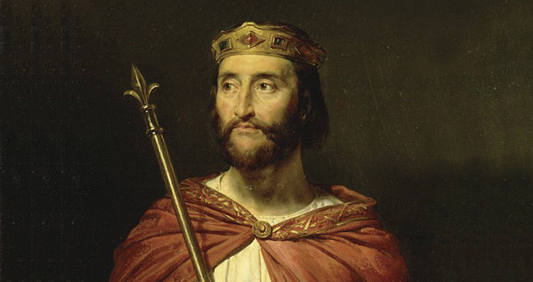
The Carolingian Empire
A Frankish Kingdom was established following the fall of the Western Roman Empire in present-day France.
  The official rulers were called the Mayors of the Palace.
The name Carolingian is derived from the Latinised name of Charles Martel, Carolus, who was the de facto ruler of Francia.
  His descendants became the Frankish Kings, starting with his son Pepin the Short (751), followed by his grandson Charlemagne (768).
  “Carolingian” means “descendant of Charles.”

Slide 3
Charlemagne’s Conquests
Under Charlemagne’s rule, the Carolingian Empire acquired many new territories throughout Europe.
  In present-day Germany he defeated the Pagans Saxons (and forced them to become Christians).
  He conquered the Lombard Kingdom in Italy.
  He Gained control of the North of the Iberian Peninsula.
  In 800, the Pope crowned Charlemagne Holy Roman Emperor, making him successor to the restored Western Roman Empire.

Slide 4
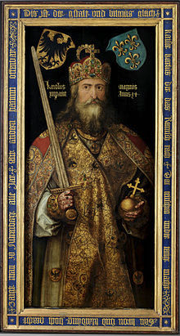
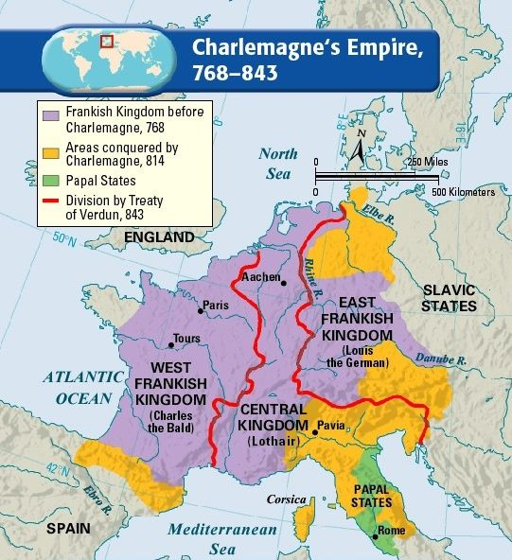
Charlemagne
What were...
Counties?
Missi dominici?
Marches?

Slide 5
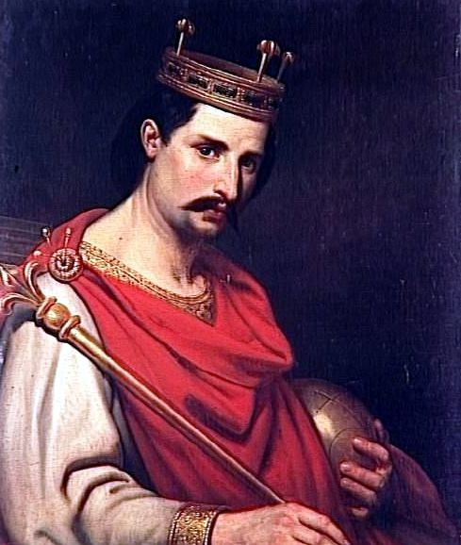
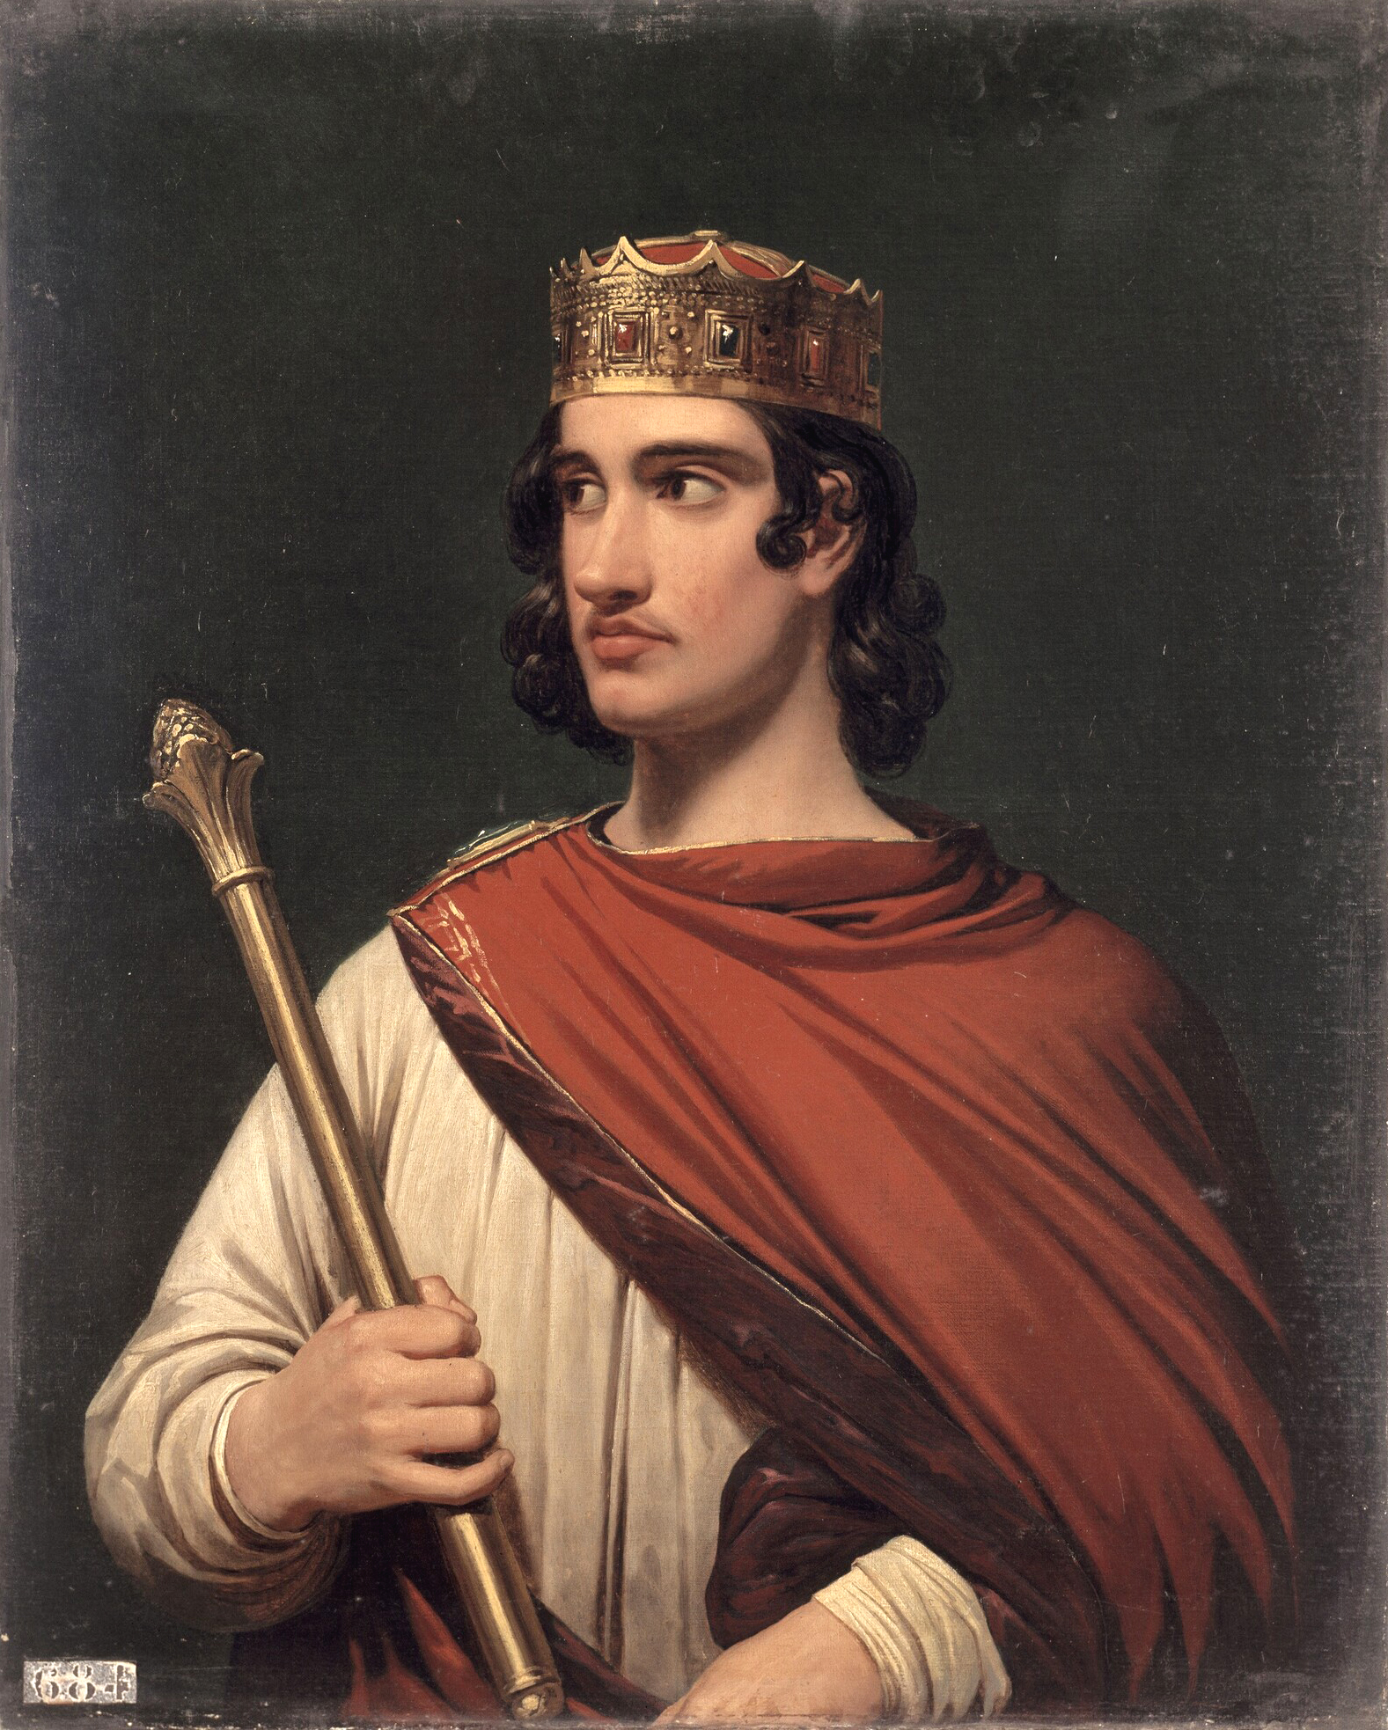
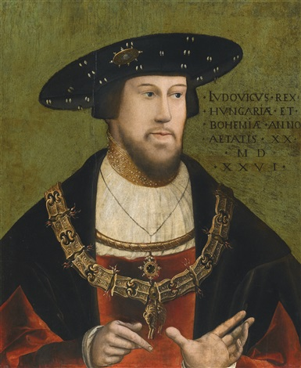
Division of the Empire
Charlemagne’s empire was very diverse, as many different peoples spoke their own language and kept their own traditions.
Nonetheless, the empire remained intact until a few years after Charlemagne’s death.
  In 843, the empire was divided into three parts, which were ruled by Charlemagne’s grandsons.

Slide 6
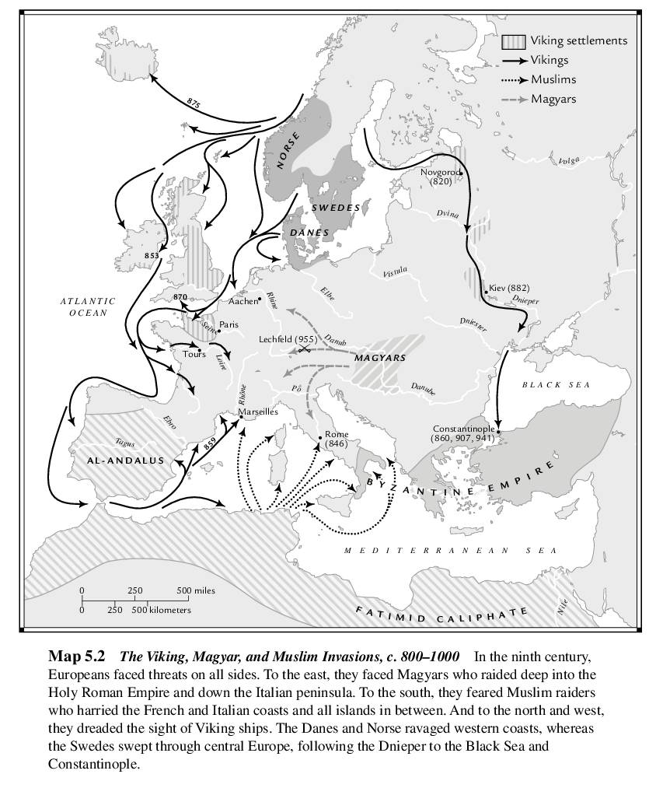
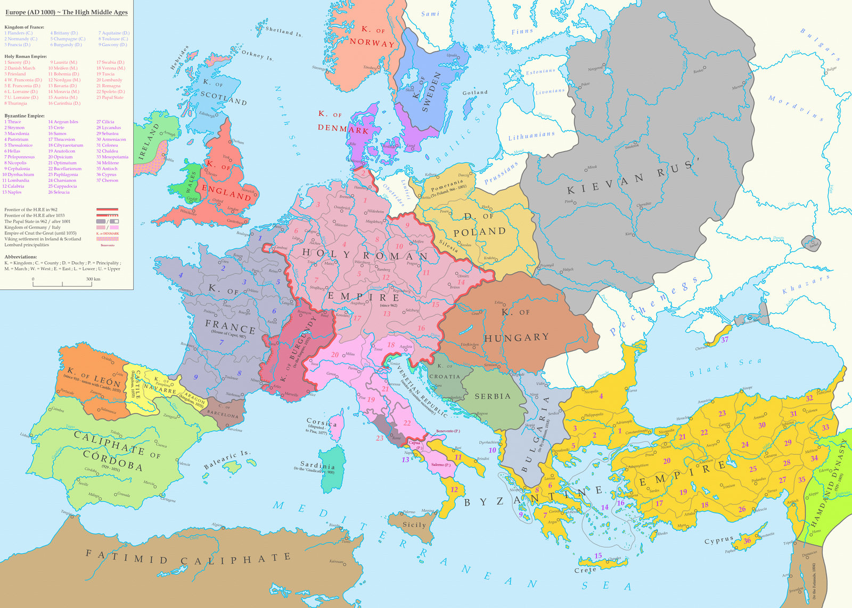
9th and 10th Century invasions
Re-shaping of Europe

Slide 7
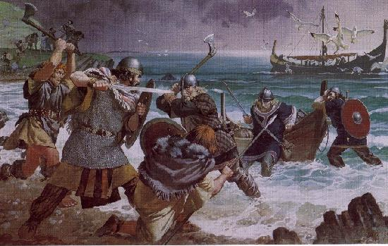
Weak Royal Authority
Following the division of the Carolingian Empire, kingdoms did not have permanent capital cities.
  Monarchs travelled with a court, made up of family members, warriors and a royal council (curia), which helped the monarch to rule.
Monarchs had little power during this period; little authority over land, kingdoms were often divided, royal armies were small, and lacked power to collect taxes.

Slide 8
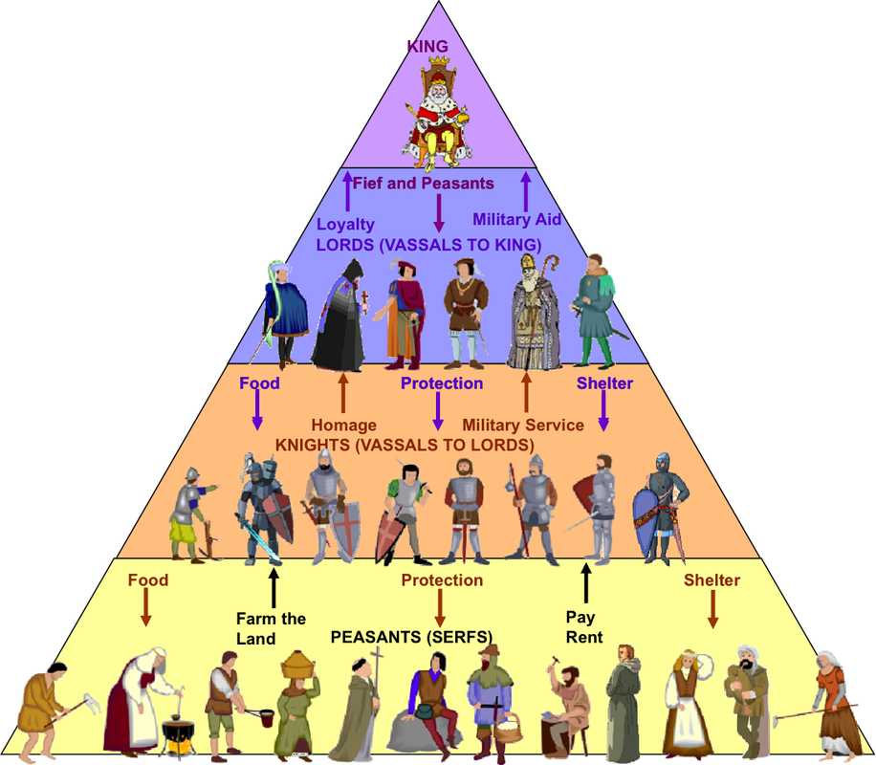
Feudalism
The main political, social and economic system in Europe between 10th and 13th centuries.
Kings relied on the private armies of nobles.
In a ceremony of homage, the vassal promised the lord personal loyalty and military assistance.
In return, the lord gave the vassal a fief.

Slide 9
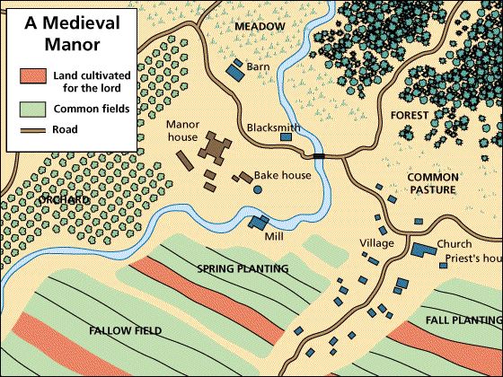
Life on a Fief

Slide 10
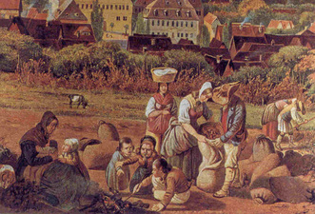
Medieval Society
It was organized into three social groups.
  1) Nobility (military)
  2) Clergy (church)
    Both did not pay taxes, or do manual labor.
  3) The rest of the population; peasants, merchants, and craftsmen.
Only the clergy was allowed social mobility.

Slide 11
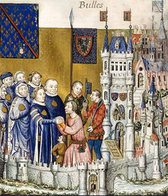
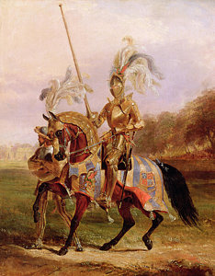
Upper Nobility
Lower Nobility
Duke
Knights
Count
Squires
Marquis
Pages

Slide 12
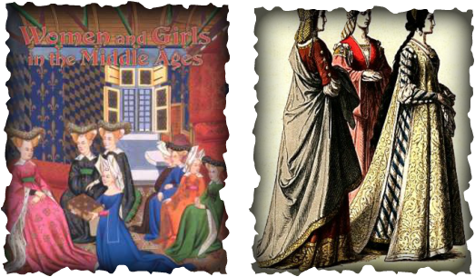
Noblewoman
Little rights and were expected to marry and have children.
Leading families usually arranged marriages.
Noblewomen were expected to do house duties, but were often better educated than their husbands.

Slide 13
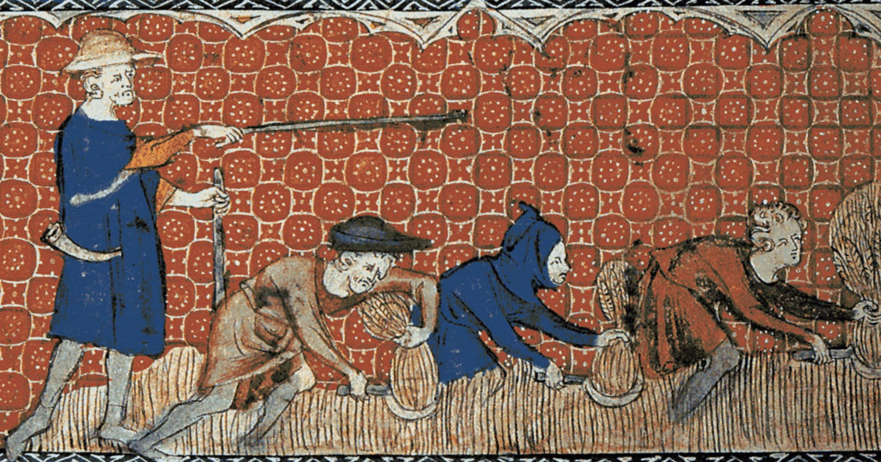
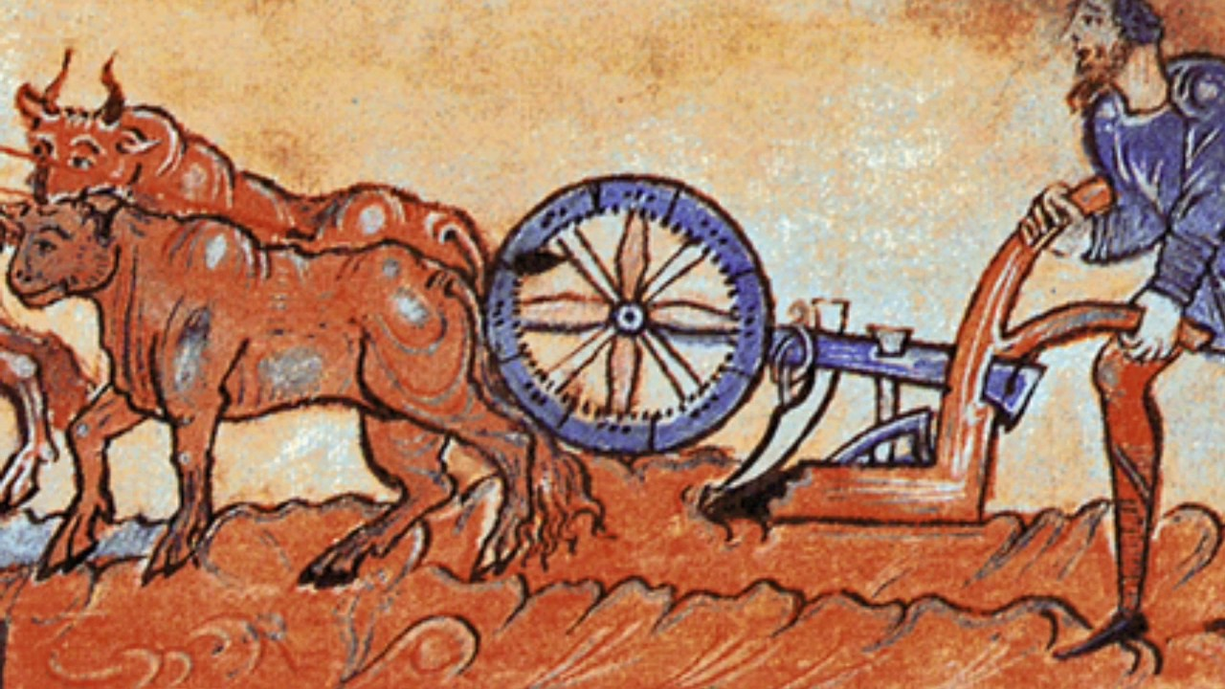
Serfs and Peasants
Serfs were completely under the authority of their feudal lord.
  They lived under many restrictions and weren’t allowed to leave without the lord’s permission.
Free peasants owned small plots of land and lived in villages.
  Paid taxes to the lord and the Church, and also paid to use the lord’s mill, oven, and press.

Slide 14
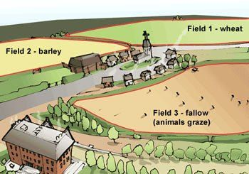
Agriculture
Three-year crop rotation
Agricultural work was very hard and demanded a lot of labor.
In the 11th century though new techniques were introduced.
Two crops are shown above, what else did they farm?

Slide 15
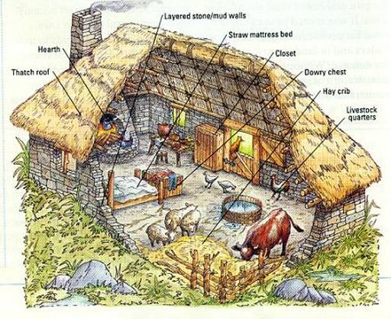
Peasant life
Lived in small villages.
Small vegetable gardens were laid near the home.
Lived near forests’ in order to collect firewood and fruit.
They were self-sufficient.

Slide 16
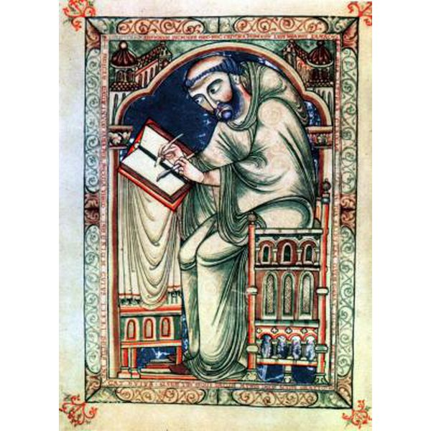
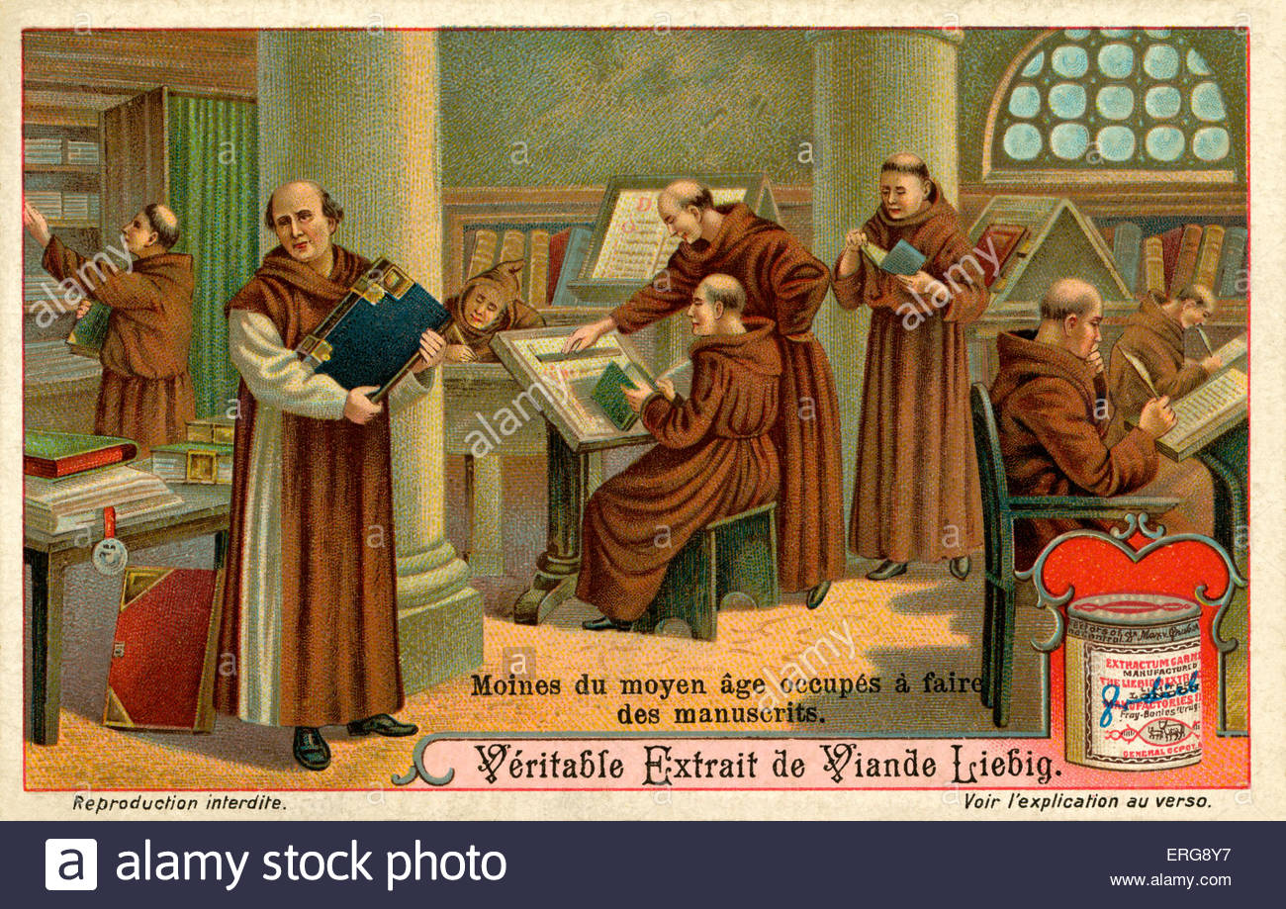
The Church
Had great influence in many areas of medieval life:
  Political: The Pope had the authority to excommunicate rulers. Monarchs often used church leaders as main advisers.
  Economic: The Church received donations of land in return for prayers. Peasants paid the Church a tithe, which was a share of their harvest.
  Cultural: Few people could read and write apart from the clergy. Monks copied manuscripts and artwork was created for churches and cathedrals.

Slide 17
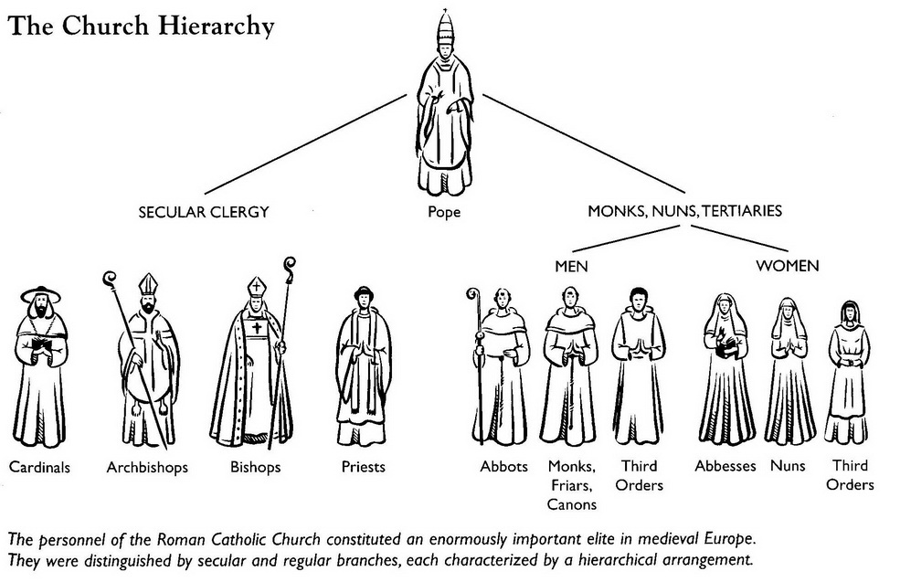
Church Organization

Slide 18
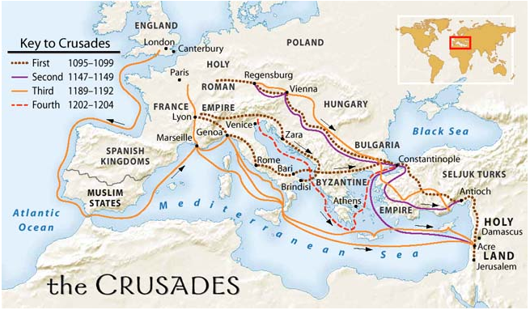
The Crusades
Were military expeditions to recover the Holy Land from Muslims.
During the first Crusade, Christians conquered Jerusalem (1099).
  Pilgrimages followed.
Military Orders

