Slide 1
What is media?

Slide 2



Would you consider social media an effective tool for spreading news?

Slide 3
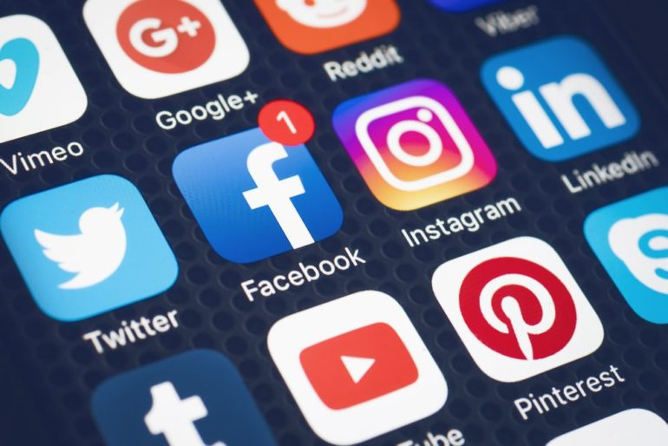
Can social media platforms be used as a way to present news?

Slide 4


Slide 5
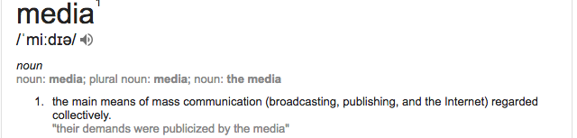
Defining the word media.
What are the three main types of media?

Slide 6
Do you think media platforms should be objective or subjective?

Slide 7
Anything objective sticks to the facts, but anything subjective has feelings. Objective and subjective are opposites. Objective: It is raining. Subjective: I love the rain!

Slide 8
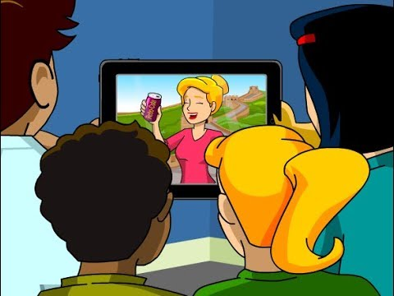
Video on media subjectivity.

Slide 9
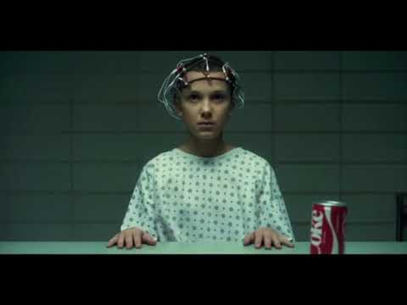
Advertisements as a form of media.

