Slide 1
Analyzing architecture

Slide 2
How do we analyze architecture?
Architecture reflects the artistic style of a particular historical period.
During the Renaissance this meant creating harmonious spaces, place an emphasis on symmetry, proportion, and geometry.
Some classical elements that were incorporated into the Renaissance style were Greek columns, semi-circular arches and Roman Domes in churches, palaces and other buildings.

Slide 3
To analyze we must highlight
Type and Function: indicate if the building is a church, castle, palace, etc. and say what function it has (religious, military, political, etc.).
Materials Used: Note if the building is made of brick, stone, wood, etc.
Type of plan: Explain if the plan is a basilica plan, Latin-cross plan, Greek-cross plan, elliptical plan, circular plan, etc.

Slide 4
Continued.
Supporting and Supported Elements: Supporting elements include walls, columns, and pillars. Supported elements refer to arches (horseshoe, semicircular, pointed) and roofs.
Construction Period: When was it built? Relate the building to the historical context in which it was constructed.
Architectural Style: Based on your analysis of the above features, indicate the style of the architecture.

Slide 5
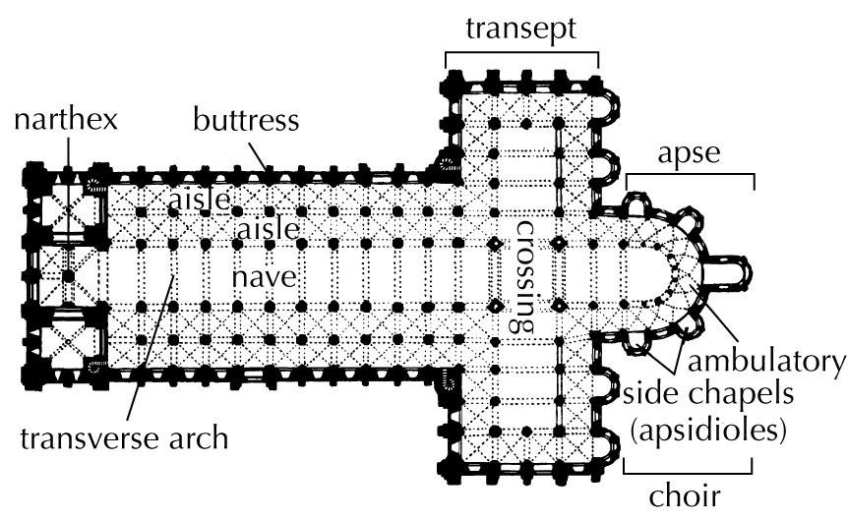
Latin-cross plan

Slide 6
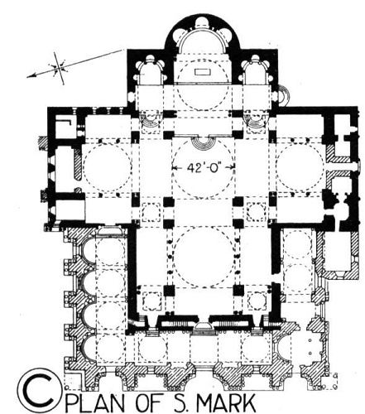
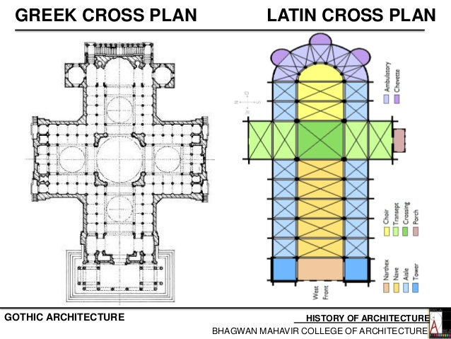
Greek-cross plan

Slide 7
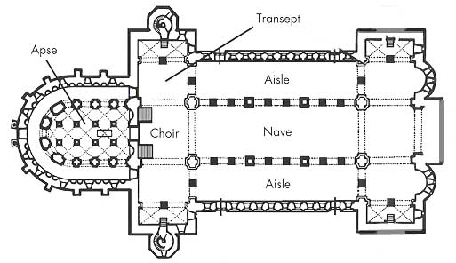
Basilica Plan
Rectangular walled structures with an open hall extending from end to end, usually flanked by side aisles set off by colonnades, and with a raised platform at one or both ends.

Slide 8
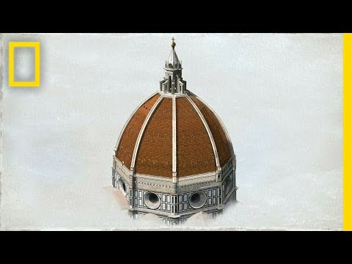
Filippo Brunelleschi

Slide 9
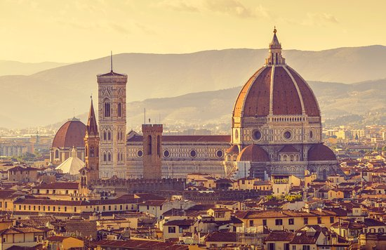
Santa Maria del fiore

Slide 10
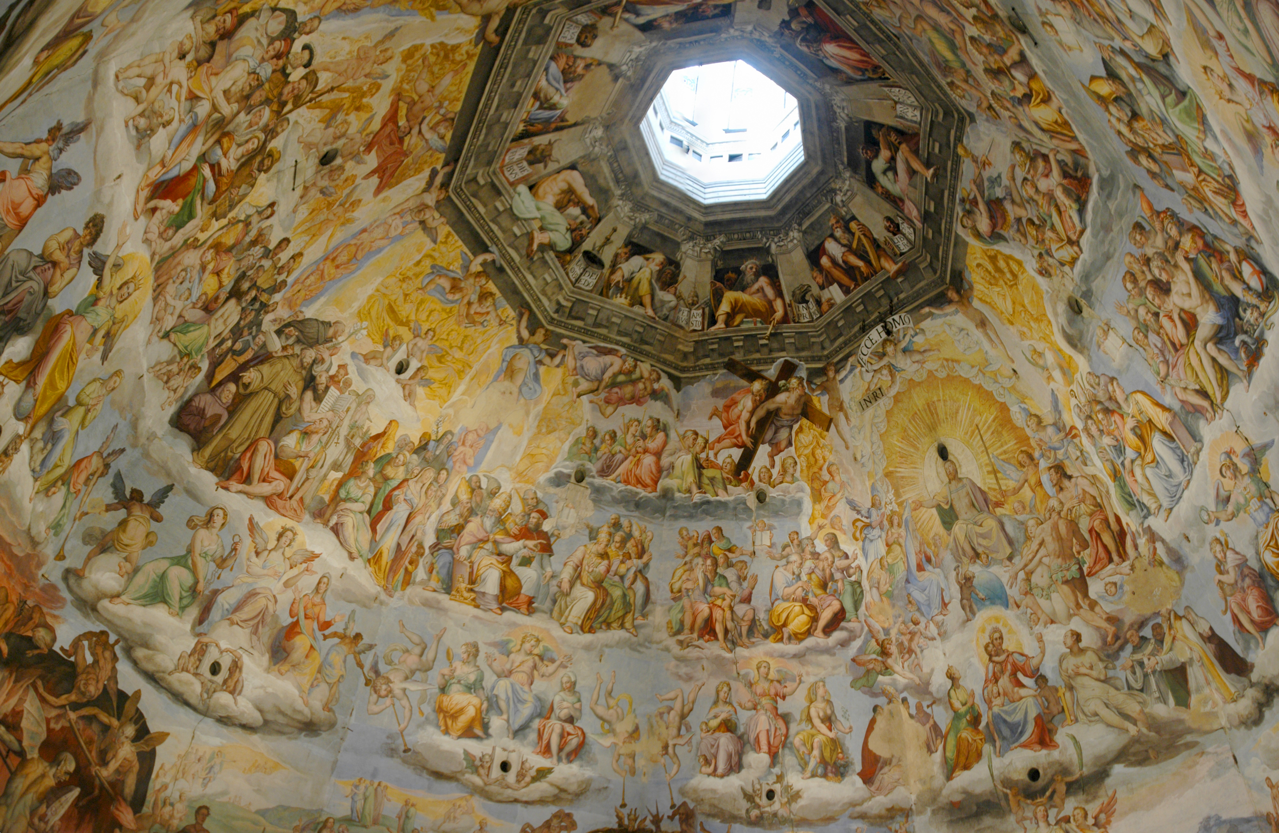
Santa Maria del fiore

Slide 11
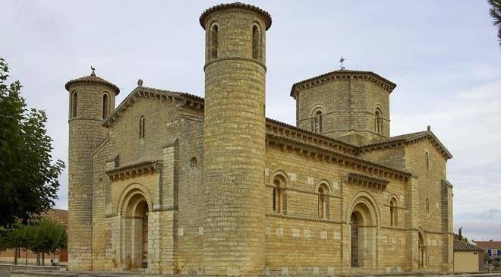
Church of San martín de Frómista

Slide 13
Analyzation
Type and Function: The building is a church and its function is religious
Material: Ashlar walls (type of brick)
Floor Plan: Basilica plan with two circular towers on the front of the building.
Supporting and Supported Elements: Supporting elements are the walls and the columns at the windows. Supported elements are the arches at the doors and windows.
Construction Period: 11th Century, located in Palencia, Spain.
Architectural Style: What do you think?

