Slide 1
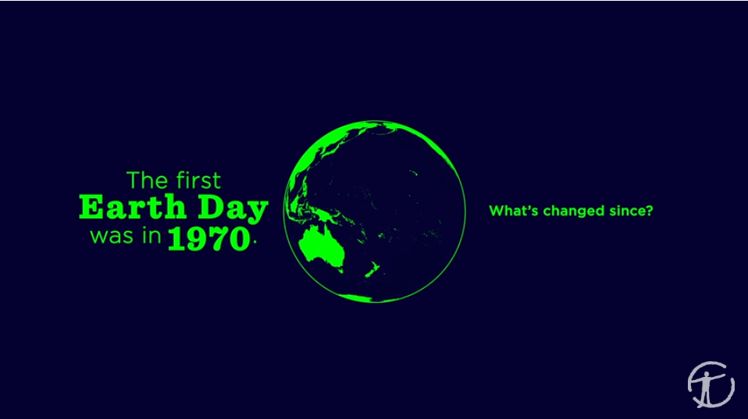
1970 to 2017: What has changed?
https://www.youtube.com/watch?v=xClCgciaSYM

Slide 2

Discussion questions:
What happened to the population since 1970?
  The population has doubled
What is the population now?
  7.5 billion people
How does omitting 2.4 times more carbon dioxide (CO₂) impact the environment?
  Rising temperatures → melting ice → rising sea levels → less fresh water
What is happening to the animals?
  Animal populations are shrinking (declining, decreasing)
Which animals are affected the most? Why do you think this population is declining so drastically?
  Freshwater animals have declined 81%...
  …because rising sea levels reduce and contaminate (pollute) fresh water

Slide 3
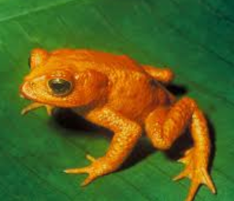
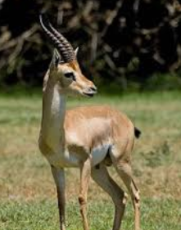
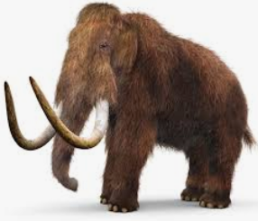
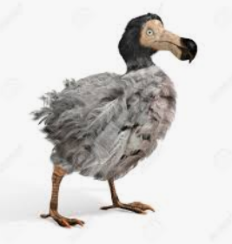
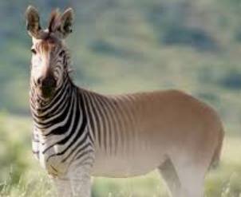
Discussion questions:
Name several animals that have gone extinct
  Golden toad, Saudi gazelle, Woolly Mammoth, Dodo bird, Quagga
List 3 positive changes that have occurred since 1970
  The US Clean Air Act was signed in 1970
  New vehicles are much cleaner, so the ozone layer is stabilizing
  Major pollutants (CO, SO₂ gas, lead) have decreased
  The economy has grown
How would you describe this video?
  E.g.: alarming, eye-opening, optimistic…

Slide 4
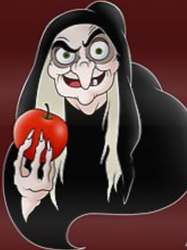
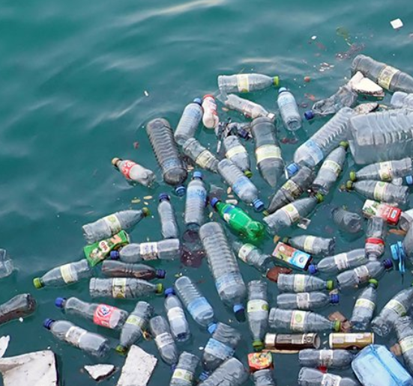
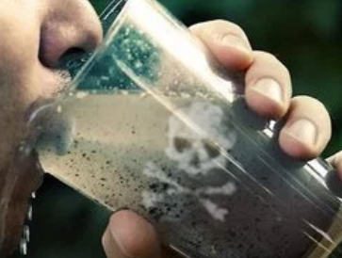
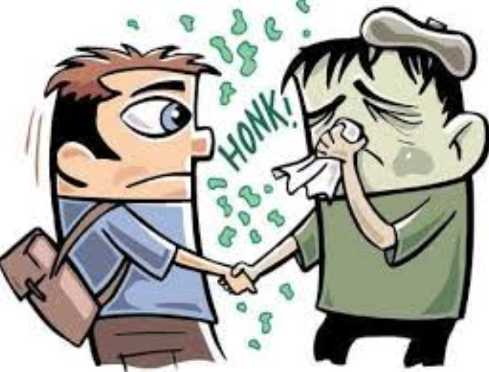
Word Check
Contaminated
Infected
Poisoned
Polluted
Someone got harmed from unsafe food or beverage
Natural element (air, water, land) that has been made dirty and unsafe
Something that was clean before, but now has unsafe substance(s)
Something/one affected by bacteria or virus

Slide 5
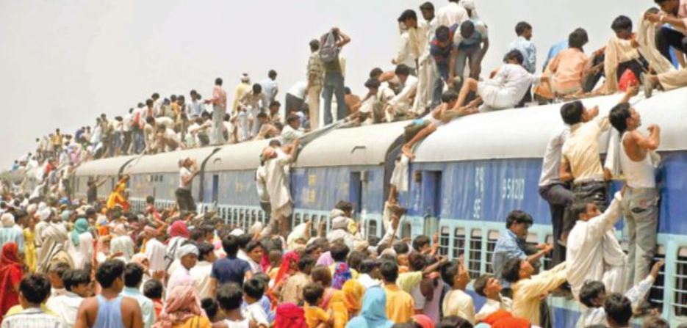
Discussion:
What will the Earth look like in 2100?
What are the biggest environmental problems that we face now?
GROUP WORK:
  Review and discuss your possible solution to overpopulation. Prepare to share your opinion with the class and discuss.

