Slide 1

Example Calculation of MHR and Training Zones
MHR = 220 – Age
MHR = 220 – 22 = 198 bpm
Aerobic Training Zone: 198 x 0.60 = 119 bpm
198 x 0.80 = 158 bpm
119-158 bpm
Anaerobic Training Zone: 198 x 0.80 = 158 bpm
198 x 0.9 = 178 bpm
158-178 bpm

Slide 2

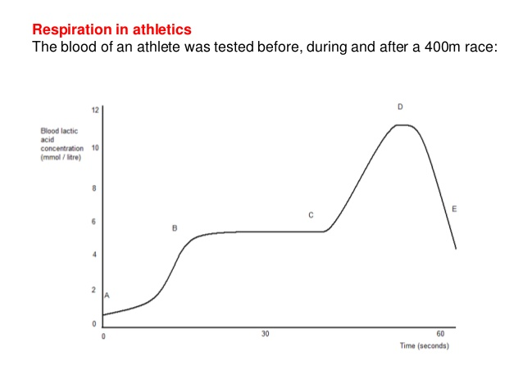
Lactic Acid and Oxygen Debt
Lactic Acid is produced when our body is creating energy anaerobically
  Alternative form of energy production
Oxygen debt – amount of oxygen consumed in recovery above the normal amount consumed during rest
  “Working on borrowed time”
What is Recovery Rate?
https://youtu.be/DGq94gpKEbg
https://youtu.be/40Wp3-ntNis

Slide 3

Principles of Training
FITT Principles
  Frequency – How often?
  Intensity – How hard?
  Time – For how long?
  Type – Which training methods?
  All of these questions must be answered to make a training program!

Slide 4
Other Key Principles
Overload – Fitness can only be improved by overloading your muscles or cardiovascular system
Specificity – Training must be matched to the needs of the sport
Progression – Start slow and gradually increase intensity
Variation – Combine different exercises and training methods
Reversibility – You can lose fitness…if you don’t use it, you lose it!
Moderation – Allow your body time to rest and recover

