Slide 1
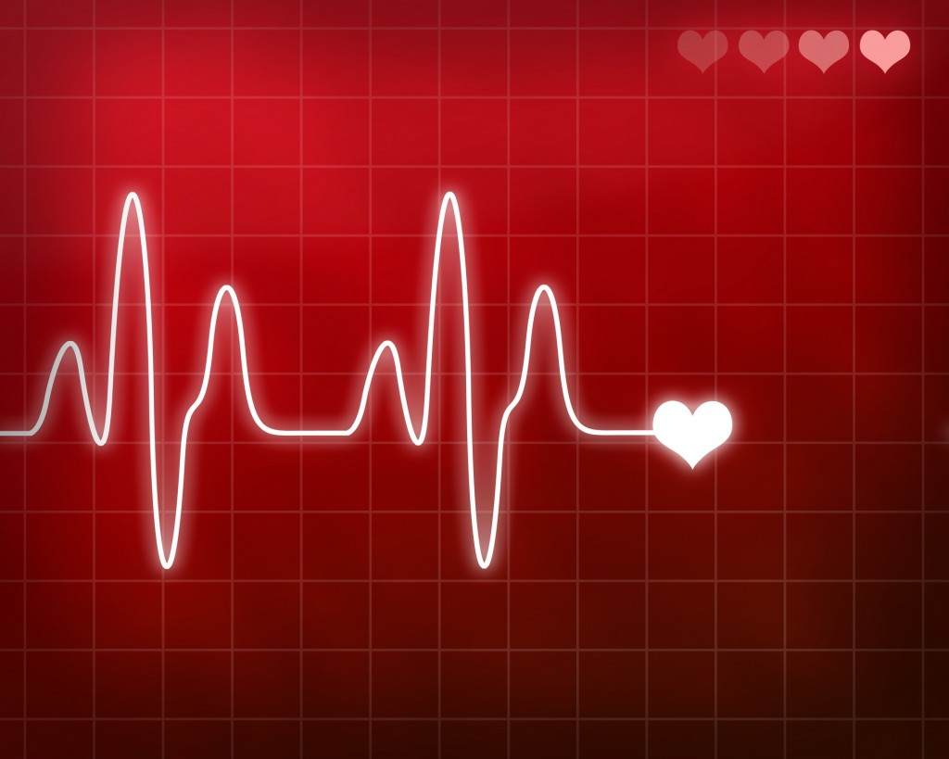
Circulatory Illnesses

Slide 2

What is the strongest muscle in the human body??
Your Heart!!

Slide 3
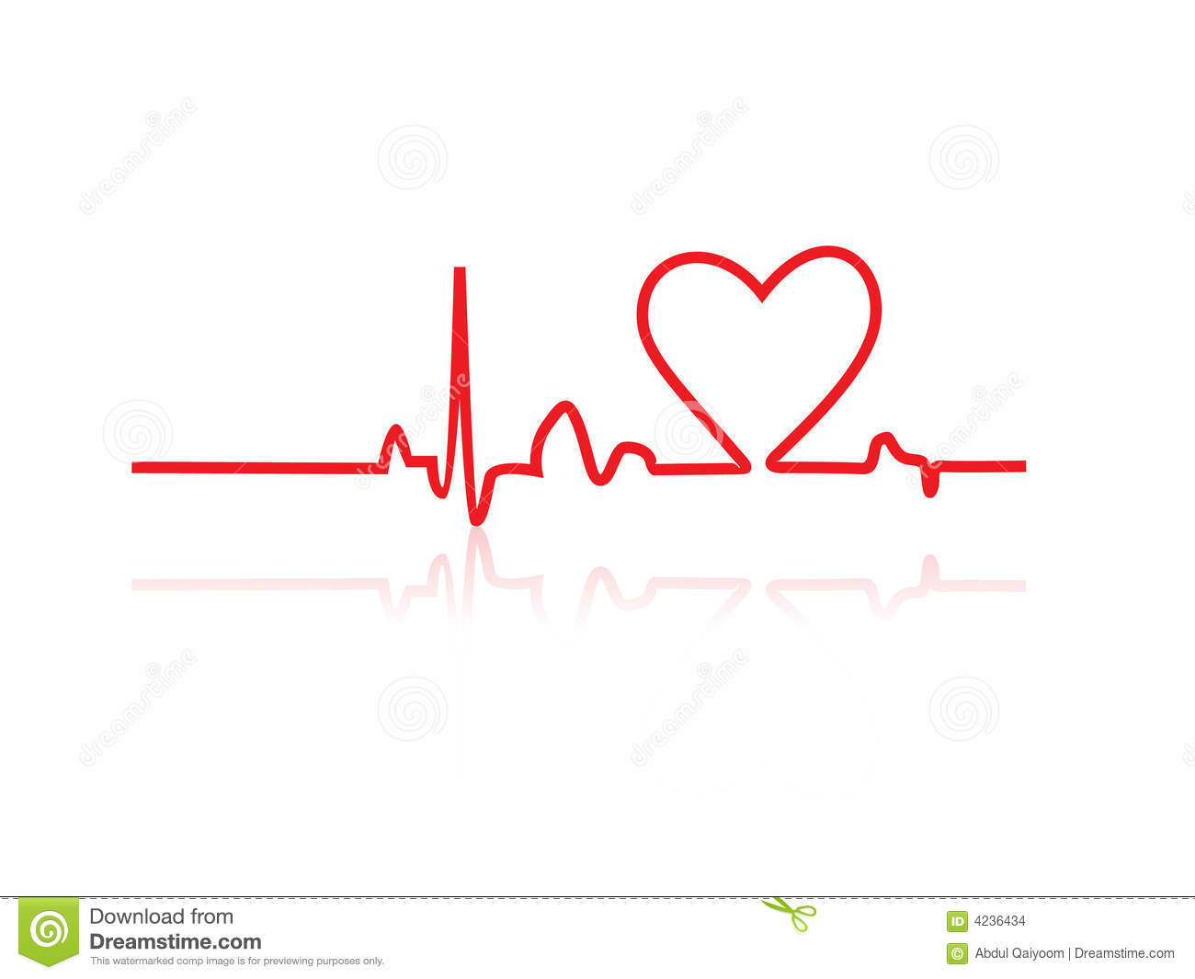
We must take care of it!!
There are many common illnesses in the circulatory system – they all have to do with Malfunctions of the blood vessels, the heart, or the blood itself

Slide 4

But first… some heart trivia!
How many times does your heart beat in a lifetime?
2 and a half billion times!
Avg heart rate is 72 bpm x 60 min
x24 hrs x 365 days
x 75 years (avg)

Slide 5
But first… some heart trivia!
How big is your heart?
The size of your fist!

Slide 6
But first… some heart trivia!
Which day of the week do more people have heart attacks?
Mondays – especially Monday morning,
Statistics show that Monday
morning stress causes an
increase of cortisol levels
which can lead to
heart attacks

Slide 7
But first… some heart trivia!
How many times does your heart recycle your blood each day?
1000x a day

Slide 8

And… a heart riddle!
I have hearts but not other organs.
What am I?
A deck of cards!

Slide 9
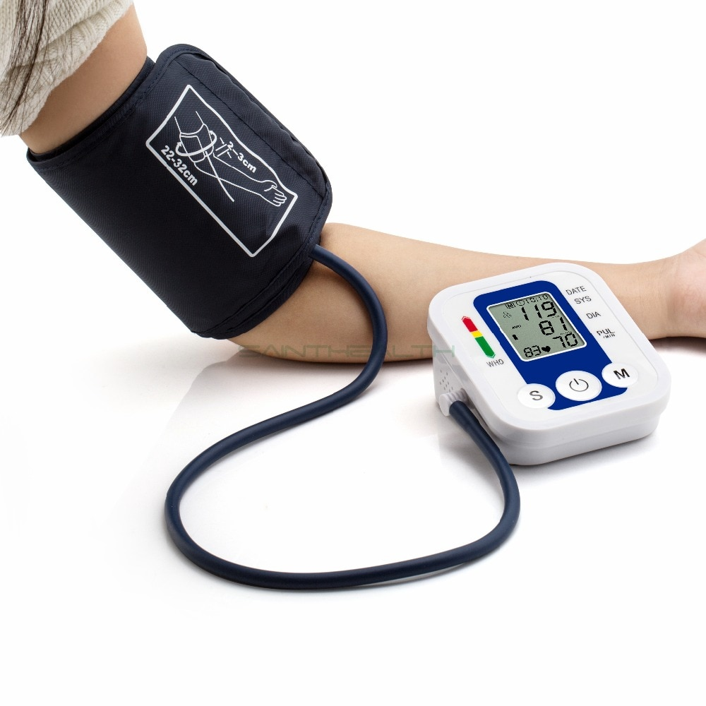
Blood Vessels
High Blood pressure
Blood pressure that exceeds normal ranges (ie force of blood moving through your veins is too high)
Can lead to other serious diseases like stroke, heart attack, etc but no immediate symptoms

Slide 10
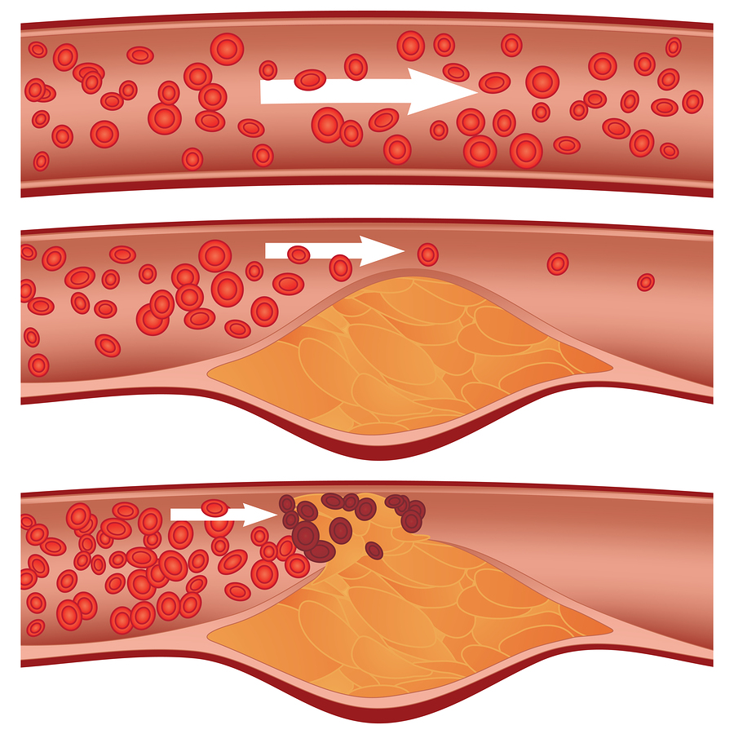
Blood Vessels
Arteriosclerosis
Hardening of the
Arteries – blood
Pressure rises and
Can cause hyper-
tension

Slide 11
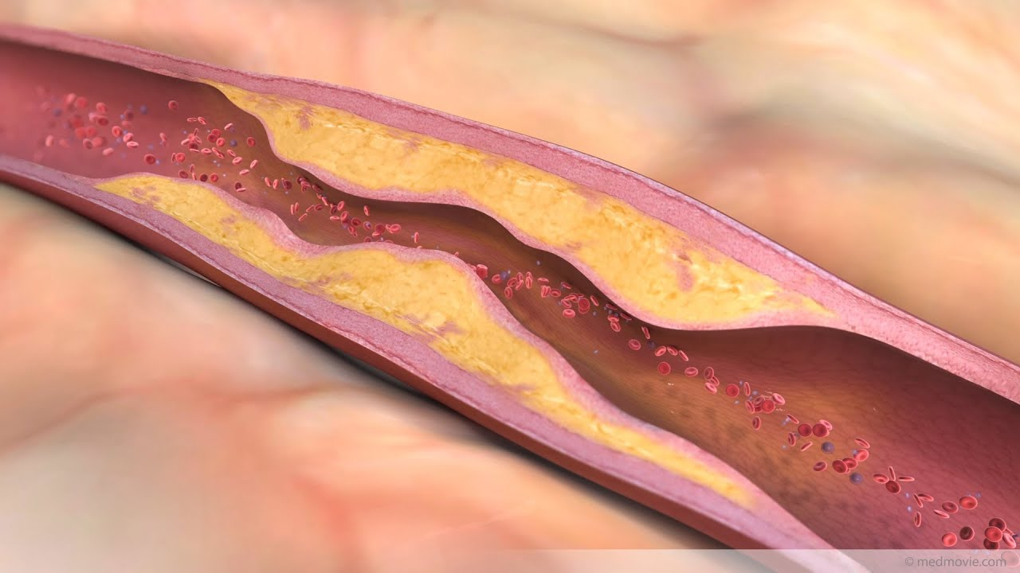
Blood Vessels
Atherosclerosis – cholesterol plaque build up in the internal walls of the arteries which leads to thickening/blockage

Slide 12
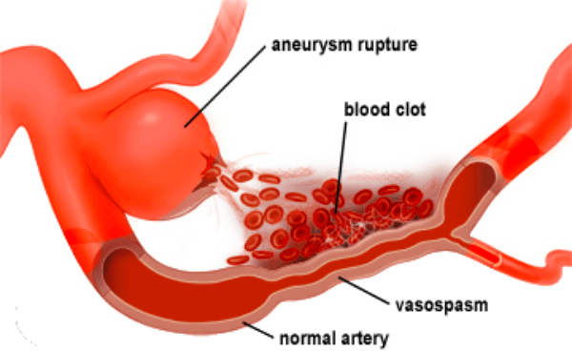
Blood vessels
Aneurism – abnormal dilation of a blood vessel, generally a main artery, and when it ruptures it can cause death

Slide 13
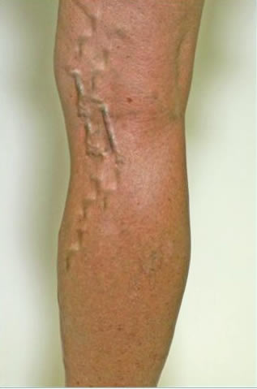
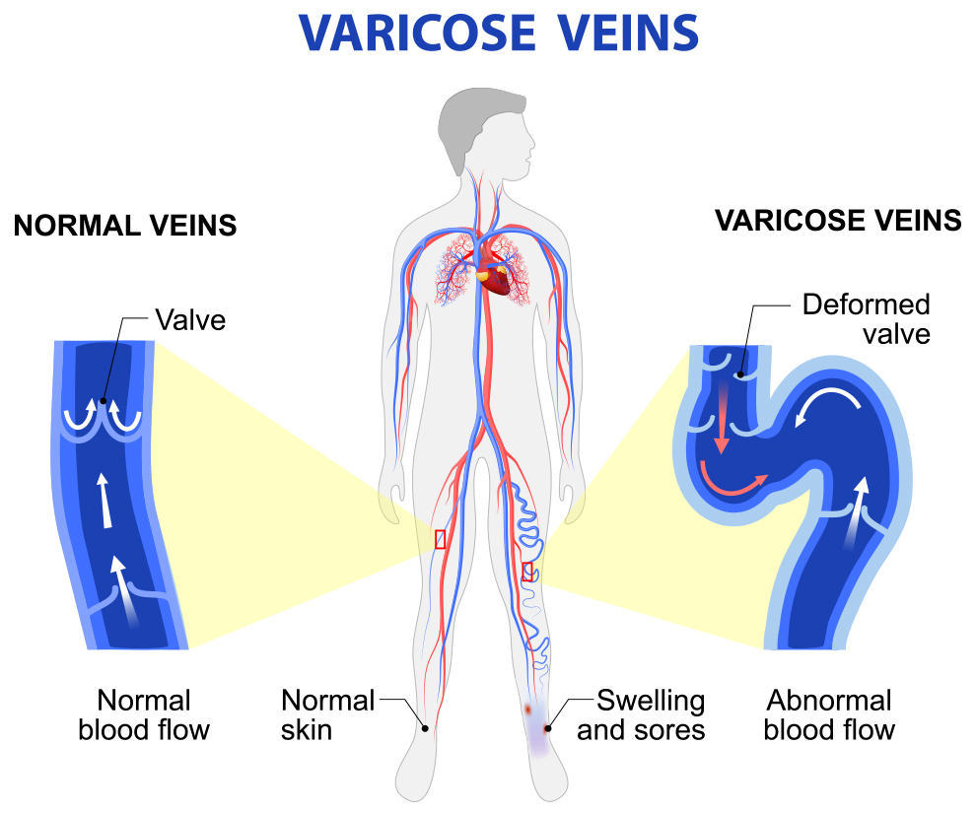
Blood Vessels
Varicose Veins – abnormal dilations of veins caused by the deterioration of venous valves

Slide 14
Heart
Heart Attack – Myocardial infarction
https://www.youtube.com/watch?time_continue=28&v=3_PYnWVoUzM

Slide 15
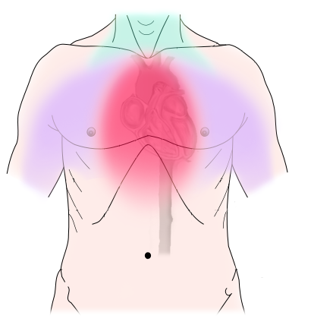
Heart
Angina pectoris – lack of oxygen in myocardium due to plaque build up in coronary arteries when exercise is carried out
Symptoms: sensation of chest pain, squeezing, and pressure

Slide 16
Heart
Heart failure – heart is unable to provide adequate blood flow for the body’s needs
Essentially your heart can’t pump blood as well as a healthy one
Usually happens if you overwork the heart via high blood pressure or heart defects you’ve had since you were young, diabetes etc

Slide 17
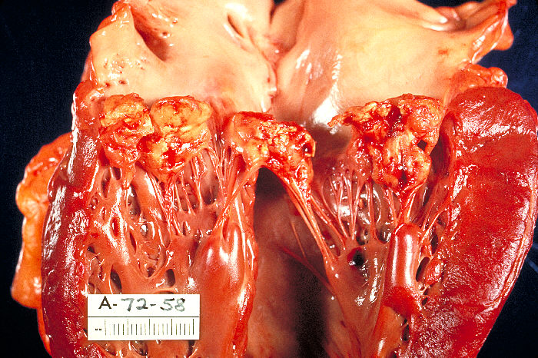
Heart
Endocarditis – inflammation of the endocardium caused by a bacterial infection

Slide 18
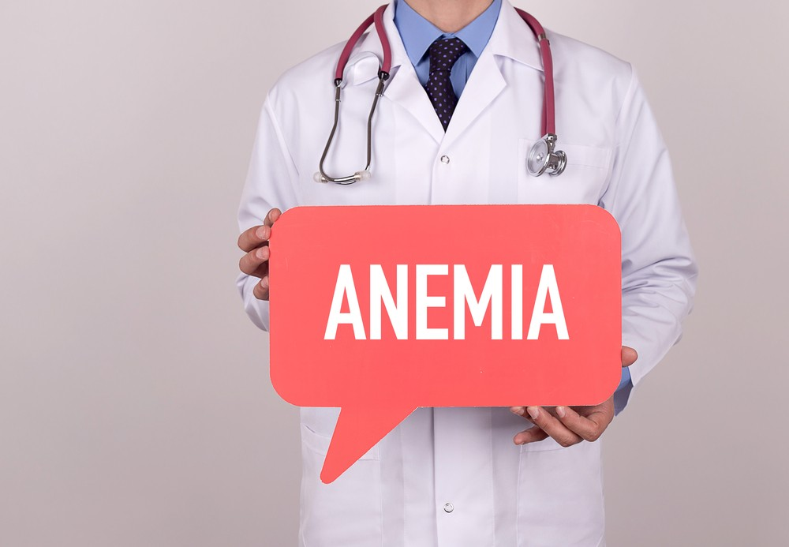
Blood
Anemia – A decrease in the number of red blood cells in the blood or of hemoglobin present
Can cause fatigue, shortness of breath, lack of iron

Slide 19
Blood
Leukemia
https://www.youtube.com/watch?time_continue=2&v=Z3B-AaqjyjE

Slide 20
Blood
Hemophilia – a hereditary disease where patients cannot form blood coagulation
Ie) if they had a cut or something they would continue to bleed out until death
Very popular in royal families

Slide 21
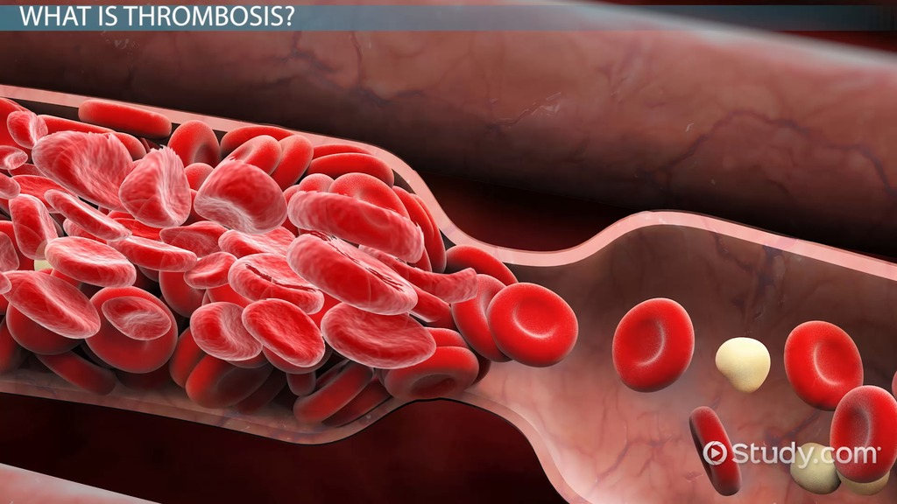
Blood
Thrombosis – the formation of a blood clot inside an artery

Slide 22
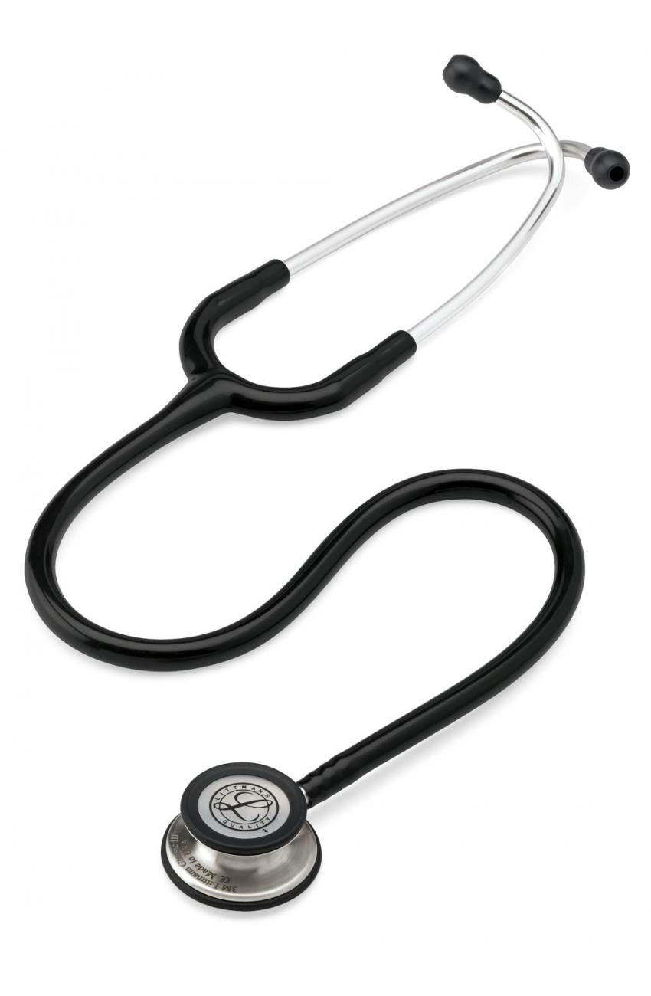
DOCTOR!!

Slide 23
Peter has a history of hypertension in his family and currently has really high cholesterol with frequent chest pain. Doctors are concerned so they have been watching him. What disease would an electrocardiogram device diagnose?

Slide 25
BPM 140/90

Slide 26
Cole’s parents are very overprotective with him because his family has a history of certain hereditary diseases. They are concerned with him accidentally cutting himself on something and have fool-proofed their house with bubble wrap.

Slide 27
Kyle has been running sprints recently in the mountainside to train for his upcoming race. But one day he reported feeling a very big sense of heaviness in his chest after running. As his doctor, what do you think he most likely has?

Slide 28
During her routine check-up at the doctor’s office, Mary had her blood drawn and scientists noted a significant decrease in her number of red blood cells. They were slightly concerned and wanted to do further tests to check for ___________.

Slide 29
Sarah was born with a heart defect as a child and her family ahs a history of diabetes. Because of this doctors are worried about potential _____________ later on in life and have put her on a strict diet as well as prescribed a certain amount of exercise a week.

Slide 31
Abby hasn’t been eating correctly all year. She is lacking a lot of essential nutrients and metals that her body needs. What key nutrient could she be missing?
What circulatory system disease could arise from this lifestyle choice?

Slide 33
Torrey was rushed to the emergency room after experiencing an intense, acute headache followed by symptoms of vomiting, lack of balance/coordination, and confusion with mental awareness. The doctors rushed to give her a brain scan because they were loking for signs of a(n)……

