Slide 1
The environment and climate change

Slide 2
What is the environment?
The environment is something that should be very familiar to you.
It is everything that makes up our surroundings and it is what allows us to live on earth.
There are many different types of environments, can you name some?

Slide 3
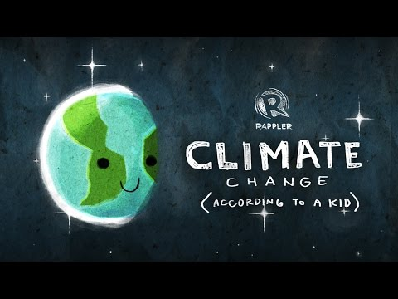
What is climate change?

Slide 4
https://happylearning.tv/en/climate-change/

Slide 5
Answer questions in pairs and prepare to share!
Remember, You must speak in english!

Slide 6
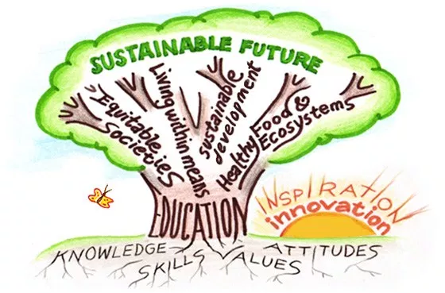
Questions
How important is it to take care of the natural world?
Is it important to learn about the environment at school? Why?/ Why not?
Do you think some animal species are more intelligent than humans? Which ones?
Use your notes from the videos I showed you to help answer these questions!

Slide 7
How important is it to take care of the natural world?
It is very important to take care of the natural world for a number of reasons. For starters we only have one world, meaning we only have one chance to take care of this world.
It is our only home, so we must conserve this world to the best of our ability.
We live off of the natural world, we depend on it to survive because it provides us with nutrients from vegetables and fruits, it provides us water that we need to live, and of course it allows us the ability to breath.

Slide 8
Is it important to learn about the environment at school? Why?/ Why not?
It is very important because it is one of the most effective ways to raise awareness around the topic of environmental protection.
Climate change has already begun, and certain places in the world are already seeing extreme changes in temperatures, climates, and sea levels.
Some effects of climate change you won’t see in your day to day life because different places are affected in different ways.

Slide 9
What can we do to help protect our environment and help prevent climate change?

Slide 10
What can we do to protect the environment?
Recycle your products whenever you can.
  Instead of using plastic water bottles, buy a reusable one instead.
Take shorter showers to conserve water.
Use both sides of paper!
Use natural light so you can waste less energy.
Tell your friends about the negative effects of climate change!

Slide 11
Do you think some animal species are more intelligent than humans? Which ones?
It is very hard to compare the intelligence of an animal species to humans.
Every type of animal species in this world lives for different reasons and have different lives.
I will now show some experiments where animals were tested to show their intelligence.

Slide 12
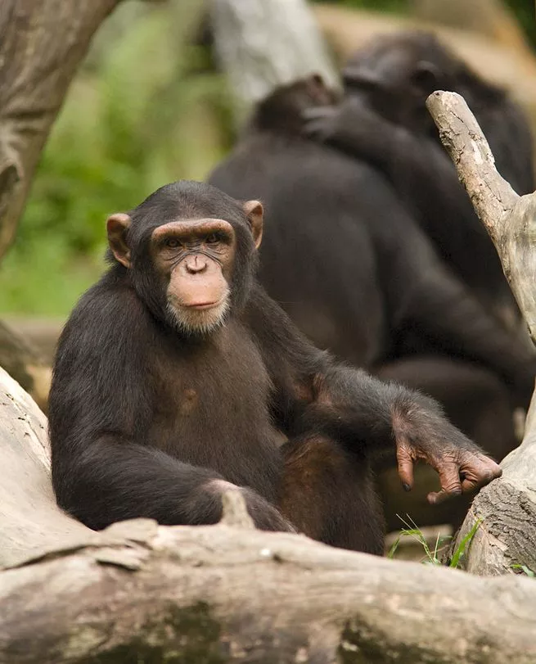
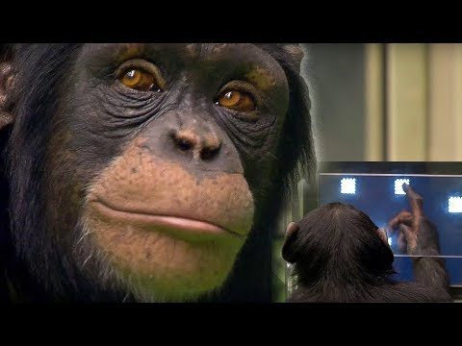
CHimpanzees

Slide 13
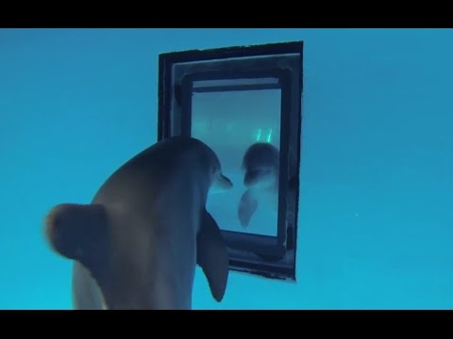
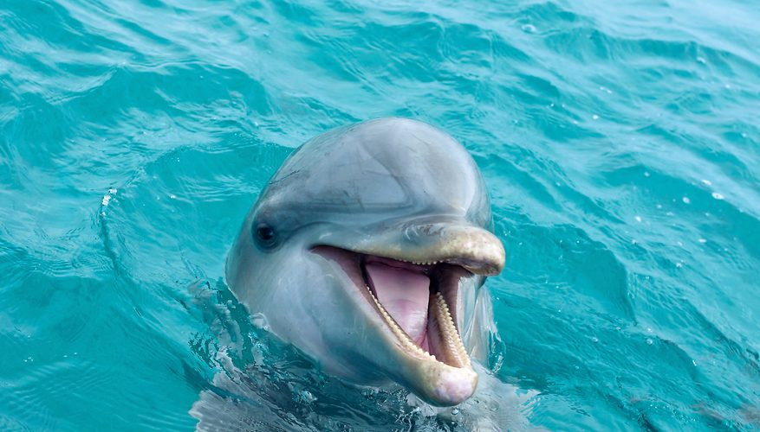
Dolphins

Slide 14
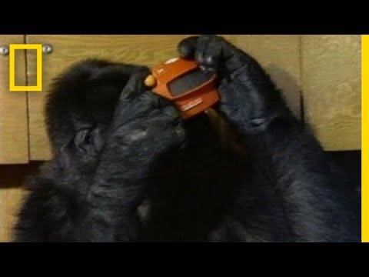
“Koko” The gorilla
Koko was a female gorilla that was born in the San Francisco Zoo.
She was born on July 4, 1971 - June 19, 2018
Koko understood approximately 2,000 words of spoken english.
According to her trainer, Francine Patterson, Koko was able to use 1,000 signs of “Gorilla sign language.”

Slide 15
I hope you learned something new today about our environment!

