Slide 1

Unit 4
Industrial Revolution

Slide 2

Industrial Revolution
INDUSTRIAL REVOLUTION: ~100 year old process that began in GB around 1750, through which advances in technology led to dramatic economical changes.
Agriculture became less important, and industrial capitalism emerged.
Causes of the Industrial Revolution
Population growth
Agricultural holdings replaced family owned farms
Mechanization (e.g. steel plough & harvester)
Fertilizers & crop rotation
Agricultural revolution
Increased trade
Foreign & domestic trade increased
Technological advances
Machine age & steam engine (James Watt)

Slide 3
Industrial Revolution
INDUSTRIAL REVOLUTION: ~100 year old process that began in GB around 1750, through which advances in technology led to dramatic economical changes.
Agriculture became less important, and industrial capitalism emerged.
Consequences of the Industrial Revolution
Population growth
Increased demand & more workers
Agricultural revolution
Increase in food, raw materials, population & capital
Increased trade
Trade profits reinvested into industry
Mechanization
Cheaper and more efficient production

Slide 4
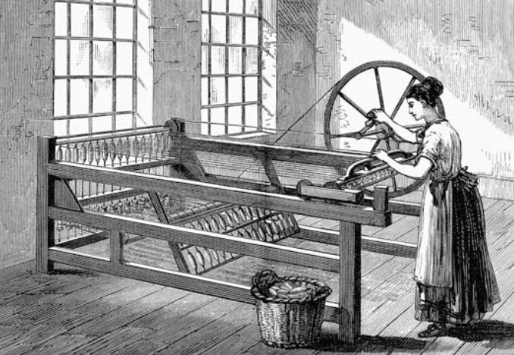
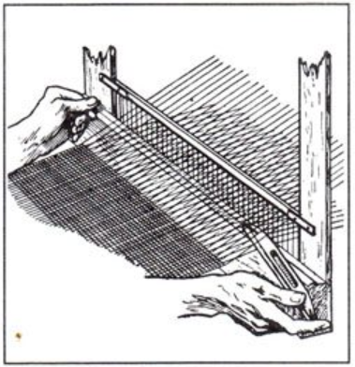
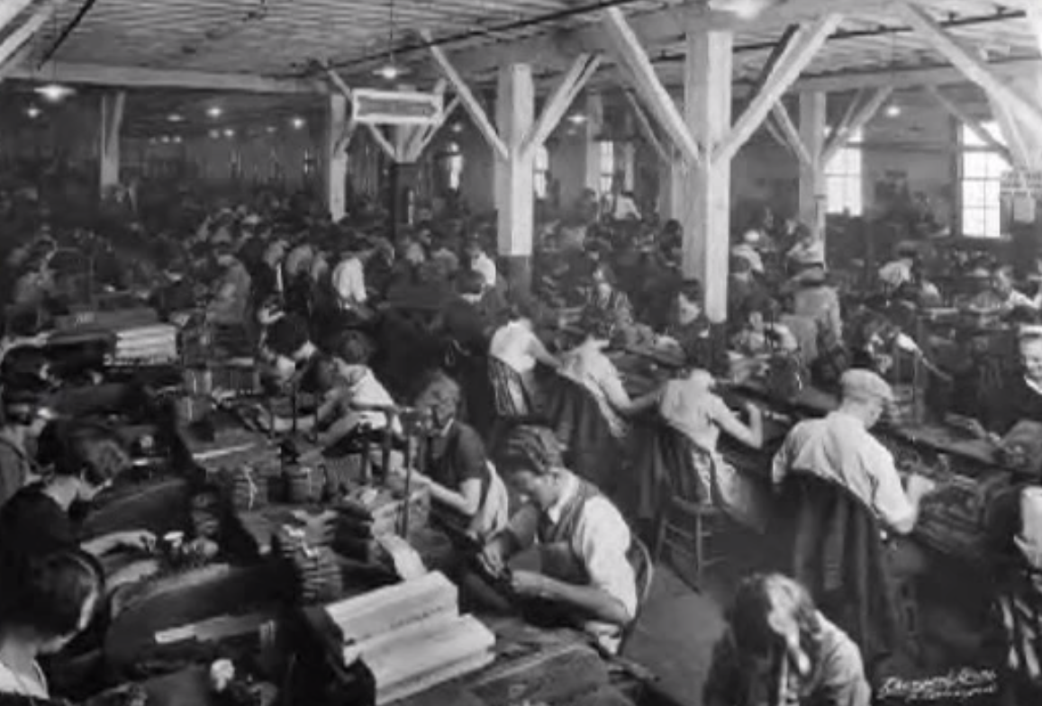
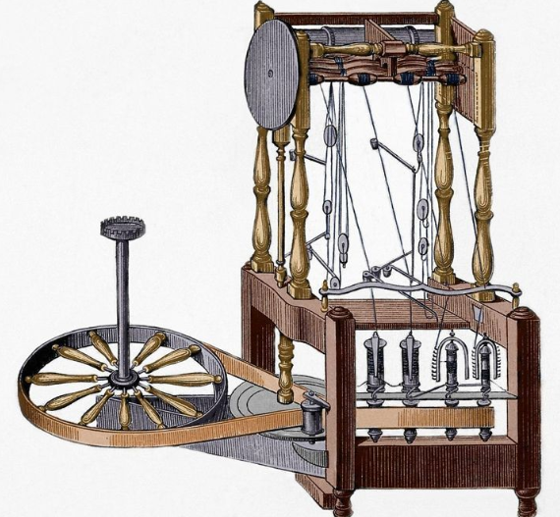
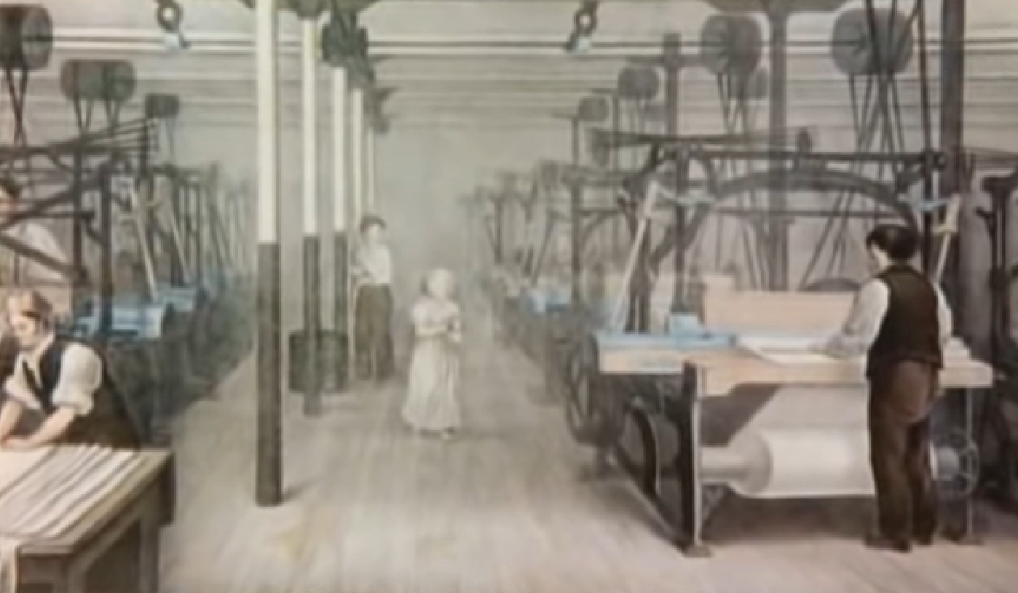
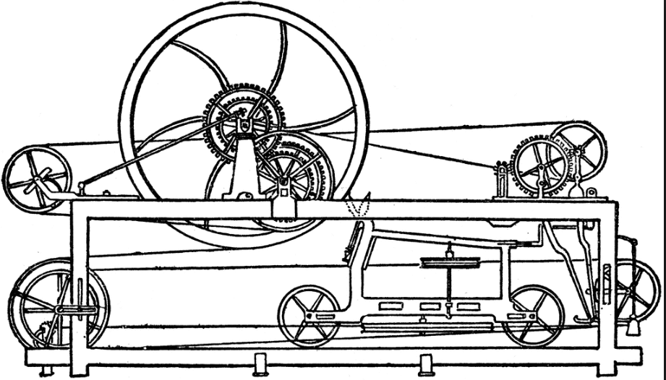
Key Industries Driving Economic Growth
Textile Industry Innovations
Flying Shuttle
Spinning Jenny & Spinning Mule
Factory & Power Weaving Loom
Water Frame

Slide 5
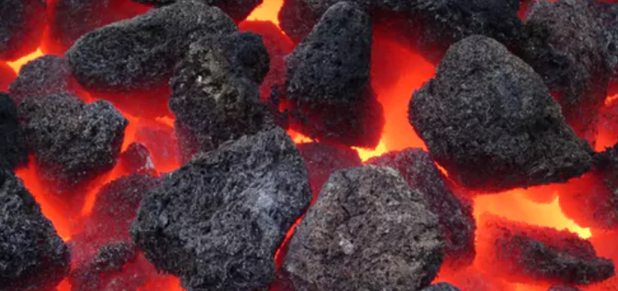
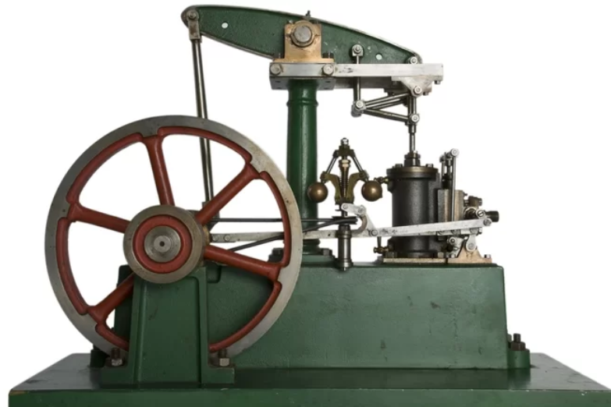
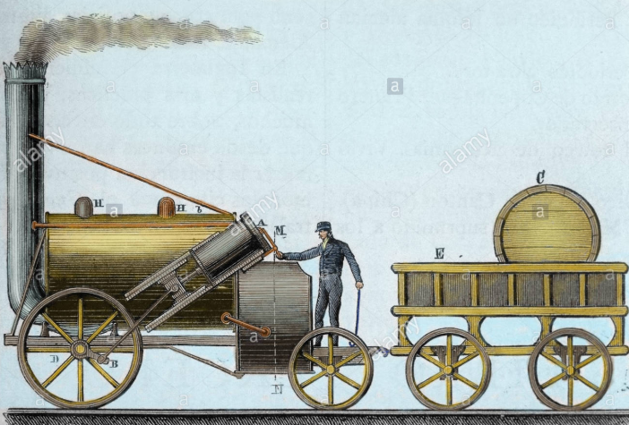
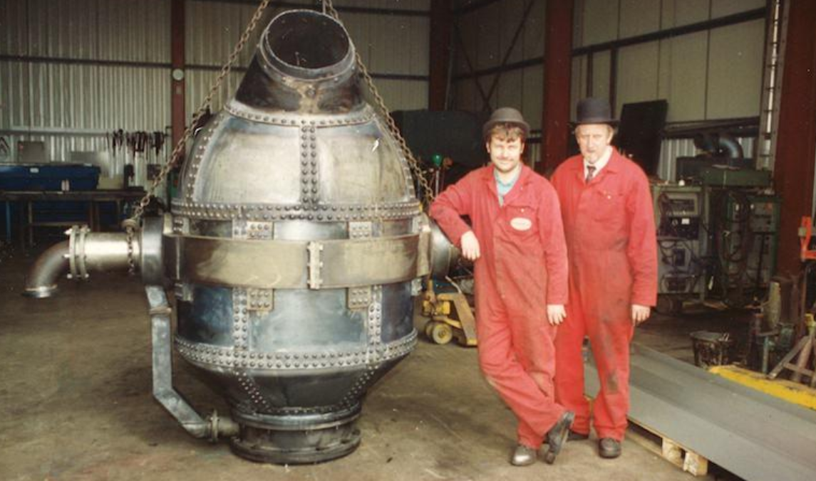
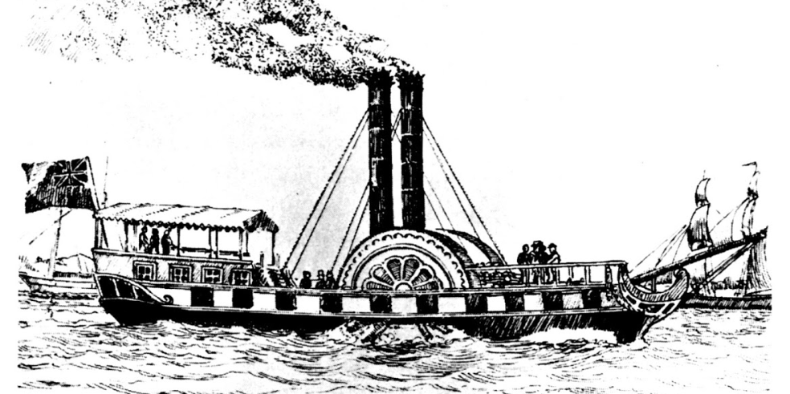
Key Industries Driving Economic Growth
Iron & Steel
Transport
Used in agriculture, transport, industry, construction
Improvements to waterways & roads
Coal energy
Bessemer converter

Slide 6





Industrialization in the 19th century
Conditions necessary for industrialization
Reasons for slower
industrialization in Spain
Abundance of coal & iron
Poor quality of coal
Capital investment ($$$$)
Low domestic capital ($)
Growth of population & demand
Low domestic income & demand
Railroads & transport
Important new industries in Spain
Trade links (US)
Cotton
Iron & steel

