Slide 1

Unit 4
Class Based Society

Slide 2





18th Cent: Class Based Society
Society based on family
Based on wealth & job
French Revolution: legally abolished the estates system
Industrial Revolution: rise of bourgeoisie power & the working class
Upper Class:
Wealthy bourgeoisie
Nobility
Middle Class:
Civil servants, lawyers, doctors
Small merchants & craftsmen
Small farmers
Working Class:
Proletariat (industrial workers)
Tenant farmers
Laborers
Upper Class:
Large land owners
Bankers & businessmen
Middle Class:
Civil servants, lawyers, doctors, architects
Military
Working Class:
Peasants, tenant farmers
Laborers
Limited proletariat

Slide 3
Industrial Life
Urban city growth
Industrial working conditions
People moved from countryside to cities to work
Increasing differences b/w bourgeoisie & working class living conditions
Population & city growth
Very low wages leading to child labor
New buildings & infrastructure (e.g. factories & train stations)
Extremely long and exhausting work day
New neighborhoods for middle & working class
Chronic illnesses & accidents due to lack of safety and hygiene
Ensanches in Madrid and Barcelona
No worker rights; no right to protest, strike, or discuss their conditions

Slide 4
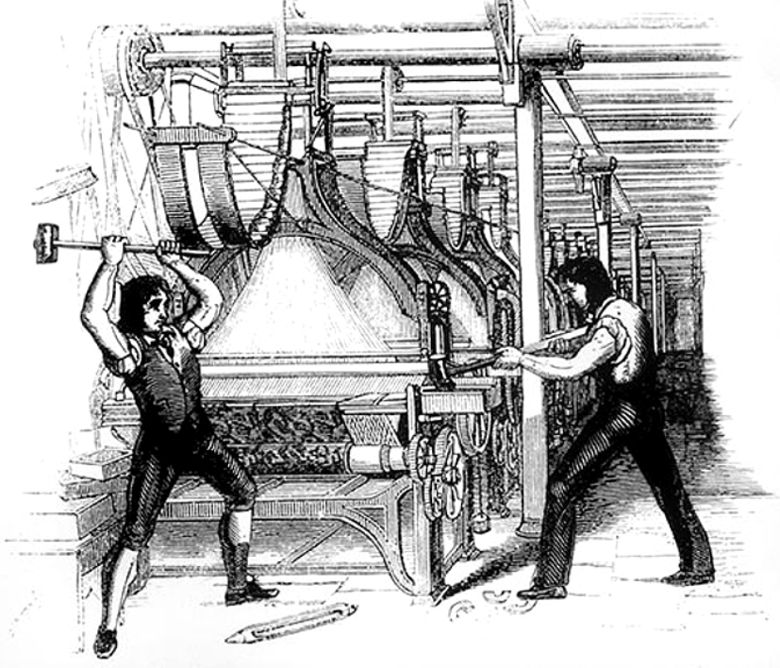
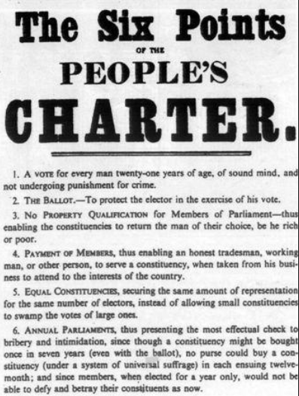
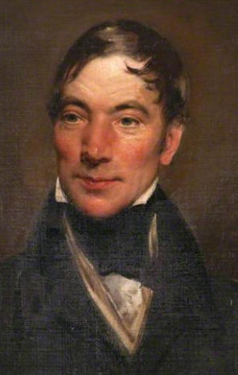
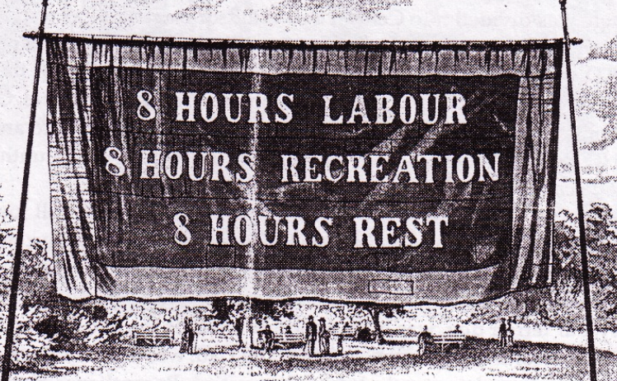
First Working Class Movements
In the early 19th century, Great Britain proletariat began to organize itself to protest against factory owners and terrible working conditions.
Luddites (1811)
Trade Unions (1830s)
Chartists (1838 - 1848)
Utopian Socialism

Slide 5

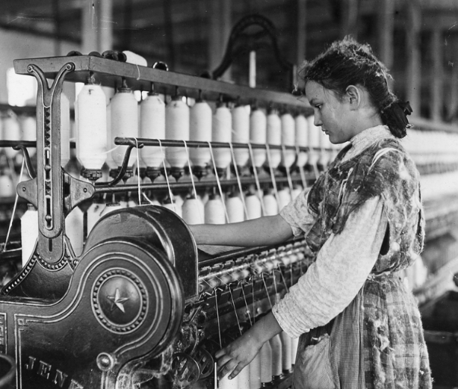


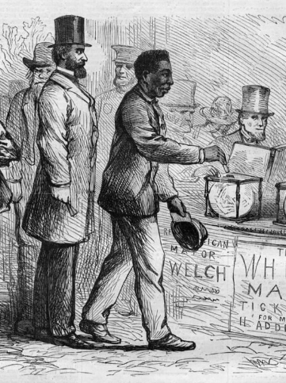
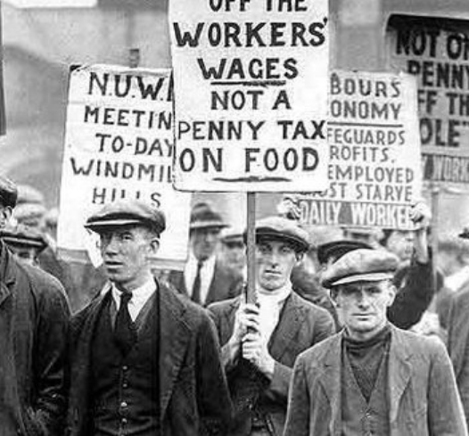
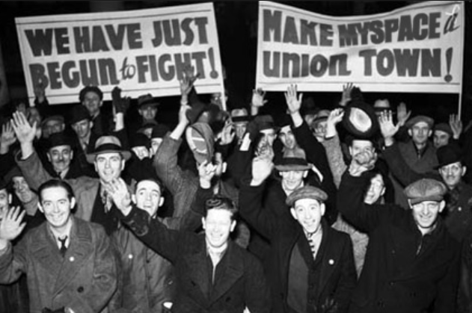
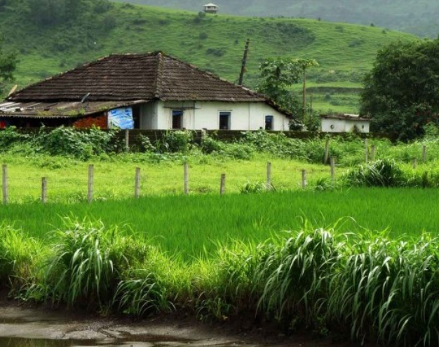
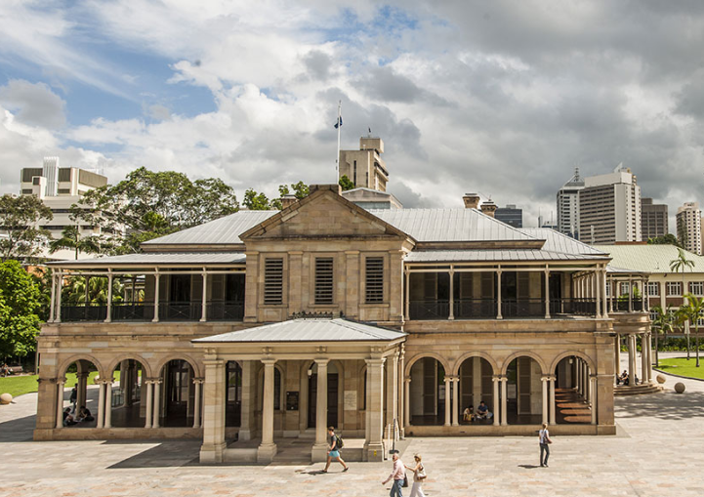
Desired Worker Reforms in the 19th Cent
Which are labor reforms and which are political reforms?
Better safety & hygiene
No child labor
Shorter days
Higher wages
Universal suffrage
Right to strike & protest
Freedom of association
No property requirement
Government representation

Slide 6
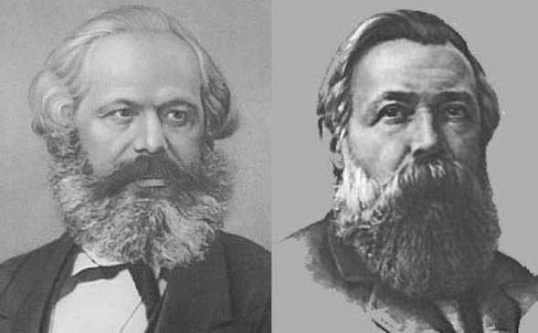
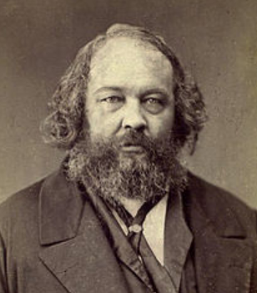
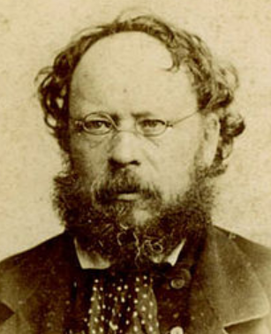
Revolutionary Ideologies
Marxism / Socialism
Anarchy
Class struggle
Supported a social revolution to overthrow capitalism
Working class dictatorship
Individual freedom
Communist economy
Direct action
Socialized means of production
Equal communist society
Abolition of private property
Marx
Engels
Bakunin
Prudhon

Slide 7
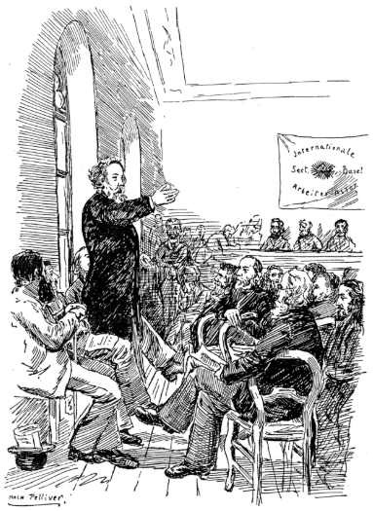
The International
The First International (London, 1864):
Marxists, trade unions, anarchists
Supported collective ownership of production, trade unions, and workers’ rights
Dissolved in 1876 due to Marxist & anarchist disagreements
The Second International (Paris, 1889):
Only socialist parties (no anarchists or trade unions)
8 hour working day
May 1st as International Workers’ Day

