Slide 1


Let’s talk careers!

Slide 2

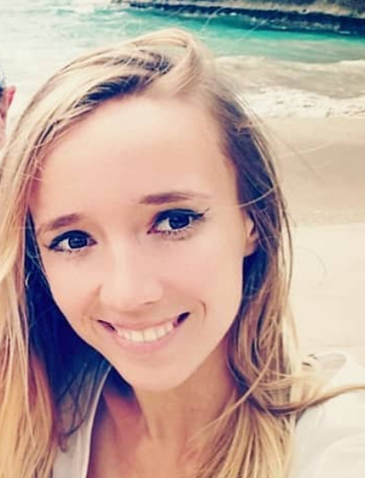
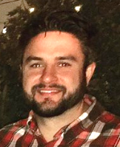
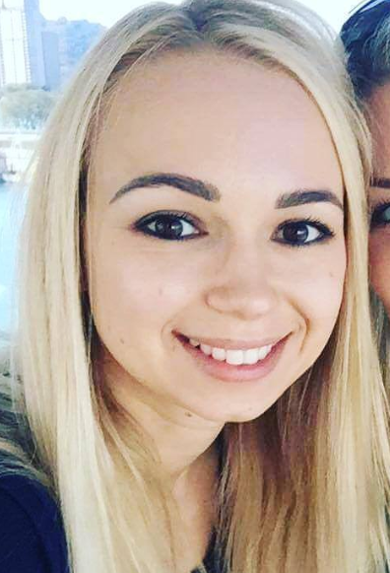
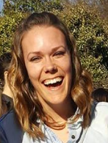
What is this job??
Stacey works with 1st grade students. They learn to read, write, and solve very basic math problems. She usually works from 6am till 3pm. (Teacher)
(Teacher)
Daria investigates political and economical issues of her state and writes exposé articles in a local newspaper. (Journalist)
(Journalist)
Matt is responsible for analyzing his company’s revenues, costs, budgets, and other monetary information. He has a team of global colleagues to help consolidate the data and make sure that it is accurate. (Finance Manager)
(Finance Manager)
Victoria designs commercial and residential buildings. She uses a program called CAD to create 3D models on her computer. (Architect / Engineer)
(Architect / Engineer)
Jessica helps connect people looking for a job with employers who have job vacancies. She calls potential candidates and sets up their interviews if they meet the required experience criteria. (Recruiter)
(Recruiter)

Slide 3


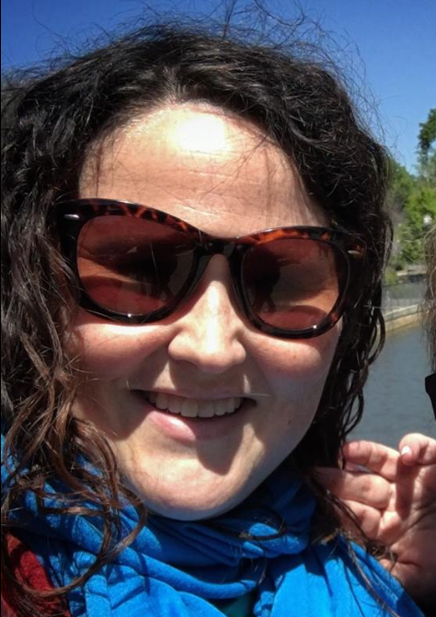

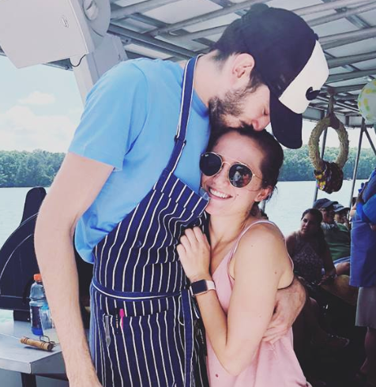
What is this job??
Lindsay works for a fabrics company. She is responsible for marketing and distributing her products to clients like hotels and design firms. (Salesperson)
(Salesperson)
Aryaz works with different team members on a specific project. His job is to make sure that the project is on track, everyone completes their tasks, and the project stays on time. (Project Manager)
(Project Manager)
Lauren develops creative materials for new products, such as advertising, packaging, and in-store displays. She uses Photoshop and Illustrator to make her work unique and attention-grabbing. (Graphic Designer)
(Graphic Designer)
Alex works with different companies to help them solve business problems. He travels often to meet with his clients and discuss their progress. (Consultant)
(Consultant)
Andrea and Z own a restaurant. Andrea manages the business side, and Z manages all the work in the kitchen. (Restaurant Manager and Chef)
(Restaurant Manager and Chef)

Slide 4

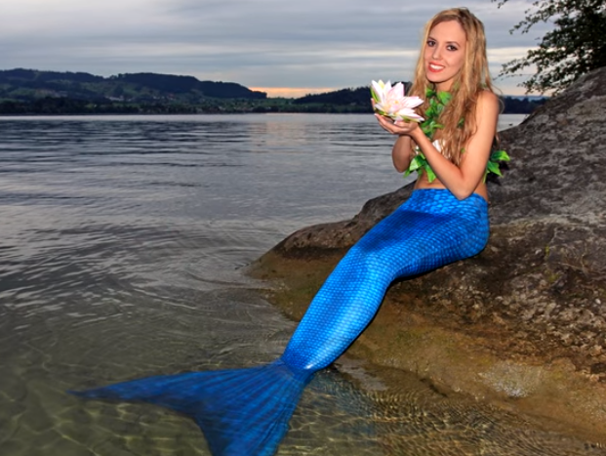



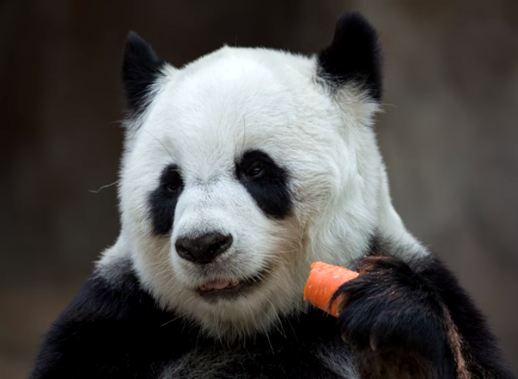
The world’s most unusual jobs
https://www.youtube.com/watch?v=NTUpb7BOJ7g
Which job is the most…
adorable
desirable
creative
hazardous
rewarding
challenging
well-paid
enjoyable

Slide 5
What is your ideal job?
Work in pairs to write your ideal job description.
Be creative! It can be anything ☺
Think about:
Main Responsibilities
Work Environment
Schedule
Location
Benefits
Work Hours
Coworkers
Salary
Requirements

Slide 6
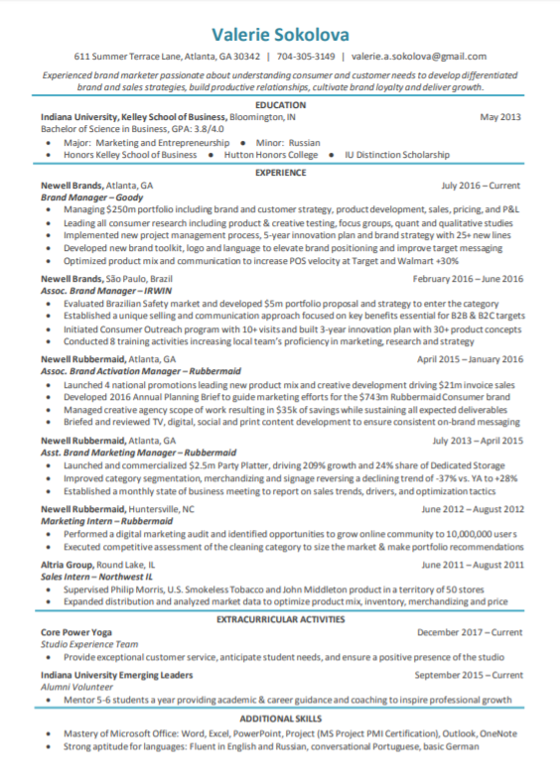
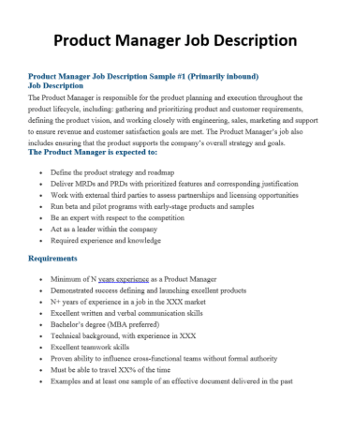
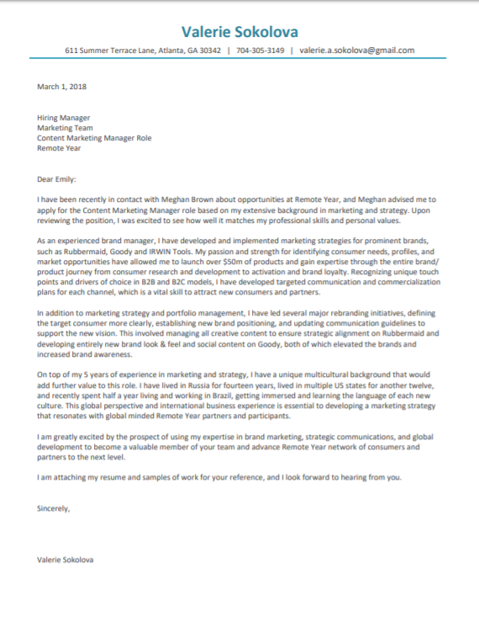
Job search process in the US
YOU
COMPANY
Recruiter

Slide 7
Resume
Contact info
Brief personal statement
Education
  Schools, degrees, scholarships
Relevant experience
  Companies, titles, responsibilities
Extracurricular activities
  Volunteering, clubs, organizations
Additional skills
  Languages, certifications

Slide 8
Cover Letter
Contact info
Date
To whom it is addressed
Body of the letter
  How you know about the job
  Why you are qualified
  Next steps
Signature

Slide 9
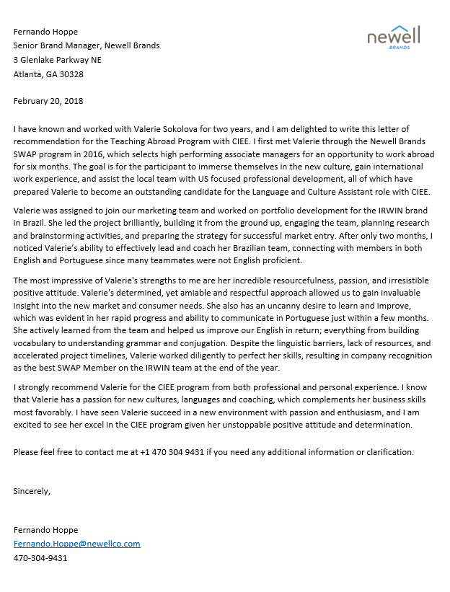
Recommendation Letter
Contact info
Date
To whom it is addressed
Body of the letter
  How the recommender knows you
  Specific examples of your achievements and best professional qualities
  Summary of why you are the perfect candidate for the job
  Invitation to reach out
Signature

Slide 10

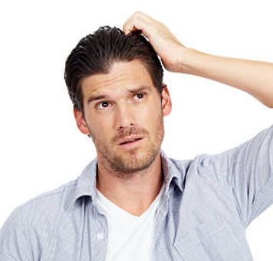

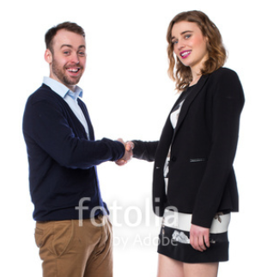
Typical interview questions
Tell me about yourself
Background, education, why you want this job
Previous experience
Tell me about a time when you worked with…
Hypothetical situations
What would you do if…
Check for knowledge & culture fit
Why do you want to work for our company
What is your experience level with…

Slide 11
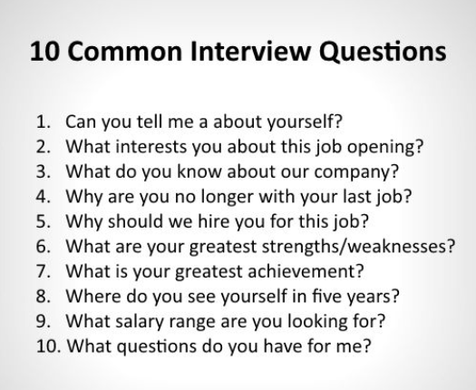
Typical interview questions

Slide 12
Additional activities
Recruiters sharing helpful interview tips:
  https://www.youtube.com/watch?v=gmss6bTs1ec
Job interview clip:
  https://www.youtube.com/watch?v=7xeQJQmdEb4
Interview for your dream job

