Slide 1

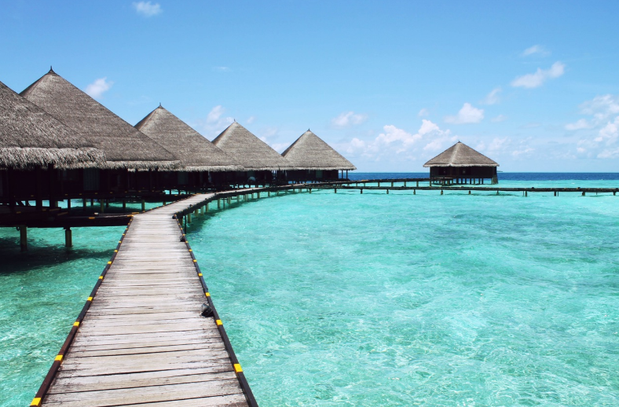
Let’s get away

Slide 2





Common conversation phrases
Initiating
the story
Responding positively
Responding negatively
How was it?
How did it go?
Tell me about…
That’s amazing!
That’s awesome!
That’s great
Sounds wonderful
Fantastic
I love it
Nice
That’s terrible
That’s awful
Sorry to hear that
Yikes!
What a pity
You have my sympathy
Expressing surprise
Really?
Are you serious?
That’s crazy
No way!
    Oh my god / gosh / goodness
    Wow

Slide 3
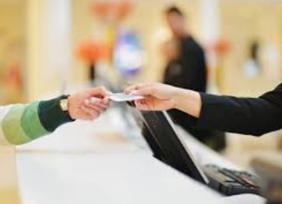
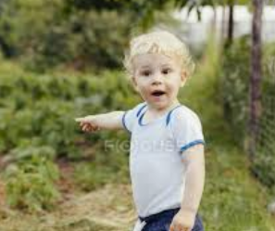
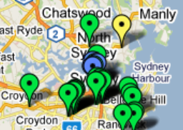
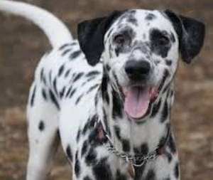
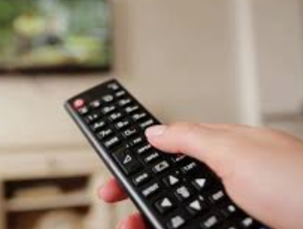
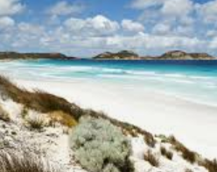
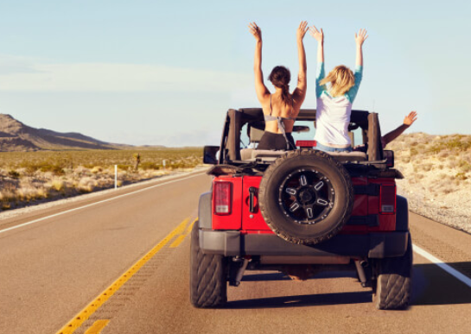
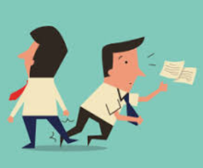

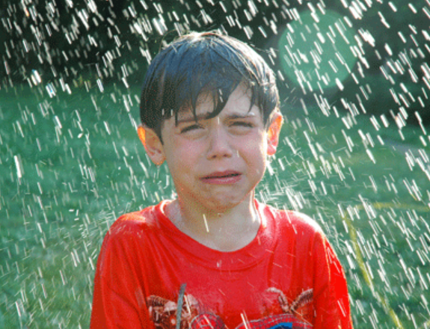
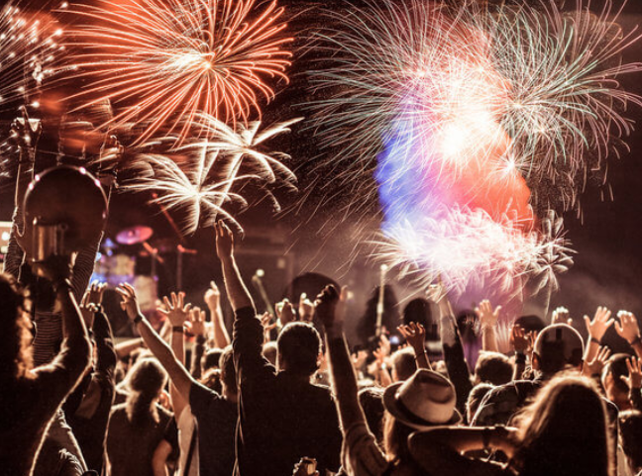

Close… But different
Check out
Check this out!
Nice spots
Nice spots!
Check out
Spot
Remote control
Remote location
Went on a trip
Got tripped
Remote
Trip
Soak up the sun
Get soaked
Celebrating a holiday
Going on holiday
Soak
Holiday

Slide 4
Mallorca adventures
Nice
Awesome
Terrible
Remote location
Nice spots
Trip
Check out
Amazing
Fantastic
Soak up the sun
Vacation
Derek: Hey man, how did your vacation go?
Nate: It was awesome! I went on a trip to this very remote location in Mallorca away from all tourist attractions, so it was calm and peaceful.
Derek: Nice. What did you do out there?
Nate: Mostly relaxed and soaked up the sun on the beach. Also checked out a few local restaurants.
Derek: Did you find any nice spots?
Nate: Yeah! The seafood there is amazing. All local restaurants are fantastic. The only bad thing that happened while I was there is that I tripped on the walk home and sprained my ankle.
Derek: Yikes, sounds terrible! Hope you are feeling better now.
Nate: Much better now, thanks!

Slide 5
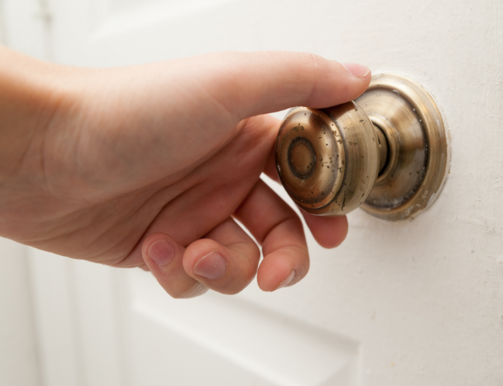
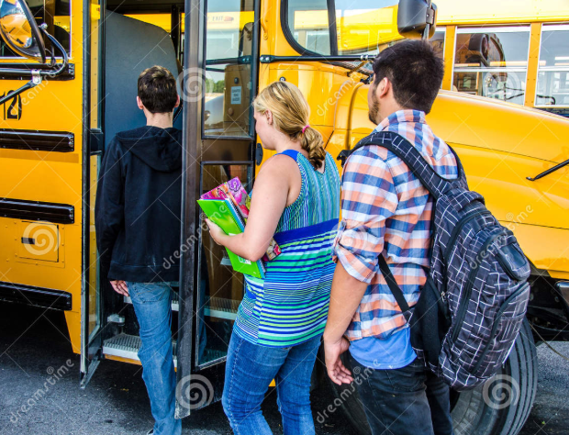

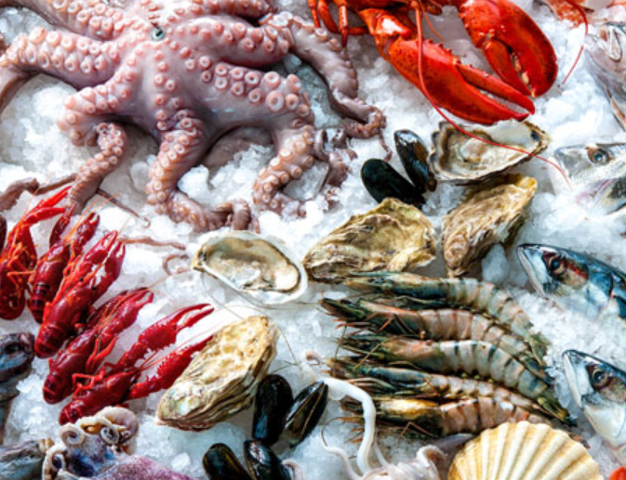
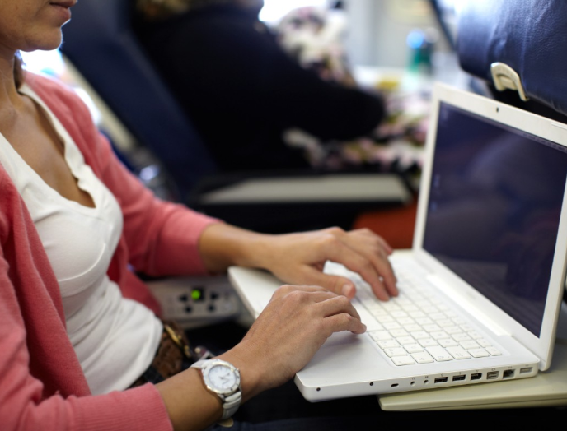
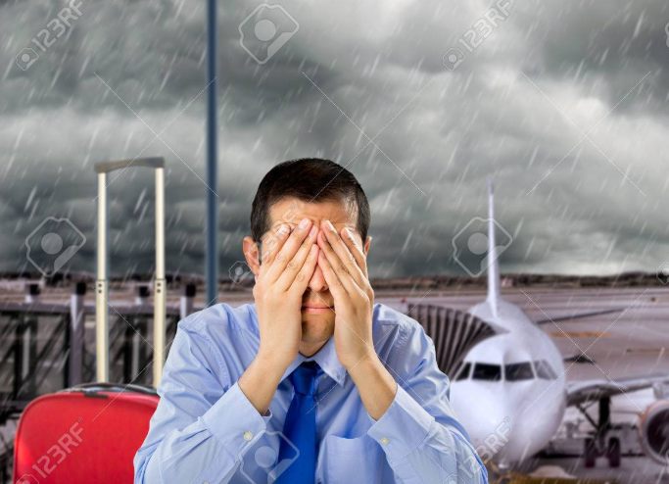
Yikes! What do we do?!
Real life situations that I have been in during traveling!
First day in Brazil: locked in the bathroom
First day in US high school: literally don’t understand anyone
Arriving at Airbnb in Bilbao: contact is not responding
China: can’t handle all the seafood and get a bad stomach ache
On a work trip to China: realize I left my laptop on the last plane
New Zealand: missed the last connecting flight to Taupo

Slide 6
How can you travel?
Accomodations
Tourist Attractions
Budget
Purchases
Payment
Luggage
Premium / Luxurious
Highest quality & most expensive
All-inclusive resort
Paying the lump sum (total)
A lot of luggage
VIP package
Credit / debit card / cash
Checking in bags
Expensive reservations
Affordable
Package deals
5-star hotel
Using your savings
Looking for good value (quality vs price)
AirBnb (self-catering)
Paying in installments
Living out of a suitcase
Booked in advance
Traveling on a budget
Find a great deal or steep discount (on sale)
Hostel (cheaper)
Traveler’s check (traveller’s cheque)
Traveling light
Low-cost sight seeing
Small allowance
You drive a hard bargain! (2 for the price of 1)
Couch surfing
Using points / miles or getting reimbursed
Just a carry-on
Free walking tours
No funds
Free (but don’t get ripped off)
Work & stay
Non-refundable tickets
Back packing
Hiking & exploring

Slide 7
Preposition Process
You check in (into your flight)
You get on the plane (on board)
Plane takes off
You pick up your bags
You get picked up by a friend
Outbound flight
One-way ticket
Madrid
Rome
Return flight
Round trip

